Slide 2
Energy Best Deal
Gas and electricity prices are rising but there are ways to cut the cost of your energy bills:
Make sure you’re getting the best energy deal for you.
If bills are a struggle - get help from suppliers or government schemes.
Make your home more energy efficient.
Energy Best Deal can help you pay no more than you need to.

Slide 3
Simpler, clearer, fairer
Suppliers are now required to make sure that:
The number of tariffs has been limited to 4 for gas and 4 for electricity and their tariff structures are simpler.
They provide better information on bills and your annual summary to help you compare deals.
They treat you fairly in all your interactions with them.
Download Ofgem's handy Be An Energy Shopper guide from goenergyshopping.co.uk

Slide 4
Every year, ask yourself:
Would switching supplier(s) save me money?
Am I eligible for welfare benefits?
Am I eligible for a grant to improve the energy efficiency of my home?
Am I on the best energy deal and/or payment option? (dependent on your needs)

Slide 5
Switching supplier

Slide 6
Information required to make an informed choice
Find your most recent annual summary or bill. It will show you:
the name of the tariff you are currently on, and the tariff that is cheapest for you
how much energy you used in the last 12 months
your personal projection – how much energy your supplier estimates you’ll use over the next 12 months.
You will also need your postcode and to know how you pay for energy.

Slide 7
Finding a better energy deal
Talk to your supplier or view their website.
Use the Citizens Advice comparison site energycompare.citizensadvice.org.uk
Use an approved online price comparison site, found on goenergyshopping.co.uk/confidence-code
Contact other suppliers to compare deals.
If you can’t access the internet call the Citizens Advice consumer service on 03454 04 05 06.

Slide 8
Before switching
How do you want to pay? Suppliers offer a range of payment options, so make sure that you choose one that is right for your circumstances.
Can you manage your bills online? Discounts are available for dual-fuel accounts and managing your account online.
Do you owe money to your current supplier? If you have an outstanding debt to your supplier find out what your options are.
Which tariff suits you best? Fixed price tariffs may be the cheapest but there could be penalties if you switch before the end of the deal.
Do you currently receive Warm Home Discount? If you get the Warm Home Discount it’s worth checking whether you will still get this help if you switch.

Slide 9
Can everyone switch?
Most people can switch supplier.
With a pay-as-you-go meter you can switch with a debt of up to £500.
If you rent and you are responsible for energy bills, you have the right to switch. A landlord only has the right to choose energy supplier if they are paying the energy bills.
If you switch:
There is no danger of your energy supply being disconnected.
You will not need a new meter.
The gas and electricity you receive in your home will remain the same.
The only difference you will see is that your bill will be from your new supplier.

Slide 10
Choosing the right tariff and payment method
Dual fuel - although be aware that dual fuel isn’t always the cheapest. Sometimes
it can be cheaper to get gas and electricity from different suppliers.
Fixed term - this means the price of your energy will not change for the duration
of the deal (there may be a penalty for leaving the deal early). Remember that
bills could still increase if more energy is used
Internet deals - offer discounts for customers who manage their account online
Payment options could save you money or help you budget:
Direct debit - payments for your energy come straight out of your bank account.
Standard credit - paying your bill by cheque, cash, bank card or
PayPoint/Payzone.
Pay-as-you-go meters - pay in advance for your energy by topping up a card or a
key.

Slide 11
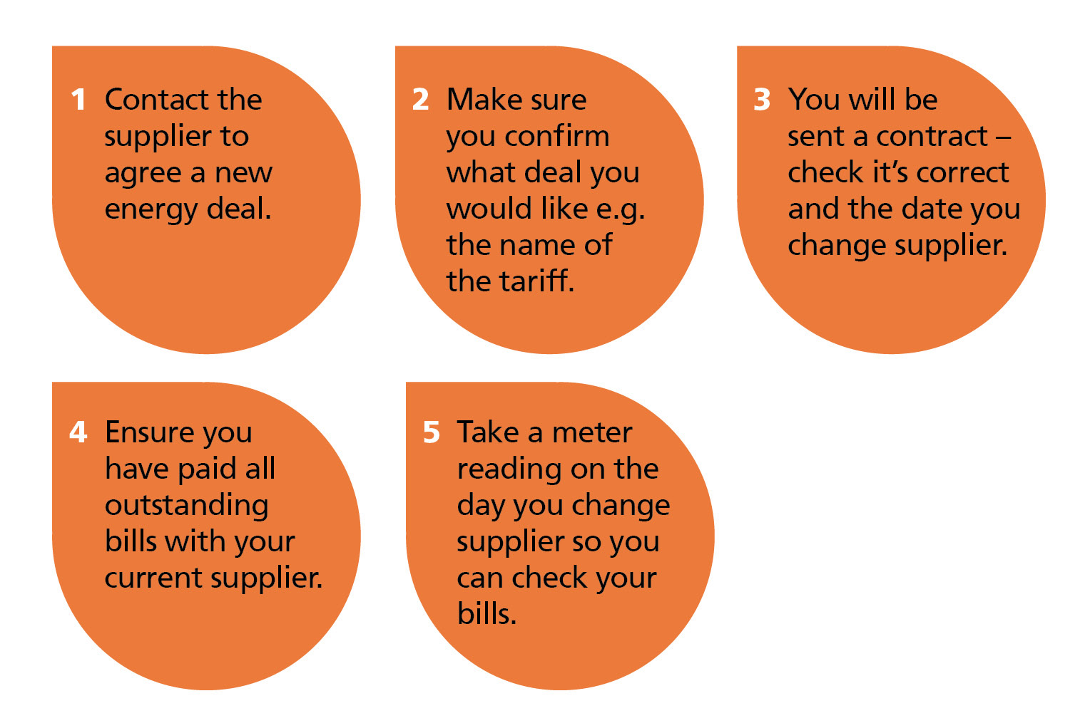
Switching to a new supplier

Slide 12
Help available

Slide 13
Priority Services Register (PSR)
If you are of pensionable age, disabled, chronically sick or have sight or hearing difficulties you can qualify for your supplier’s PSR. Dependent on circumstances, PSR customers can access services such as:
Free gas appliance safety check
Relocation of pay as you go meter for improved access
Password protection scheme
Quarterly meter readings
Bill nominee scheme
Advance notice of supply interruptions
Bills in alternative formats

Slide 14
Getting help with your energy bills
Most energy suppliers offer some form of help to their customers who are struggling to pay their energy bills.
If you owe your supplier money, they must offer a payment arrangement that takes account of your financial circumstance and ability to pay. Talk to them about your options.
The Home Heat Helpline also offers advice – call them on 0800 33 66 99. In Scotland you can also call Home Energy Scotland 0808 8082282.

Slide 15
Warm Home Discount
This is a discount of £140.00 which is deducted from your ELECTRICITY bill ONLY.
You automatically qualify for the discount if on the 12 July 2015 all the following apply:
Your supplier was part of the scheme
Your name (or your partner’s) was on the bill
You were getting the Guaranteed Credit element of Pension Credit (even if you were getting Savings Credit as well)
You may also qualify if you are on certain benefits. Call your supplier to find out if you are eligible and see citizensadvice.org.uk.

Slide 16
Help from the Government
Winter Fuel Payment – an annual payment to people of pensionable age to help keep warm in winter. Payments vary between £100 to £300 depending on your individual circumstances. If you have not been receiving this payment, call the Winter Fuel Payment Helpline on 08459 15 15 15 or visit gov.uk or citizensadvice.org.uk.
Cold weather payments – eligible households who experience temperatures below zero degrees Celsius over seven consecutive days between 1 November – 31 March will automatically receive £25 for each seven day period.

Slide 17
Initiatives where you live
ECO (England, Scotland and Wales): insulation and heating improvements for older properties and householders on low incomes.
Home Energy Efficiency Programmes (HEEPS): helps eligible households in Scotland reduce bills and make their homes more energy efficient. NEST is the equivalent scheme for Wales.
For information on ECO, HEEPS or NEST visit your local Citizens Advice or call the Energy Saving Advice Service (ESAS) on 0300 123 1234. For HEEPS call 0808 808 2282 and for NEST call 0808 808 2244.

Slide 18
Private one-to-one appointments available (Energy Best Deal Extra Appointments)
If you or someone you know would like a private appointment with a Citizens Advice Adviser to help you deal with any of the following matters, please let us know on your session feedback form.
Our advisers are qualified to help you with matters relating to
whether you are on the best energy tariff for your circumstances
grants to help pay for thermal efficiency measures in your home
identifying and claiming benefits you are eligible to receive dealing with fuel bills and other problem debts
Let us know today if you would like to get an appointment booked. Or contact the EBDx coordinator at xxxx CAB, Direct line telephone xxxxxx [local rate number, no premium charges] any time and ask for an Energy Best Deal Extra appointment.

Slide 19
Energy saving tips

Slide 20
Cutting your energy bills by making your home more energy efficient
Energy suppliers are obliged by the government to offer you help in doing this.
Contact your energy supplier to see what help is available. Help may include free insulation.
The Energy Saving Trust can offer advice on energy efficiency on 0300 123 1234.

Slide 21
Prepayment meters (also called pay-as-you-go)
Fair play prepay
A Citizens Advice campaign about prepayment meters that aims to get a fairer deal for energy customers.

Slide 22
The 2015-16 Energy Best Deal campaign is supported by: EDF Energy First Utility Scottish Power SSE Utility Warehouse
Although care has been taken to ensure the accuracy, completeness and reliability of the information provided, Citizens Advice assumes no responsibility. The user of the information agrees that the information is subject to change without notice. To the extent permitted by law, Citizens Advice excludes all liability for any claim, loss, demands or damages of any kind whatsoever (whether such claims, loss, demands or damages were foreseeable, known or otherwise) arising out of or in connection with the drafting, accuracy and/or its interpretation, including without limitation, indirect or consequential loss or damage and whether arising in tort (including negligence), contract or otherwise.
Copyright © 2015 Citizens Advice All rights reserved. Any reproduction of part or all of the contents in any form is prohibited except with the express written permission of Citizens Advice.
Citizens Advice is an operating name of the National Association of Citizens Advice Bureaux, Charity registration number 279057, VAT number 726020276, Company Limited by Guarantee, Registered number 1436945 England. Registered office: Citizens Advice, 3rd Floor North, 200 Aldersgate Street, London, EC1A 4HD

