Slide 1
Consumer Expectations of Regulation: Heat Networks
RM/ MN/ KK
March 2018

Slide 2
Contents
Research Objectives and Methodology | 03
Things to consider | 07
Heat Networks: Awareness and Experience | 09
Information seeking | 18
Awareness of consumer protections | 25
Preferences for future regulations | 30
Overall Findings | 34

Slide 3
Research Objectives and Methodology

Slide 4
Project background and objectives
The system of Heat Networks, where heat is delivered directly to homes rather than being converted at property, has seen significant growth and is intended by Government to grow even further with its offer of a more sustainable method of largescale heat delivery.
As an unregulated market however, there are concerns about protections for consumers in relation to:
Inability to switch supplier
Billing levels
Limited consumer market power due to monopoly state of delivery
Citizens Advice is already part of the debate on customer protections and regulation for the Heat Network sector but rightly wishes to explore the perceptions of consumers directly. Such consultation will provide Citizens Advice with reliable evidence on which to base its discussions with working groups.
Project Objectives
Project Background
Experience
1
Complaints Process
2
Perceptions of protection
3
In depth exploration of previous experience of complaint and/or awareness of complaints process:
are there reasons for complaint?
what is the experience of complaining like?
is contact solely with supplier or third party as well
awareness of any complaints procedure; support organisations etc.
What does the ‘perfect’ example of consumer protection look like?
awareness
access
attributes
Explore the experiences and impact of heat networks. Understand the perceived pros and cons of the system for consumers.

Slide 5
In order to meet the research objectives, we conducted 8 focus groups in 4 different heat network locations across the UK
Recruitment summary
Even split between male and female participants
Mix of ages (from 24-65+)
Mix of social grade
Mix of payment types
All to be solely or jointly responsible for energy payments
Half to be heavy users, half to be lighter heating users
All to be confident, outgoing and articulate
At least a third to have experience of being bill payer for other type of heating provision in previous property (e.g. gas/electricity)
Scotland
East Midlands
Wales
South East

Slide 6
Composition
Profiling Information
4 different networks were selected at random across GB
All were different suppliers
2 sessions were hosted for each site
Location | Number of Participants* | Supplier Type | Network Type | Heat Trust Member | Tenure | Payment Types
Wales | 15 | HA | District Heating (range of properties/buildings) | No | OO – 3 Private Rental – 2 LA/HA tenant – 10 | 9 PPM 6 DD/Bill
Scotland | 16 | Council; HA; ESCO | District Heating (range of properties/buildings) | Yes | OO – 2 Private Rental – 1 LA/HA tenant – 13 | 12 PPM 4 DD/Bill
East Midlands | 16 | Council and ESCO | District Heating (range of properties/buildings) | No | OO – 2 Private Rental – 1 LA/HA tenant – 7 | 13 PPM 3 DD/Bill
South East | 15 | Council and ESCO | District Heating (range of properties/buildings) | No | OO – 1 Private Rental – 1 LA/HA tenant – 5 | 10 PPM 4 DD/Bill 1 Pays landlord
* 9 people were recruited for each session and so 7-8 attended for each following drop-outs on the day)

Slide 7
Things to consider

Slide 8
There were some differences in overall attitudes and issues identified based on house ownership and payment type
Those who were owner occupiers were more likely to be disgruntled by maintenance costs than those who were renting from landlords or living in Housing Association accommodation
A sense of frustration that despite owning the properties, they still have no control over choice of heating system and are having to pay for maintenance work, even if they have no input into the decision to have the work done
Many renters said they felt sorry for owner occupiers as they are impacted to a greater extent financially by the above issue
There were also some differences in satisfaction amongst those who pre-pay their heating (with a top-up card) vs. those who pay by direct debit: those who pre-pay were more likely to be less satisfied
This group have even less clarity around what they are paying for i.e. standing charge vs. actual heating units and also mentioned problems with debt collection
The method of debt collection (i.e. to immediately take x amount off the card as soon as you top up) was felt to be unfair and prompted some to stop putting on their heating altogether (even during the coldest winter months)

Slide 9
Heat Networks: Awareness and Experience

Slide 10
Good heating is integral to comfort at home – it’s seen as a basic service that needs to work
What residents want from a heating supplier isn’t ground-breaking – they want reliable, hot, affordable heating that they can instantly turn on and adjust when they need it
This is especially important in the winter months, and any long term interruption or poor supply can become quite emotionally distressing and impact upon quality of life
“No matter where you live in the UK, you expect to have working heating”
Wales
“I use my heating to help dry my clothes so I rely on it a lot”
Wales
“You just want it to work, it’s stressful when you have to always faff about with it”
Scotland

Slide 11
Everyone spoken to in the research sessions were aware they are part of a heating network, but there are a lot of questions!
Whilst the specifics of what this meant were a bit unclear, all realised the difference in their heating compared to other properties
All understood their energy was produced at a central source but…
How many generators are there per site?
Does it only serve this estate?
What kind of energy is it? Is it renewable? Do they generate it onsite?
Why are they doing it this way?
Is it better for the environment?
Why are they doing it on this estate and not others?
“We can’t change suppliers, we’re locked in”
Scotland
“I know that our heating system is different to other estates in the area, we are part of a network of some kind so all the houses are supplied the same”
Wales

Slide 12
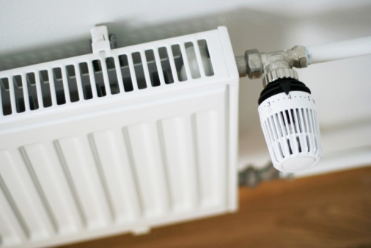
In theory, heat networks are systems that should be beneficial, and this was the expectation when residents were new to the system
In theory…
Energy provided should be cheaper or at least match what is provided from other energy suppliers
The service should be transparent in terms of costs
It should provide an efficient means of heating homes
Heating should be of a high quality for everyone on the system – to help tackle fuel poverty amongst vulnerable groups
It should be hassle free and reliable
“When they installed the system, we all thought it wouldn’t be much of a change from what we had already, it would just be more efficient – which it isn’t!”
Wales
“It’s supposed to be the cheapest system” East Midlands

Slide 13
For some, Heat Networks are a convenient, reliable solution that serves their homes well
“Sunday nights turned different for mothers when the new heating was put in. With the old heating you had to wait three hours to have a bath.”
Scotland
When working well, the heat is HOT
It is hassle free, with suppliers taking responsibility for any issues
Bills are sorted out and require minimal admin for residents
“Since most of the estate have been changed over to that new system, ours has been brilliant. South East
“They are very responsive if anything goes wrong with it or the heating goes down”
Scotland
What is important to note, is that the experience across different Heat Networks varies greatly, and the more positive experiences came from residents who had experienced an overall higher quality service and reliability of hot heat – predominantly in Scotland. This was not however the experience shared by all…

Slide 14
However, for the majority of residents using heat networks, the levels of satisfaction are overwhelmingly poor
“It used to heat up, now this one you get like cold spots all over the place”
East Midlands
“I found that without community heating, that the heating was more evenly distributed in the rooms so they were all evenly heated.”
South East
Number of respondents
“It is terrible”
Scotland
NOTE: not statistically robust, taken from a questionnaire conducted in a qualitative group

Slide 15
The negativity surrounding heat networks centres predominantly around three core issues:
Prices are very high – some residents are paying double or even triple compared to friends and family in similar properties not on a heat network
Of particular significance for the lower income estates – it’s become a matter of simply not being able to afford to put the heating on in some cases
1. Price
It’s criminal, it just seems to eat my money!
Wales
2. Unreliable heat
I just feel like I am paying for a system that is very expensive and not even that hot. It barely heats up my flat
Wales
Heating levels vary by location but also between properties on the same estate
In Wales, the heat quality is so poor in some cases, it can take an hour to get enough hot water for a shower
3. No option to opt out/lack of control
We’re not in control. You own the home, and you’re not in control.
South East
The lack of flexibility and opportunity to switch energy suppliers in order to find the most competitive rates can make people feel like they are trapped

Slide 16
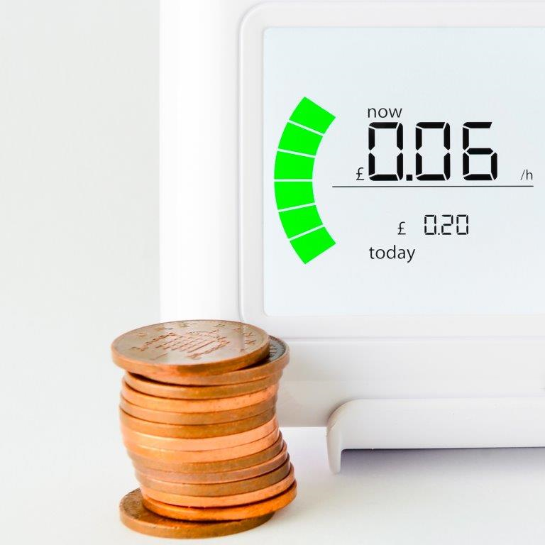
Price is a big issue for those on a heat network – most notably on lower income estates
Whilst specific bills and charges vary wildly across different houses and heat network locations, price is a huge issue
For those on a low income estate in Wales and East Midlands, the prices have become such an issue that some now can’t afford to turn on their heating for more than an hour a day
Examples were raised of residents coming back from a holiday only to have spent £20+ on heating – so trust in what they are paying for is low in many cases
It’s not that the price per unit of energy is expensive, but once the standing charge is added, it can be more than the heating bill itself
We can’t get the best deal. We work all day and only have it in the evening, I put £20 or £30 in mine each week and it is disgusting
Wales
“The standing charge is always more than the heating bill. So my £100 heating might be £60 standing charge and £40 heating. Crazy isn’t it.” E. Midlands
“The first bill, for £700! Honestly!”
Scotland

Slide 17
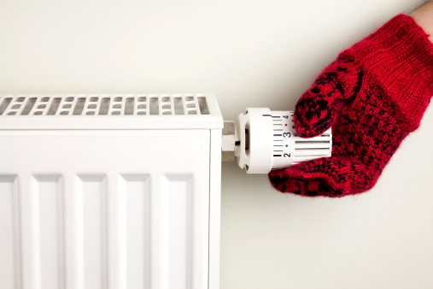
Unreliable heat can cause stress and worry
Where heat is more reliable and HOT, satisfaction is higher as was the case in Scotland
Older estates and/or those with poorly insulated houses struggle to retain heat efficiently
Networks can experience pressure issues – those at the top of tower blocks can suffer from poor heat and low pressure
Any issues to do with the reliability of heat further compounds dissatisfaction with the price they are paying – it can feel very over priced for the quality
“The problem is where it goes from one radiator to the next radiator to the next radiator, rather than going in the pipes and out the pipes. You’ve got to have them all on. If you turn one off they all go off.” South East
“There is a constant draught in my place, you can feel it, the draught. There are large gaps in the pipes and draught comes in through them” East Midlands
“I used to love doing the dishes, but since they put the heating in I have to boil a kettle.” Scotland

Slide 18
The fact there is no possibility to opt out can make residents feel trapped
Many residents felt misinformed and lacked information when the heating systems were installed on their estates
For those who have recently moved onto their estate, they didn’t receive much information prior to signing their tenancy agreements
Lack of freedom to seek out the best deal from different suppliers can lead to a feeling of entrapment into a deal that perhaps they don’t want or can’t pay
I think I would feel more comfortable about having a choice and being able to talk about things. I feel that I don’t have a choice. No choice at all.” East Midlands
“They never consulted us, they didn’t tell us we couldn’t do a comparison to see if it could be cheaper with another company. We are stuck with it.” Scotland
“It's on the deeds of your house, it's, like, legal, you're not allowed to go and get something different” South East
“It must be criminal!” Wales

Slide 19
Standing charges are another cause for contention, no one is sure what they are paying for and why
Is this for maintenance?
What is a standing charge?
?
“The heating is cheaper, but my standing charge every quarter is more than my heating bill.”
E. Midlands
In 2007 it was £120, and now it’s £330-something this year. So, it’s just going up, and up, and up. I don’t know when they’re going to stop.”
South East
Why is it more expensive than my heating unit price?
“I would like an explanation about why the standing charges are so high.” Scotland
“It doesn’t say anywhere what we are ACTUALLY paying for with the standing charge” Wales
I wasn’t told about this when I signed up!
I didn’t agree to pay for this?

Slide 20
Bills are an area of concern – not clear or consistent across different properties and serve as a great source of confusion
Lack of clarity
“Bills should be itemised, they do have a unit price and a day price. How much it is, but not what you used.”
Scotland
Bills are not always itemised
The standing charge sometimes isn’t separated out from the unit price
People want to know in detail what they are paying for – currently it feels like the companies make it unclear on purpose
Lack of consistency
“I think just more of a breakdown on what you have used, you are not really given any options on it, I don’t know, compared to other bills you get a breakdown on what the units, but on these, the amount you have used never quite add up right." East Midlands
Bills can differ month on month, when residents feel like they are maintaining the same monthly usage
Neighbours can pay drastically different amounts in bills when their usage isn’t vastly different
Residents want to know exactly what they’re paying for – broken down in layman's terms. Nothing should be hidden or not make sense

Slide 21
Information seeking

Slide 22
The majority of residents spoken to have had to contact their heating suppliers at some point in time
Radiator not heating up
Broken thermostat
De-pressurisation
Number of respondents
Radiator fallen off wall
Leaking radiator
NOTE: not statistically robust, taken from a questionnaire conducted in a qualitative group

Slide 23
Seeking out information or trying to get questions answered can be tricky –information provided to residents is vague and sometimes incorrect leading to high levels of dissatisfaction with their heating suppliers
Number of respondents

Slide 24
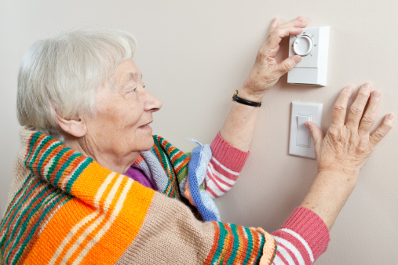
The lack of information or clarity is especially worrying for more vulnerable people, especially the elderly or disabled
There was awareness amongst participants of elderly or disabled neighbours who struggle with not only the cost of heating, but also what do in case of an emergency (i.e. broken heating in winter etc.)
There is genuine concern and worry amongst residents about not being able to contact the right people to fix their heating as the networks can be so hard to get hold of
Most information about the heating is online or via a housing association/council website (numbers on notice boards etc. can be out of service or incorrect) and more vulnerable people might not have access to the internet or know how to use it
“My mum and dad live on the estate as well. They are 80 and 85 and when the heating system was first put in, their bill was £700. Now if I hadn’t stepped in they would have paid that” Scotland
“You get some people who are elderly or vulnerable. By giving them no choice in this, people get scared, don’t they, especially old people? ” South East
“I feel sorry for people who are maybe a bit older, they don’t have access to internet or anything. How do they get the information” Scotland

Slide 25
Residents expect a clear, easy to use customer service and complaints experience, which in some estates is not being met
Expectations
Reality
An easy to use free phone number to contact the appropriate person
Numbers listed on boilers and leaflets are sometimes wrong and it can be hard to track down the right person to talk to
Minimal waiting times to speak to someone who can help
In some cases, wait times in a phone queue can be more than 1 hour
At busy/ peak times, a call back service so residents don’t have to spend all day trying to get through
Hit and miss as to whether you will get to speak to anyone and no way of contacting unless willing to wait
A fast turn around depending on the severity of the issue ranging from 24-48 hours
Sometimes there is no follow up and residents resort to trying to fix the issue themselves or pay for someone to come and fix it

Slide 26
For those who have had an issue, the level of service received once they have contacted the supplier has been variable
No follow up
Many residents had not had issues followed up without more persistent contact despite initial communication
Safety
Response teams have been known to turn up late/ without forewarning at peoples homes. In higher crime areas this can be unnerving
“They always turn up un-announced, and when you live on a high crime rate estate that can sometimes be a bit worrying, especially if you aren’t expecting anyone!”
East Midlands
“They were supposed to come back and do a check but they didn’t after a year.” Scotland
01
02
04
03
“The big radiator fell off the wall in the living room. Walked past it and it fell off. It was at Christmas time and I was taking the decorations down and just had that much away from the heater, if I was close I would have been trapped under that heater. I would not have been able to push it off me. The water just came gushing out.”
Scotland
Unprofessional
Lack of official documents to show residents when they arrive to do a job or lack of any uniform can make it seem unprofessional, especially as much of the work is contracted out
Poor quality workmanship
Poor workmanship can leave properties and appliances in bad condition
“They are not very professional when you ring up. They are like ‘what’s up’. It’s not great.” East Midlands

Slide 27
Issues regarding the clarity of information given to residents and the service received, compounded with other issues has lead to high levels of complaints
“If you try and complain, it’s not worth the effort. You can never speak to the right person” Wales
“I would like a bit of respect. I work full time like a lot of people and I can’t be in 24 hours a day in case they decide to turn up to fix something” East Midlands
Number of respondents
“I don’t think there is enough information. It is always hidden.” Scotland
“I wasn’t told anything about it and I got a huge bill. They were not going to offer me anything so I complained and made a big fuss.” Scotland
“They either create you another problem, which I’ve had on many occasions, or they just don’t do it right and then end up having to come back anyway. ” South East
NOTE: not statistically robust, taken from a questionnaire conducted in a qualitative group

Slide 28
Awareness of consumer protections

Slide 29
There is a slight lack of understanding of what ‘regulations’ actually mean for the consumer…
Regulations can only be a good thing, right?
All acknowledge that it’s something they’ve heard about and companies should have – but the specifics of what/ why regulations are in place can be a bit confused…
Do companies have to be accountable to something/ someone?
Surely they do, but who? What are the expectations and requirements? Is there one regulatory body for different sectors? These are all questions that can be quite muddled in the minds of the consumer

Slide 30
There are certain expectations that consumers hold as standard across all energy providers
“We used to get boiler checks every year when I moved in, but for the past few years I haven’t had any at all. You used to get a letter to call for an appointment.”
East Midlands
Expectations that an energy provider will…
Control energy tariffs
Have a certain standard of customer service
Have yearly maintenance checks on all networks systems
Uphold a standard of professionalism
“They should provide information regarding where our money goes and what we receive for our money.” South East
“I think there should be regulations like if you are in hospital you need to be seen within four hours. If you have a problem they should see it in two to four hours, because I have had a day sitting in waiting.” Scotland

Slide 31
The Heat Trust means little to residents – none had heard of it and are unsure of the protections it offers
The Heat Trust is an unknown to residents
We spoke to residents of one network registered to the Heat Trust (Scotland), and none of the residents had heard of it before
As it is voluntary for heat suppliers to join, it feels like it doesn’t have that much clout in terms of holding companies accountable for their actions
“Well I don’t see any evidence that the Heat Trust has done anything on our estate to make it better or cheaper? I’ve never heard of them before”
Scotland – network part of the Heat Trust
“If it’s voluntary, I don’t see it making any actual difference”
Scotland – network part of the heat trust

Slide 32
Residents are shocked that Heat Networks currently don’t have to adhere to any regulations – but for some it is unsurprising
Most respondents were alarmed that the sector is unregulated and were unaware of this fact previously
For those who moved to a property with a heat network there is frustration that while they may have been aware of the system they were taking on, they were not aware that the sector itself is unregulated
There is uncertainty about the impact of having an unregulated market and the assumption that it means suppliers can do what they want with little repercussion as residents are locked into the system
Some respondents were unsurprised at the lack of regulation through their experiences of poor service
they believed that this explained why their needs are not prioritised, there is a lack of communication and clarity and that prices are high
No choice. You have no way of challenging. In other words, they are in control of you.
East Midlands
I wouldn’t be surprised, but it should be regulated. It is shocking that you have a contract for 30 years and we don’t have a say or agree with it. Scotland
The only option we have is to move out. Wales
If they're supplying all these things, they should be held to a higher standard. They should be held accountable. Obviously, the only way they can be held accountable is if they're regulated.
South East

Slide 33
Preferences for future regulation

Slide 34
Having a regulated sector is considered essential by most respondents
Why is no one doing anything about it? They’re just getting away with it
Wales
They need to be held accountable!
East Midlands
Number of respondents
“We in our societies are regulated…so then, why should they get away with it”
South East

Slide 35
Moving forward, there is appetite for a fully regulated sector
FACTORS FOR INCLUSION
GOALS
Contact/complaints information
Ease of knowing who to go to
Up to date contact numbers
Complaint handling
Dedicated system for complaints
Set response times
Establishing an Ombudsman
Pricing
Clarity on pricing policy and standing charges
Transparency of any additional charges
Quality standards
Customer services standards
Repairs/appliances are safe
Qualified engineers
Support
Clarity of consumer rights
Compensation schemes
Protections for vulnerable people

Slide 36
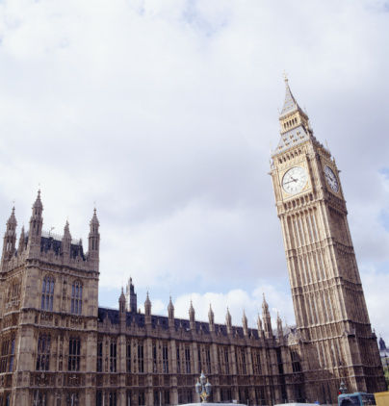
Residents urge the introduction of regulation to the sector to be considered as a matter of urgency
Demand for protections for residents who perceive the current system as wrongfully unaccountable
Most research participants wished the issue of consumer protection to be treated as a priority particularly in areas where frequent issues had been experienced with minimal restorative action
There were differences of opinion on who should be responsible for undertaking a review of the market, whether it should be central or local government or an arms length body
Customers want to be able to trust the service they are receiving and an unregulated market currently undermines this
If there was an Ombudsman that any of us could go to regardless, if we were really dissatisfied with the service and everything else that we were getting, I think it would make a big difference” South East

Slide 37
Overall findings

Slide 38
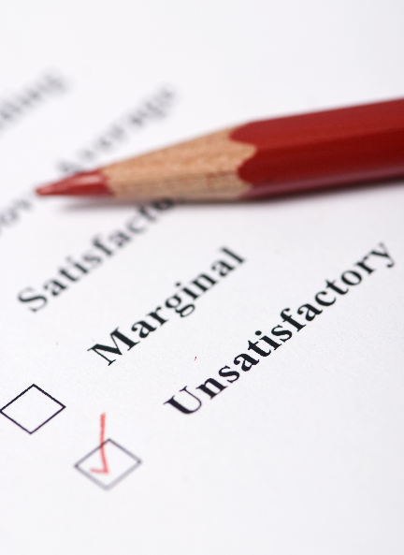
Key findings
Heat Networks are in general, not working for residents in our sample, especially for those on lower income estates. They are unreliable, expensive systems that residents are unable to opt out of
The cost of heating houses (especially the standing charges) is felt to be out of control and residents feel unable to hold anyone to account over the perceived extortionate fees they are paying
The service received from both the heat suppliers and housing associations/councils deemed less than satisfactory – it is hard to talk to the right person and residents can be passed around several people until a resolution is found
Residents are shocked there is no regulation in place – but find it unsurprising given their experiences. Help is needed and there is demand for Heat Networks to be held accountable for their actions and service provided
Those who are economically the most vulnerable in society feel like they are getting the worse deal with no way of changing the situation – regulations are needed especially to protect this group and help ease the burden of simply not being able to afford to heat their home

Slide 39
Rachel McGrail

Slide 40
Future Thinking takes a consultative approach to market research with commercial focus driving everything we do. That’s why we focus our attention on the three key areas that drive competitive advantage: Launch, Communicate, Experience.
We’re a global company of researchers, marketeers, statisticians, strategists, innovators, creatives and industry experts, integrating qual, quant and analytics through the latest technologies, to deliver research that engages audiences and drives action.
Our mission is to deliver consumer and business insights that tells stories, inspires action and travels within an organisation, long after the debrief.
London
Laystall House
8 Rosebery Avenue
London, EC1R 4TD, UK
Latimer House
Langford Business Park
Kidlington, OX5 1GG, UK
123 rue St Lazare
75008
Paris, France
visit: www.futurethinking.com or follow us on Twitter: @FutureThinkHQ

