Slide 1
Energy Team Update
Supplier liaison meeting
29 May 2019

Slide 2
Recent energy publications
May: Supply and final demand explores the experiences of consumers in vulnerable circumstances and in energy arrears
Smarter protections explores how people experience purchasing heat as a service
Standard issue assessed how energy networks have performed against the Guaranteed Standards of Performance
April: SoLR: Good practice guide
Notes:
2

Slide 3
Recent blogs on energy issues
May: How vulnerability can make falling behind on energy bills even worse
Are plans for the future energy market fit for customers?
April: The human reality for smart home technologies — control, understanding and support
Are your energy bills delivering value?
March: How regulators can save people money on their bills
How we help people keep their homes warm — wherever they are
February: What can the regulator do to reduce energy company failures?
Consultation responses
Too many to list and available here

Slide 4
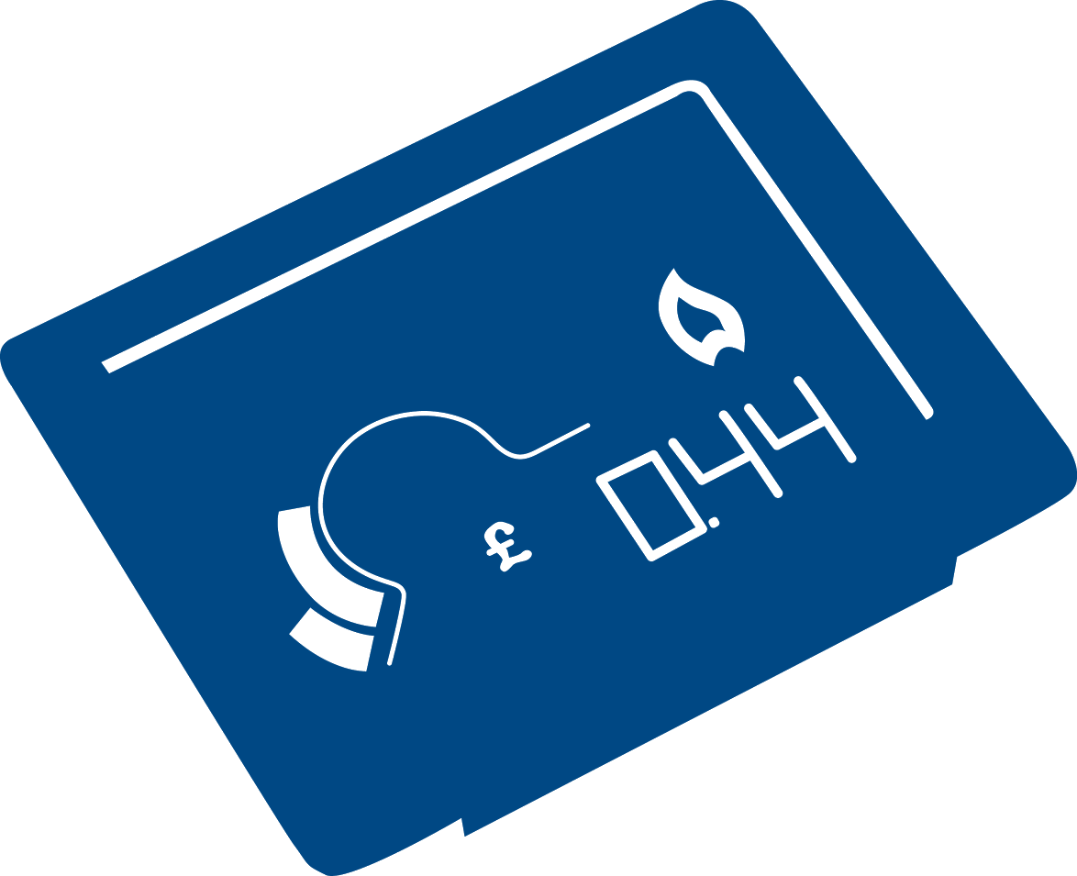
Future Energy Services Team: updates
Current work
Ongoing work with BEIS, Ofgem and SEGB on the smart meter rollout and impact on consumers
Working with the Heat Trust and BEIS on the consumer journey for people on heat networks & potential shape of the future regulations
Leading work on smart EV charging for part of the Govt OLEV taskforce
Regularly monitoring contacts to Citizens Advice about energy issues that are not supply/network related - eg insulation, solar panels, other renewables, EVs etc
Coming soon
Consumers and smart meter data
Consumer experience of prepay meters on heat networks
Info and labelling for smart appliances (currently in the field)

Slide 5
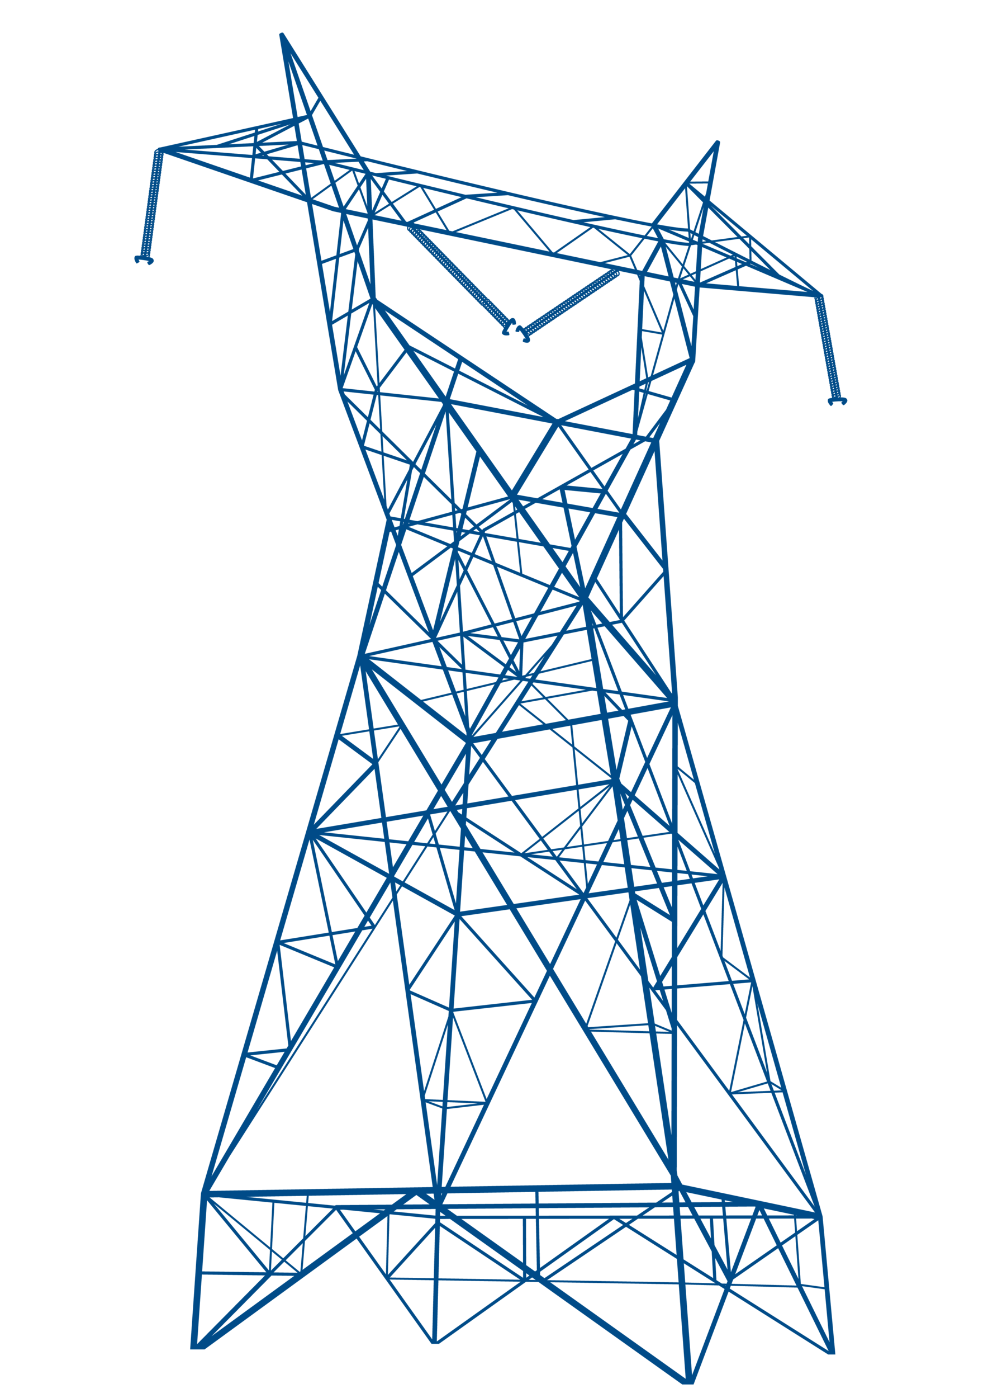
Energy Networks & Systems Team: updates
Current work
RIIO-2 - responded to 6 “sector specific” policy consultations and:
Sitting on 4 Customer Engagement Groups run by the gas networks and ESO
Key member of RIIO-2 Challenge Group run by Ofgem
Feeding into User Groups run by the Transmission companies
Coming soon
Research to understand how acceptable flexibility is to drivers of Electric Vehicles in the future
Initial look at issues around independent gas and electricity networks.
Research around “core” offering for future electricity network charging

Slide 6
Energy Retail Markets Team: updates
Current work
Engagement with Ofgem on their updated Vulnerability Strategy, and Ofgem and BEIS on the future retail market review
A project with the Institute of Customer Service, looking at the challenges of providing good customer service to all, in an evolving energy market
Coming soon
Best practice report on time of use tariffs
Micro-business protection gaps
Quarterly energy perceptions survey (jointly commissioned with Ofgem, published on its site)
Report on what consumers want from a future supply market, and how accessible new models are likely to be for different consumers

Slide 7
Energy supplier rating development
Updates
Last year we decided to expand the rating to include small suppliers (with over 25,000 customer accounts) in the rating. These changes will be partially implemented in the upcoming Q4 2018 release (published March 2019) and completed by the Q1 2019 release (June 2019).
Plans for development of the rating
Changes following Ofgem’s customer communications changes: We have proposed removing the Annual Statements element of the bill timeliness metric from Q2 2019 and changing how we ask about bill accuracy. Comments on these changes have been received.
Review of customer service metric: In January this year we issued an exploratory RFI on other communication methods (email, webchat etc). Using this data we’ll develop a set of proposed updates to the methodology.
Consultation on changes to the rating: In the coming months we will consult with suppliers on our proposed updates to the customer services metric. This will likely be via in-person and online webinar forums. We’ll also consider if changes are needed to the billing metric, in the context of the smart meter rollout and customer communications changes.

Slide 8
Price comparison tool
Updates
We’ve recently updated our energy comparison tool to better help people save money on their energy bills
Notes:
Key points - has had a makeover with an improved user friendly customer journey. Easy to navigate and has a step by step process with prompts to help users.
Has been updated with our brand guidelines.
Now showing exclusive tariffs

Slide 9
Thank you
Presented by Gillian Cooper
@CAEnergyPolicy
citizensadvice.org.uk/energypolicy

