Slide 1
Supplier Liaison Meeting
27 February 2019
Leanne Dullard

Slide 2
Performance and Operations Q3
We have continued to see an increase in contacts received into the service this quarter which has impacted on performance. Contacts have remained significantly above forecast and remain inline with contacts seen in Q2.
Ongoing work with the energy delivery centres includes:
Regular data and quality checks
EHU visit to both delivery centres in Q4
Process refresher training

Slide 3
Forecast
The service has continued to experience demand above forecast
This demand has remained in excess of 110% of forecast since February 18
Volumes have increased compared to 2017/18 as well as increasing above the original 2018 /19 forecast.
Given the demand levels seen in 2018/19, we conducted a reforecast that was implemented in November 2018. Volumes continued to track above reforecasted figures during November and December, some of which can be attributed to the three Supplier of Last Resort situations that occurred during this time.

Slide 4
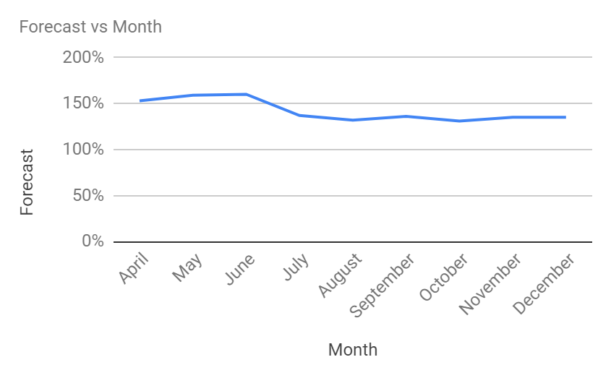
Forecast
Month | Forecast
April | 153%
May | 159%
June | 160%
July | 137%
August | 132%
September | 136%
October | 131%
November | 135%
December | 135%

Slide 5
Energy IVR
The messages are available in English and Welsh
Implemented a busy message on the Energy line as of 27/6/18
An increase seen across all areas in quarter three, caused predominantly by three Suppliers ceasing to trade in November and December
 | Priority calls | Supplier switch | Supplier price increase | Supplier of last resort
Oct | 1031 | 746 | 394 | 84
Nov | 1023 | 1168 | 522 | 926
Dec | 697 | 507 | 369 | 1352

Slide 6
Consumer service statistics

Slide 7
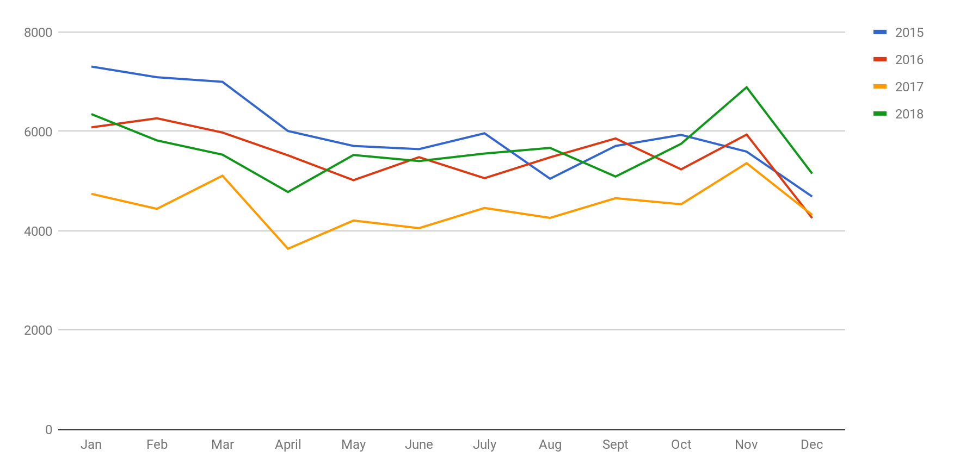
Contact volumes comparison 2015 - 2018

Slide 8
Contact volumes comparison
Month | 2014 | 2015 | 2016 | 2017 | 2018
January | 6345 | 7304 | 6080 | 4745 | 6357
February | 5851 | 7089 | 6263 | 4440 | 5817
March | 6377 | 6997 | 5976 | 5107 | 5531
April | 4717 | 6007 | 5517 | 3612 | 4779
May | 7014 | 5706 | 5017 | 4205 | 5524
June | 5565 | 5642 | 5480 | 4051 | 5402
July | 6018 | 5961 | 5057 | 4458 | 5553
August | 5350 | 5046 | 5477 | 4283 | 5667
September | 6320 | 5706 | 5857 | 4655 | 5090
October | 6908 | 5929 | 5235 | 5261 | 5749
November | 5864 | 5592 | 5935 | 5359 | 6887
December | 6160 | 4687 | 4255 | 4319 | 5150
Total | 72,489 | 71,666 | 66,149 | 54,492 | 67,506

Slide 9
Forecasted volumes
Month | 2016 | 2017 | 2018
January | 92% | 101% | 109%
February | 101% | 95% | 117%
March | 86% | 99% | 133%
April | 91% | 86% | 153%
May | 99% | 82% | 159%
June | 95% | 87% | 160%
July | 83% | 95% | 137%
August | 102% | 98% | 132%
September | 98% | 101% | 136%
October | 92% | 102% | 131%
November | 118% | 94% | 135%
December | 86% | 111% | 135%
Notes:
Dashboard

Slide 10
Trends
Quarter 3 Oct - Dec 18 | Quarter 2 Jul - Sept 18 | Quarter 1 Apr - Jun 18 | Quarter 4 Jan– Mar 18
Disputed bill, customer not responsible (1503) | Catch up bill received (1628) | Catch up bill received (1328) | Catch up bill received (1284)
Catch up bill received (1355) | Disputed bill, customer not responsible (1193) | How to change supplier (790) | Disputed bill, customer not responsible (720)
Failure to credit/refund (1124) | How to change supplier (669) | Disputed bill, Customer not responsible (729) | Direct Debit issues (576)
Supplier unable to supply (695) | Final account reconciliation (638) | Direct Debit Issues (407) | How to change supplier (441)
Direct debit issues (666) | Price/tariff information (506) | Inaccurate bill or inaccurate estimated bill (343) | Final account reconciliation (381)
Price/tariff information (529) | Direct debit issues (472) | Final account reconciliation (323) | Meter accuracy (355)
Final account reconciliation (517) | Supplier unable to supply (447) | Failure to credit/refund (305) | Debt recovery practices (339)
How to change supplier (421) | Failure to credit/refund (437) | Price/tariff information (278) | Meter provision or exchange (322)
Supply Point Administration Query (MPRN/MPR) (393) | Supply Point Administration Query (MPRN/MPR) (361) | Supply point Administration Query (MPRN/MPR) (276) | Pricing information (315)
Debt Recovery Practices (336) | Difficulty contacting supplier (358) | Meter Accuracy (270) | PPM self disconnection (unable to credit meter) (291)

Slide 11
Client by nation Q3
Nation | Volume | %
Anon | 356 | 2.70%
England | 11370 | 86.29%
Scotland | 985 | 7.48%
Wales | 466 | 3.54%

Slide 12
Q3 Trends split by nation
England | Scotland | Wales
Disputed bill, customer not responsible (1307) | Disputed bill, customer not responsible (109) | Catch up bill received (49)
Catch up bill received (1183) | Failure to credit/refund (81) | Disputed bill, customer not responsible (46)
Failure to credit/refund (989) | Catch up bill received (78) | Failure to credit/refund (36)
Supplier unable to supply (572) | Direct debit issues (61) | Supplier unable to supply (24)
Direct debit issues (549) | Meter provision or exchange (57) | Direct debit issues (24)
Price/tariff information (458) | Meter accuracy (46) | Price/tariff information (21)
Final account reconciliation (453) | Erroneous transfer (32) | Final account reconciliation (21)
Supply Point Administration Query (MPRN/MPR) (328) | Switching (Non-Smart) (32) | Difficulty contacting supplier (17)
How to change supplier (318) | Supply Point Administration Query (MPRN/MPR) (29) | Erroneous transfer (16)
Debt recovery practices (307) | PPM self disconnection (unable to credit meter) (28) | PPM self disconnection (unable to credit meter) (14)

Slide 13
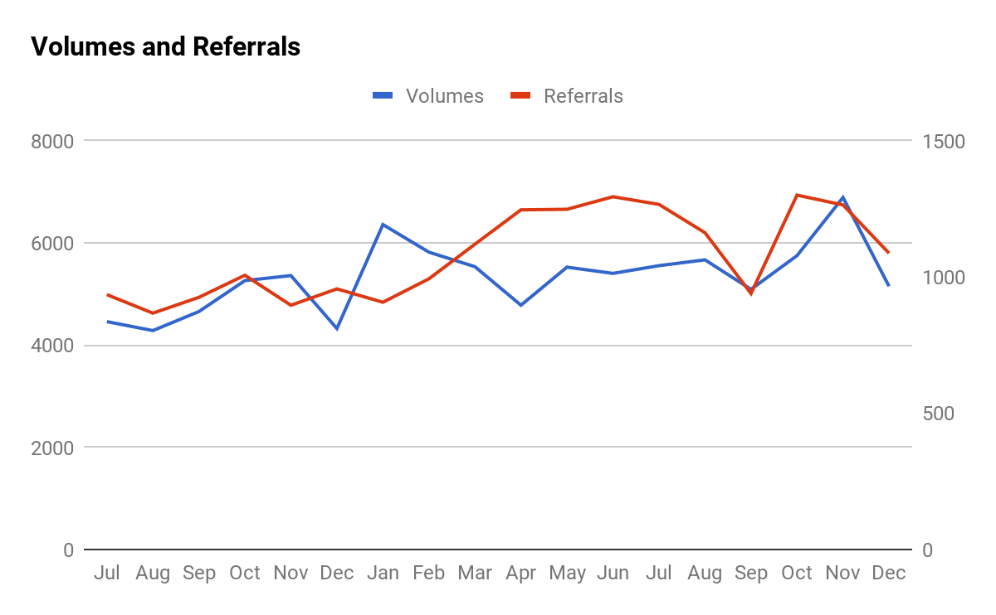
Referrals against volumes Jul 17 - present

Slide 14
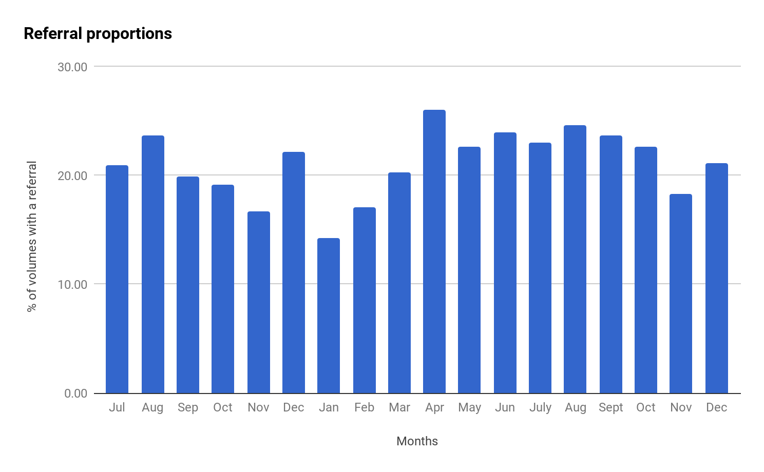
Referral volumes proportion of contacts Jul 2017 - present

Slide 15
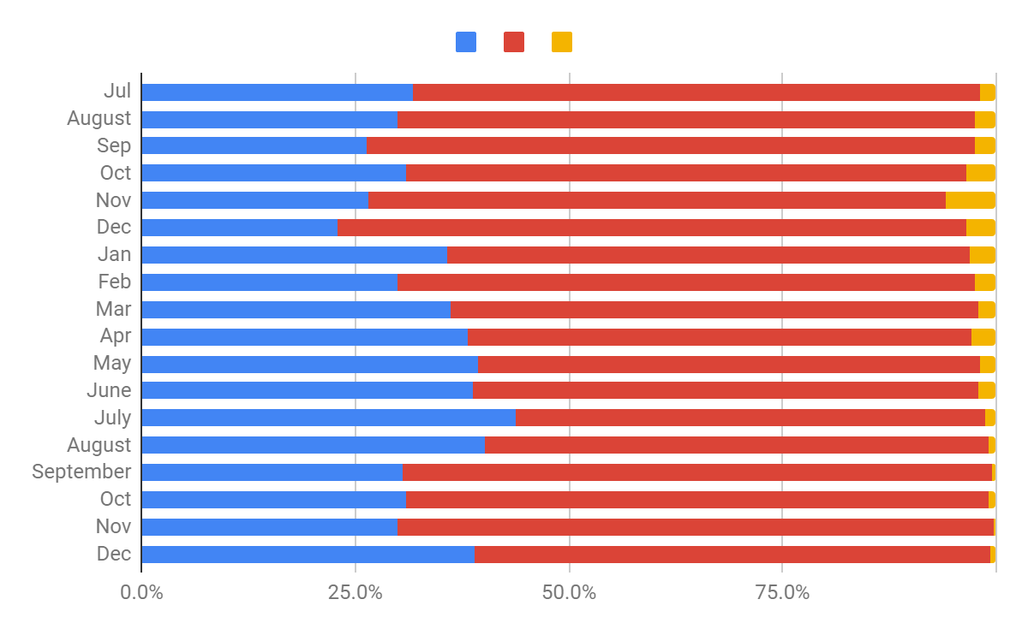
Referral proportions Jul 17 - present

Slide 16
Energy updates

Slide 17
Supplier updates
Since the last meeting new suppliers being added as referral partners include:
Nabuh
Eversmart
Yorkshire Energy

Slide 18
Presented by: Leanne Dullard
Date: 27 February 2019

