Slide 1
Supplier Liaison Meeting
07 November 2018
Leanne Dullard

Slide 2
Performance and Operations Q2
We have continued to see an increase in contacts received into the service this quarter which has impacted on performance. Contacts have decreased in comparison to quarter one however they remain significantly above forecast.
Ongoing work with the energy delivery centres includes:
Regular data and quality checks
EHU visit to one delivery centre with further visits planned in Q3
OS:e visit to one delivery centre with further visits planned in Q3

Slide 3
Forecast
The service has continued to experience demand above forecast
This demand has remained in excess of 110% of forecast since February 18
Volumes have increased compared to 2017/18 as well as above the 2018 forecast
We saw an increase in contacts for a specific supplier following them ceasing trading but no further definitive trends by supplier or issue code could be identified as the root cause of the continued uplift in volume

Slide 4
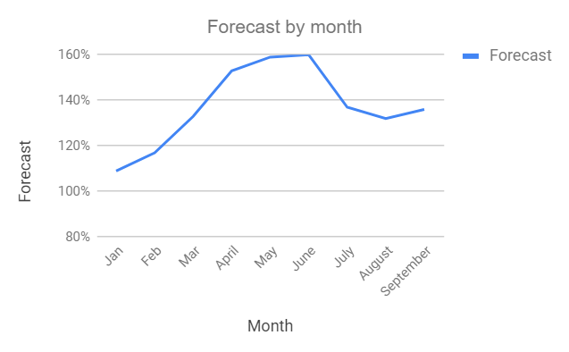
Forecast
Month | Forecast
Jan | 109%
Feb | 117%
Mar | 133%
April | 153%
May | 159%
June | 160%
July | 137%
August | 132%
September | 136%

Slide 5
Energy IVR
The messages are available in English and Welsh
Implemented a busy message on the Energy line as of 27/6/18
An increase seen across all areas in August, caused predominantly by a Supplier ceasing trading at the end of July.
In September we saw an uplift in both priority calls and supplier price increase
 | Priority calls | Supplier switch | Supplier price increase | Supplier of last resort
Jul | 738 | 760 | 412 | 99
Aug | 809 | 823 | 433 | 90
Sep | 829 | 760 | 470 | 44

Slide 6
Consumer service statistics

Slide 7
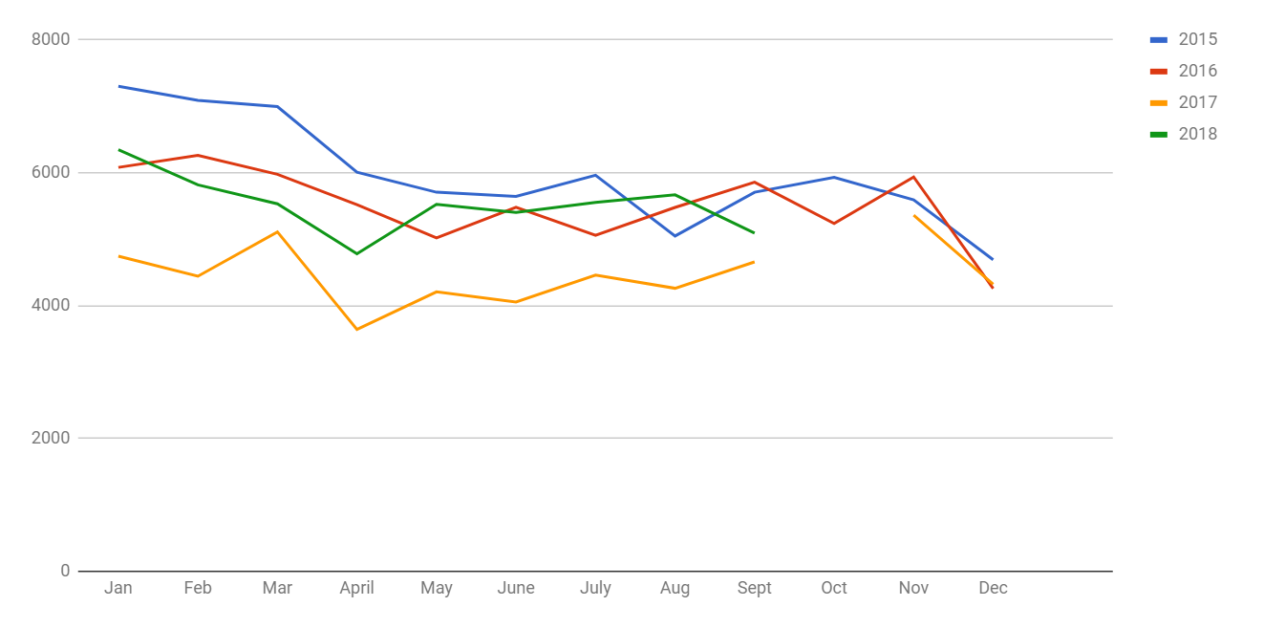
Contact volumes comparison 2015 - 2018

Slide 8
Contact volumes comparison
Month | 2014 | 2015 | 2016 | 2017 | 2018
January | 6345 | 7304 | 6080 | 4745 | 6357
February | 5851 | 7089 | 6263 | 4440 | 5817
March | 6377 | 6997 | 5976 | 5107 | 5531
April | 4717 | 6007 | 5517 | 3612 | 4779
May | 7014 | 5706 | 5017 | 4205 | 5524
June | 5565 | 5642 | 5480 | 4051 | 5402
July | 6018 | 5961 | 5057 | 4458 | 5553
August | 5350 | 5046 | 5477 | 4283 | 5667
September | 6320 | 5706 | 5857 | 4655 | 5090
October | 6908 | 5929 | 5235 | 5261
November | 5864 | 5592 | 5935 | 5359
December | 6160 | 4687 | 4255 | 4319
Total | 72,489 | 71,666 | 66,149 | 54,492 | 49,710

Slide 9
Forecasted volumes
Month | 2016 | 2017 | 2018
January | 92% | 101% | 109%
February | 101% | 95% | 117%
March | 86% | 99% | 133%
April | 91% | 86% | 153%
May | 99% | 82% | 159%
June | 95% | 87% | 160%
July | 83% | 95% | 137%
August | 102% | 98% | 132%
September | 98% | 101% | 136%
October | 92% | 102%
November | 118% | 94%
December | 86% | 111%
Notes:
Dashboard

Slide 10
Trends
Quarter 2 Jul - Sept 18 | Quarter 1 Apr - Jun 18 | Quarter 4 Jan– Mar 18 | Quarter 3 Oct - Dec17
Catch up bill received (1628) | Catch up bill received (1328) | Catch up bill received (1284) | Catch up bill received (738)
Disputed bill, customer not responsible (1193) | How to change supplier (790) | Disputed bill, customer not responsible (720) | Disputed bill, customer not responsible (705)
How to change supplier (669) | Disputed bill, Customer not responsible (729) | Direct Debit issues (576) | Pricing information (494)
Final account reconciliation (638) | Direct Debit Issues (407) | How to change supplier (441) | Final account reconciliation (383)
Price/tariff information (506) | Inaccurate bill or inaccurate estimated bill (343) | Final account reconciliation (381) | Debt recovery practices (372)
Direct debit issues (472) | Final account reconciliation (323) | Meter accuracy (355) | Switchin (Non-smart) (371)
Supplier unable to supply (447) | Failure to credit/refund (305) | Debt recovery practices (339) | Direct debit issues (345)
Failure to credit/refund (437) | Price/tariff information (278) | Meter provision or exchange (322) | Meter Accuracy (329)
Supply Point Administration Query (MPRN/MPR) (361) | Supply point Administration Query (MPRN/MPR) (276) | Pricing information (315) | Price/tariff information (296)
Difficulty contacting supplier (358) | Meter Accuracy (270) | PPM self disconnection (unable to credit meter) (291) | Failure to credit/refund (253)

Slide 11
Client by nation Q2
 | Volume | %
Anon | 549 | 4.48%
England | 10,432 | 85.10%
Scotland | 838 | 6.84%
Wales | 440 | 3.59%

Slide 12
Q2 Trends split by nation
England | Scotland | Wales
Catch up bill received (1391) | Catch up bill received (127) | Catch up bill received (62)
Disputed bill, customer not responsible (1058) | Disputed bill, customer not responsible (69) | Disputed bill. Customer not responsible (36)
Final account reconciliation (556) | Meter Accuracy (50) | Direct debit issues (25)
How to change supplier (540) | ISupply Point Administration Query (MPRN/MPR) (40) | Meter accuracy (19)
Price Tarrif in formation (553) | Direct debit issues (38) | How to change supplier (18)
Failure to credit / refund (394) | Difficulty contacting supplier (37) | Erroneous transfer (14)
Direct Debit Issues (391) | FInal account reconciliation (35) | Failure to credit/refund (13)
Supplier unable to supply (374) | Price Tarrif information (27) | Final Account Reconciliation (13)
Difficulty contacting supplier (298) | How to change supplier (24) | Inaccurate bill or inaccurate estimated bill (13)
Meter Accuracy (284) | Supplier unable to supply (22) | Difficulty contacting supplier (12)

Slide 13
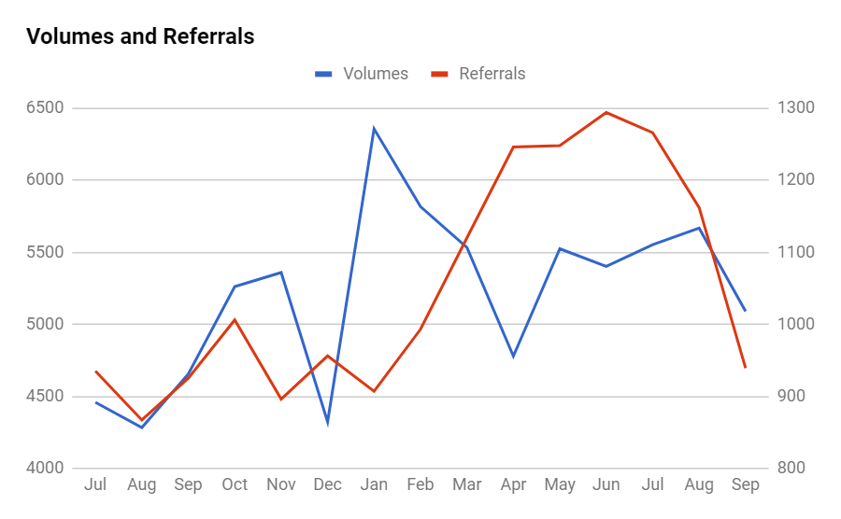
Referrals against volumes Jul 17 - present

Slide 14
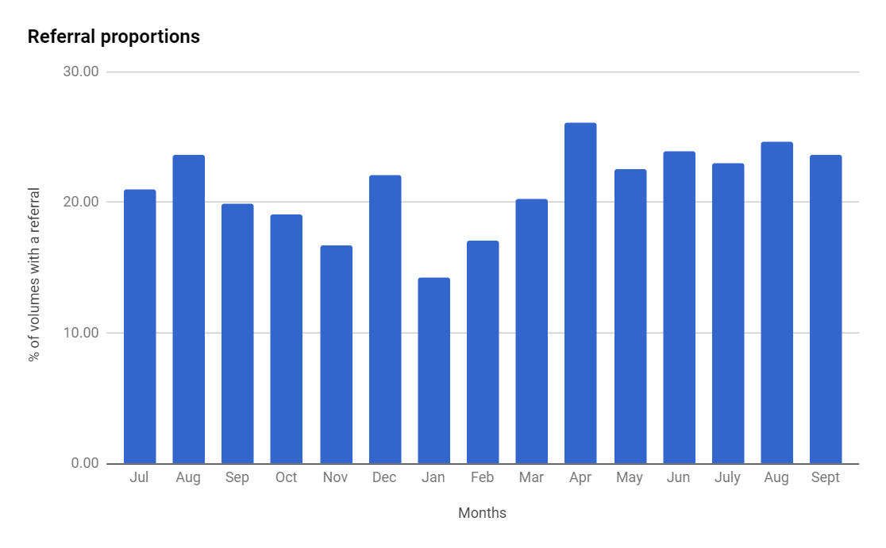
Referral volumes proportion of contacts Jul 2017 - present

Slide 15
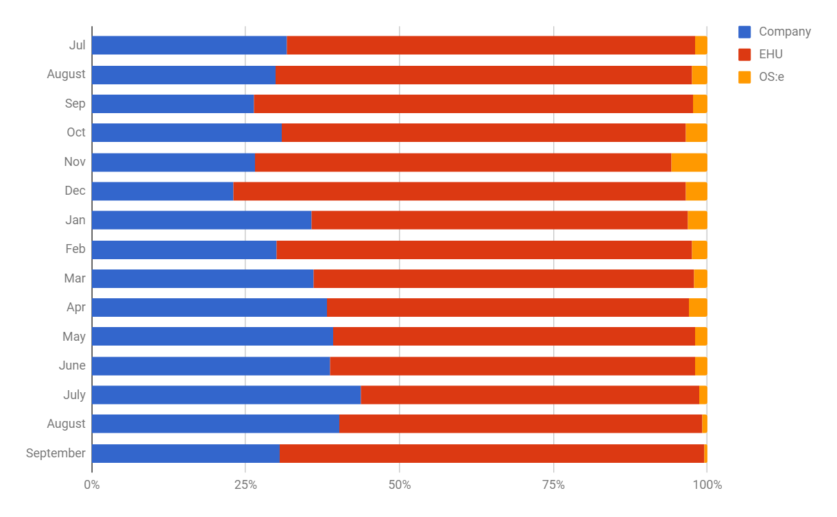
Referral proportions Jul 17 - present

Slide 16
Energy updates

Slide 17
Supplier updates
Since the last meeting new suppliers being added as referral partners include:
Gazprom
Our Power
Utility Point

Slide 18
Presented by: Leanne Dullard
Date: 07 November 2018

