Slide 1
Domestic Supplier Liaison
February 2023
Citizens Advice and The Extra Help Unit

Slide 2
Agenda
Welcome and Introductions
Minutes from last meeting
Consumer service Operations update
Advice Direct Scotland Operations update
EHU Operations update
Break
Supplier Spotlight group discussion - supplier referral process and contingency
Citizens Advice energy policy team update
AOB

Slide 3
Actions
Suzi Cassie

Slide 4
Consumer service update, quarter three 2022/23
Leanne Dullard
Operations

Slide 5
Performance and Operations Q3
Key points from Quarter 3 are:
Demand for quarter three has increased by 91.4% when compared to the same time period in 2021/2022
We continued to monitor adviser case coding to help ensure we can accurately report the types of issues clients are experiencing,
Our new resource went live at the end of the quarter and although the benefits were minimal in Q3 from a contacts answered perspective, we have begun to see the benefits in Q4
A joint project with the Citizens Advice Policy Team began to review all referral contact details with suppliers.
Notes:
97,987 contacts offered Q3 – 51,194 Q3 last year
focussing the last few months on the newly implemented EBSS codes
This project is to ensure referrals are sent to the right place and RAST contacts are up to date

Slide 6
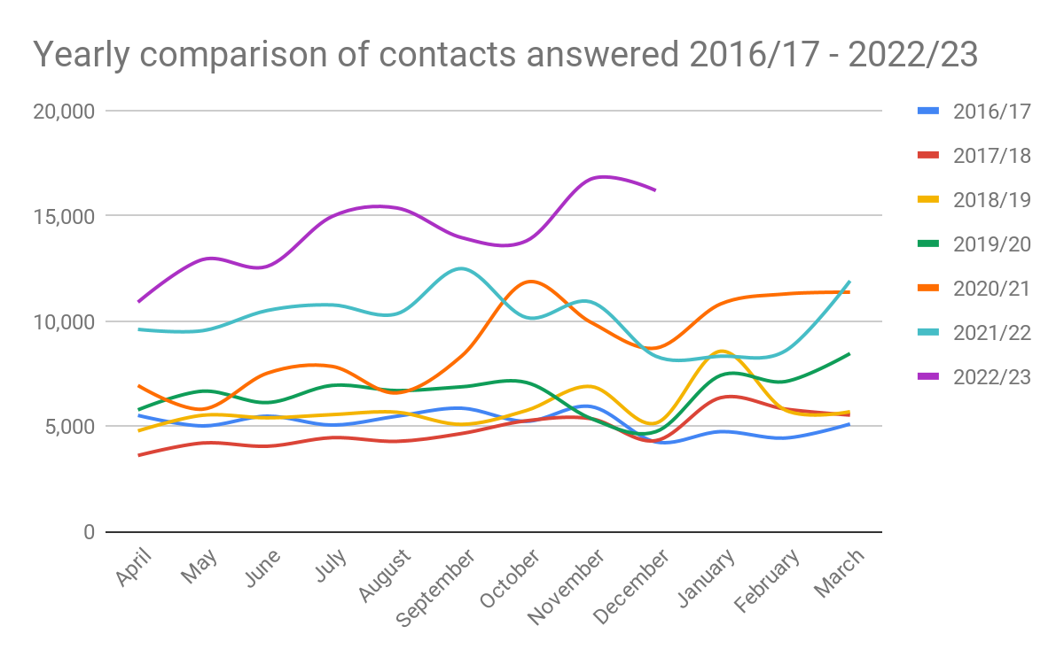
Contact volumes comparison 2016/17 to 2022/23

Slide 7
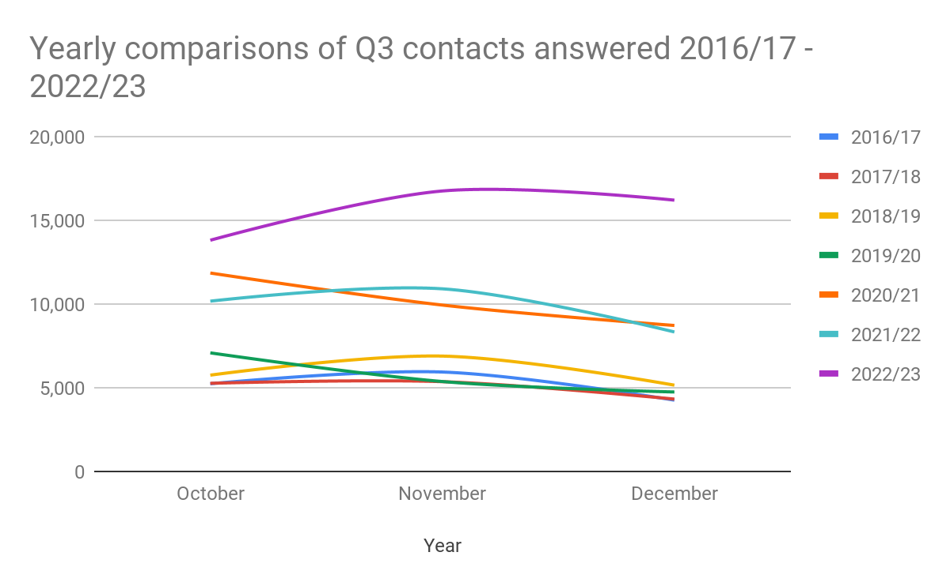
Q3 contact volumes comparison 2016/17 to 2022/23

Slide 8
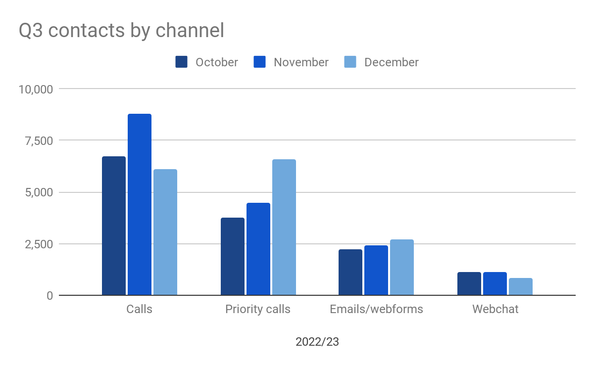
Q3 contacts answered by channel

Slide 9
Recorded information on the IVR
 | Priority calls | Price cap information | Energy hints and tips
Oct 22 | 3,719 | 3,796 | 2,193
Nov 22 | 4,179 | 2,715 | 1,840
Dec 22 | 6,646 | 2,662 | 2,200
Notes:
Price cap IVR was previously in the last position on our IVR. From Set moved to the number 1 position and hints and tips is now in the last position

Slide 10
Trends
Quarter 4 Jan - Mar 22 | Quarter 1 April - June 22 | Quarter 2 July - September 22 | Quarter 3 October - December 22
PPM self disconnection (unable to credit meter) (2,065) | PPM self disconnection (unable to credit meter) (1,874) | PPM affordability self disconnection unable to credit meter (2,713) | PPM affordability self disconnection unable to credit meter (3,787)
Credit Refund Issue (1,453) | PPM affordability self disconnection unable to credit meter (1,610) | PPM self disconnection (unable to credit meter) (2,209) | PPM self disconnection (unable to credit meter) (2,130)
Price/tariff information (1,384) | Disputed bill, customer not responsible (1,562) | Inaccurate bill or inaccurate estimated bill (1,551) | Voucher not received (1549)
Inaccurate bill or inaccurate estimated bill (1,275) | Inaccurate bill or inaccurate estimated bill (1,445) | Debt recovery practices (1,122) | Pricing information (1,396)
Disputed bill, customer not responsible (980) | Price/tariff information (1,113) | Pricing information (1,094) | Unable to credit PPM (faulty meter/payment device) (1,257)
Debt recovery practices (832) | Pricing information (919) | Price/tariff information (977) | Inaccurate bill or inaccurate estimated bill (961)
Pricing information (689) | Direct debit issues (864) | Direct debit issues (966) | Debt recovery practices (854)
Direct debit issues (654) | Debt recovery practices (864) | Disputed bill, customer not responsible (893) | Disputed bill, customer not responsible (984)
Administrator/debt issue (6 32) | Administrator/debt issue (697) | Administrator/debt issue (681) | Price/tariff information (773)
Difficulty contacting supplier (605) | Difficulty contacting supplier (637) | Catch up bill received (619) | Direct debit issues (740)
Notes:
Nation
%

Slide 11
Q3 Trends split by nation
England | Wales
PPM affordability self disconnection unable to credit meter (3,611) | PPM affordability self disconnection unable to credit meter (115)
PPM self disconnection (unable to credit meter) (2,010) | PPM self disconnection (unable to credit meter) (106)
Voucher not received (1497) | Unable to credit PPM (faulty meter/payment device) (88)
Pricing information (1,303 | Pricing information (60)
Unable to credit PPM (faulty meter/payment device) (1,160) | Debt recovery practices (57)
Disputed bill, customer not responsible (932) | Price/tariff information (47)
Inaccurate bill or inaccurate estimated bill (917) | Disputed bill, customer not responsible (44)
Debt recovery practices (790) | Difficulty contacting supplier (40)
Price/tariff information (716) | Inaccurate bill or inaccurate estimated bill (32)
Direct debit issues (706) | Voucher not received (30)

Slide 12
Q3 new affordability codes
Code | Description | Advice only | Company referrals | EHU | Energy ombudsman | Total cases
DD20 (new) | Credit meter affordability: direct debit or next bank transfer payment to cause financial detriment | 268 | 47 | 8 | 0 | 323
DD19 (new) | Credit meter affordability: missed direct debit or bank transfer payment | 44 | 6 | 4 | 0 | 54
DD18 (new) | PPM affordability: topping up causing financial detriment | 710 | 75 | 189 | 0 | 974
DD17 (new) | PPM affordability: self-disconnection (unable to credit meter) - failed supplier | 168 | 24 | 230 | 0 | 422
DD16 (new) | PPM affordability self disconnection unable to credit meter | 2,623 | 393 | 3781 | 2 | 6,799

Slide 13
Q3 new EBSS codes
Code | Description | Advice only | Company referrals | EHU | Energy ombudsman | Total cases
BSS01 | Voucher Not Received | 944 | 535 | 69 | 1 | 1,549
BSS02 | Problem topping up at paypoint/Post Office | 30 | 30 | 6 | 0 | 66
BSS03 | Other | 353 | 41 | 0 | 0 | 394

Slide 14
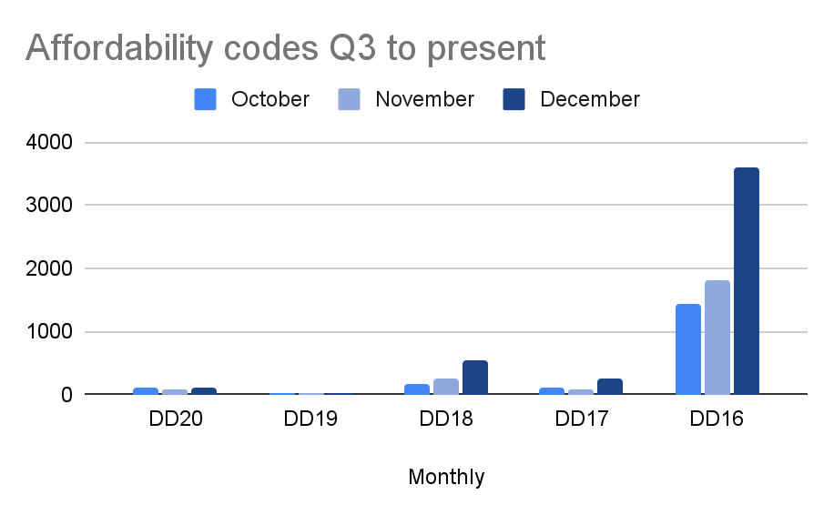
Q3 affordability trends
DD20
Credit meter affordability: direct debit or next bank transfer payment to cause financial detriment
DD19
Credit meter affordability: missed direct debit or bank transfer payment
DD18
PPM affordability: topping up causing financial detriment
DD17
PPM affordability: self-disconnection (unable to credit meter) - failed supplier
DD16
PPM affordability self disconnection unable to credit meter
Notes:
DD20
Credit meter affordability: direct debit or next bank transfer payment to cause financial detriment
DD19
Credit meter affordability: missed direct debit or bank transfer payment
DD18
PPM affordability: topping up causing financial detriment
DD17
PPM affordability: self-disconnection (unable to credit meter) - failed supplier
DD16
PPM affordability self disconnection unable to credit meter

Slide 15
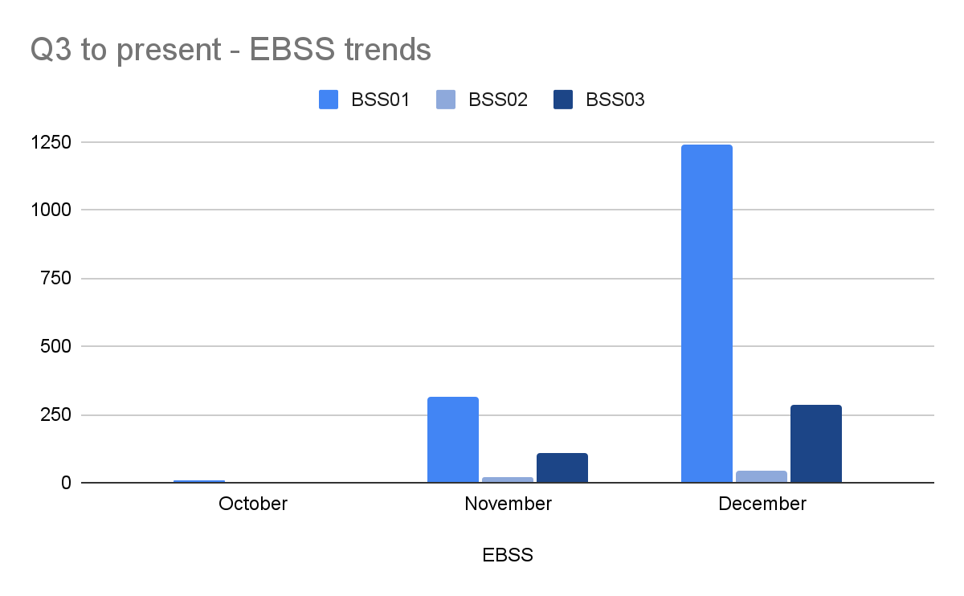
Q3 new EBSS codes
BSS01 - Voucher not received
BSS02 - Problem topping up at paypoint/Post Office
BSS03 - Other

Slide 16
Google analytics - energy pages
Top 10 energy website pages | Q3 2022/23 | Q3 2021/22 | % difference
Grants and benefits to help pay your energy bills | 355,758 | 83,785 | +324.6%
How to read your smart electricity meter | 74,901 | 45,479 | +64.69%
How to read your energy meter | 72,519 | 40,494 | +79%
You can’t afford to top up your pre-payment meter | 64,574 | 38,087 | +69.54%
How to read your smart gas meter | 54,181 | 32,336 | +67.55%
Find out who your gas or electricity supplier is | 46,415 | 29,866 | +55.41%
Find out if your energy meter is faulty | 42,320 | 21,896 | +111.97%
Moving home and dealing with your energy supply | 40,411 | 31,398 | +28.7%
Claim back credit from your energy supplier | 40,297 | 17,801 | +126.37%
Total energy page views Q3 22/23 | 3,560,763

Slide 17
Signposted cases for Q3
Signposted to | Total signposts
Citizens Advice local office | 5,408
Energy ombudsman | 524
Shelter | 218
Ofgem | 197
National debtline | 142
Information Commissioner's Office | 83
Signposted to | Total signposts
ConsumerLine | 63
Citizens Advice Scotland | 54
Law society | 38
Consumer council for water | 8
Age Concern | 7
Other | 46,322
Total signposts for Q3 - 53,065
Notes:
Other is mostly suppliers - can’t split figures down to which suppliers

Slide 18
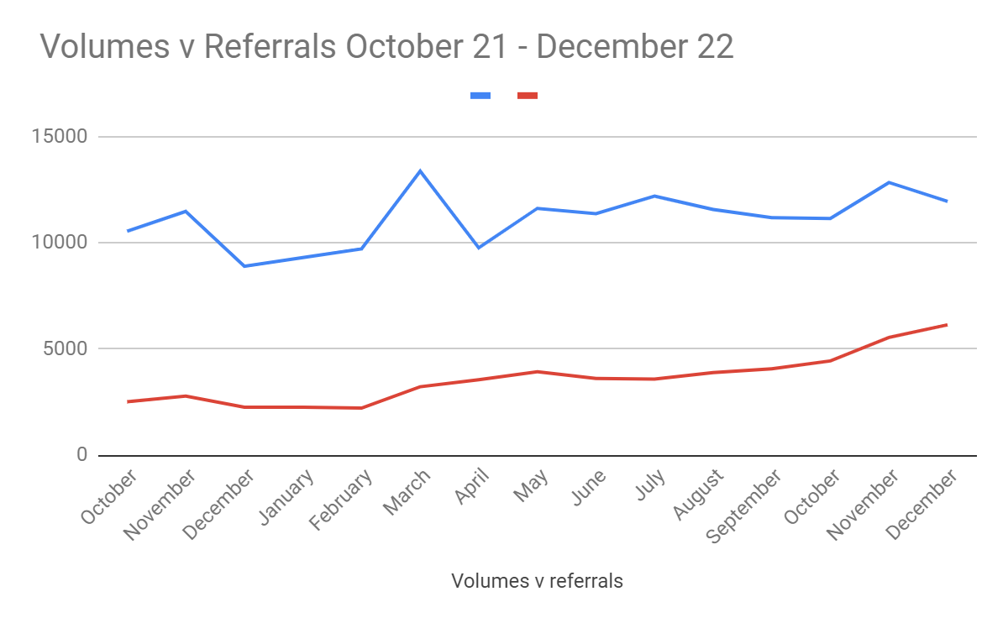
Referrals against volumes October 21 - December 22

Slide 19
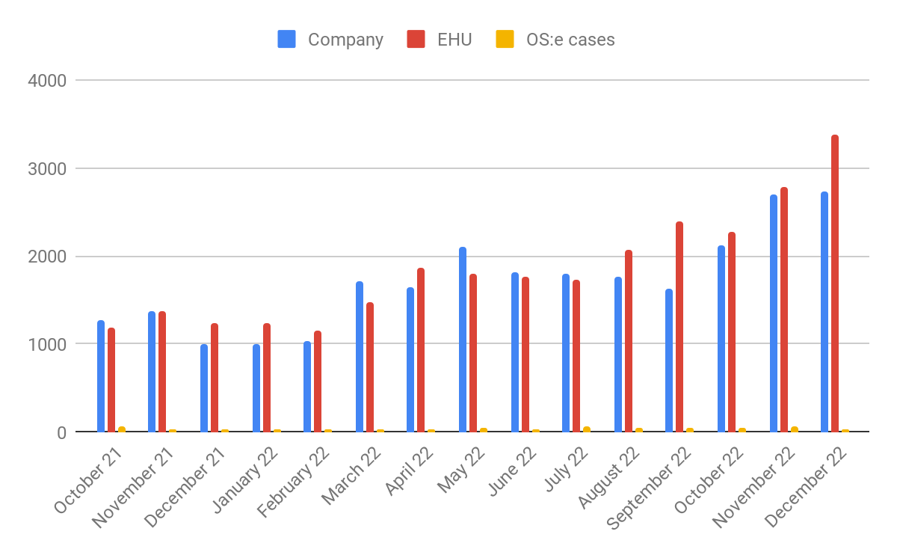
Referral proportions October 21 - December 2022

Slide 20
Looking ahead
On January 18th we migrated to a new telephony platform
The local rate 0345 number for the consumer service will be decommissioned in the coming weeks. Our freephone number 0808 223 1133 remains fully operational
With our extra resource we have answered 39.2% more demand, compared to back in October, when we didn’t have the new advisers on the phones. We expect this figure to increase as new advisers settle in more.
Continuing to review referral contact information - please get in touch if you want to ensure yours is up to date
Notes:
0345 number - vols have been monitored over the last 18 months and have plateaued for a considerable period of time, we now feel it is the right time to remove access to the number

Slide 21
Presented by: Leanne Dullard
Date: 22 February 2023

Slide 22
Advice Direct Scotland
Operational update
Hazel Knowles

Slide 24
Volume vs Forecast by month

Slide 25
Service Development
Speech Recognition Software
24/7 Energy Bot Service
Accessibility

Slide 26
Enquiries By Contact Type

Slide 27
Referrals

Slide 28
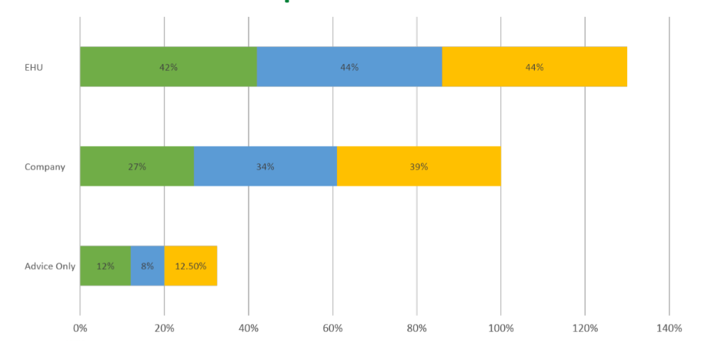
Repeat Contacts

Slide 29
Live Supplier Referrals

Slide 30
Enquiries By Contact Type

Slide 31
Case Study – EBSS Issues

Slide 32
Top 5 Affordability Codes

Slide 33
Case Study – Holistic Support

Slide 34
Staff Training and Support
ACAS: Equality Training
Energy Ombudsman Training
Scottish Power Training
Emergency First Aid at Work
Mental Health First Aid
In Office Support
Access to Counselling
4 Day Working Week
Cost of Living Measures

Slide 36
Extra Help Unit
Operational update
Natasha Gilmour and Angus Mcmillan

Slide 37
Supplier Liaison Update
9th November 2022 Natasha Gilmour, Angus McMillan & Monika Szczekotova

Slide 38
Casework Volumes
Q3 22/23
Total complaints = 9762
↑41% from Q2
Priority Complaints = 8228
↑42% from Q2
Self Disconnection = 6084
↑26%
Self Disconnection cases 417% higher in December 22 against Dec 21
Q3 22/23
84% of complaints were priorities
December highest month ever for priority complaints (3062)
97% of EHU work was domestic related
Notes:
Self Disconnection cases up by over 1000% when comparing August 21 and August 22
Q2 21/22 compared to q2 22/23 Self disconnection up by 851%

Slide 39
Q3 22/23 Referral Partners
Main referral partners across nations
Notes:
10% Wales, 12% Scotland and 78% England
Any specific changes across the nations?

Slide 40
KPI Domestic performance
 | 60% of complaints closed within 35WD | 75% of complaints closed within 66wd | 70% of Priority complaints closed within 20WD | 70% of cases categorized as green, 90% categorized as green or amber | 80% of complaints closed with a positive outcome | 85% of consumers satisfied with service
Q3 22/23 | 81% | 91% | 92% | 71% & 92% | 80% | 93%
Q1-Q3 22/23 | 78% | 89% | 87% | 71% & 92% | 83% | 92%

Slide 41
Accent research cases closed in September and November 2022
Outcomes and measures
"I went from feeling alone and depressed as I couldn’t do anything about my situation to happy that someone was fighting in my corner. I am very grateful for this service you provide.
Accent Report January 2023
Financial redress
£514,411
Answered 86% of calls (21,377)
Fuel Bank Foundation Partnership
658 Fuel Bank Vouchers
Supporting 1608 people in households
totalling over £30k
92% satisfied or very satisfied with overall quality of service
92% happy with length of time to deal with problem
85% satisfied with outcome
79% felt EHU helped them find a way forward
56% felt their mental health and well being improved after support
“It was a life saver as the stress felt before talking to them was extreme and soon as I spoke to the lady I felt straight at ease and that she was doing what was best”

Slide 42
Operational Challenges
Working with people in very vulnerable circumstances and dealing with such high demand inevitably impacts on staff morale and welfare.
High demand
Over 80% of complaints are priority – urgent support needed
High call volumes and call queues
Different supplier response rates
High liveloads (average 77)
Upsetting nature of people’s circumstances
Achieving tangible change or outcomes more challenging
Fire fighting and struggling to reach more complex casework
Unallocated complaints 371, day 18
Being creative with tackling complex complaints and taking individuals off line on a rotating basis
Restricted telephony access and routed consumers towards email, maintaining access for urgent situations.
Lead Caseworkers taking majority of micro-business cases
Asked referral partners to email priorities when reaching full capacity
Set a priority cap of 10 for each Caseworker, this has now been reduced to 8
Initiated a new process for self disconnection cases where consumer's details are emailed through rather than calling. So far feedback has been positive.
Accept on certain days we cannot process every single priority complaint
Creation of EHU newsletter to improve communication, consolidate updates and process changes
Shell secondment

Slide 43
Operational Success and Development
Success and promotion
George Holmes, EHU Operations Manager, won the Consumer Champion Award at the Energy UK Young Energy Professionals Awards 2022
Brian MacRae, EHU Quality Assurance Officer, was finalist in the Audrey Gallacher Award for Excellence at the Energy UK Young Energy Professionals Awards 2022
EHU article in the Herald 'Extra help in this terrifying cost of living crisis’ Extra help in this terrifying cost of living crisis | HeraldScotland
Civ Tech Challenge 8
We are about to embark on the accelerator phase of the CivTech Challenge, having selected a company following an intense exploration phase.
The tool named HelpFirst, dynamically assigns a prioritisation ranking to each case and risk fingerprint to each customer. EHU usage trains HelpFirst to get even better at prioritisation, meaning organisational learning is captured and shared. There are anticipated commercial opportunities.
https://www.civtech.scot/civtech-8-challenge-1-identifying-and-prioritising-support

Slide 44
Insight
Forced Prepayment
Providing additional insight to Ofgem currently on top of ongoing data and concerns
Widening analysis of cases involving force fitting of prepayment meters, remote mode changes and debt recovery practices
Self-disconnection
Given volume of cases continuing to try and identify insights
Clear many consumers unable to afford to top up their meter on an ongoing basis
Notes:
Last point is obvious and can elaborate a little bit on that. Some consumers with multiple top ups could be considered to have transient vulnerability – given age of children, temporary health conditions or situations were the level of detriment suggests ASC should continue to be provided, but its not necessary clear and obvious that a prepayment meter is not a safe and practical solution.

Slide 45
Top 5 category codes:
July – December 2022
Notes:
Last point is obvious and can elaborate a little bit on that. Some consumers with multiple top ups could be considered to have transient vulnerability – given age of children, temporary health conditions or situations were the level of detriment suggests ASC should continue to be provided, but its not necessary clear and obvious that a prepayment meter is not a safe and practical solution.

Slide 46
Working Together
Aged cases
Delays in complaint allocation at EHU and Supplier
High volumes of priority cases that need to be resolved more quickly
We understand multiple suppliers are increasing their resources and/or changing processes to speed up case handling, and we hope to see reductions in liveloads in the coming weeks.
Escalations
Raised at previous meetings
Timeliness of responses needs to improve at multiple suppliers

Slide 47
Working Together
Alternative Self-Disconnection Process
Rolled out to three suppliers
No major process issues
Broadly positive feedback from our casework team and also from suppliers – tracking, reduction in calls and options to email updates a positive
System enhancements
Full reporting functionality and transfer of data to PowerBI is still being worked on and expected to be completed by end of Q4.
Holding session tomorrow to discuss options which have been scoped
Want to ensure that systems enhancements fulfil supplier needs and allows for more effective case progression

Slide 48
Additional Support Project - Aims of Project
Enabling domestic consumers to continue their advice journey in a safe and trusted environment within the EHU
Delivering a person-centred approach
Helping consumers find a way forward in response to the rising cost of living
Reducing repeat demand for EHU services by ensuring sustainable payment plans
Enabling access to advice and maximise scope for smooth referral arrangements

Slide 49
Additional Support Project – Summary of what we do
Benefit check and advice on unclaimed benefits
Income maximisation – find ways to maximise income and reduce spending
Help with Income & Expenditure to agree on an affordable repayment plan
Identify any grants consumers may be eligible for
Initial debt assessment and identification of emergencies such eviction or bailiff action
Help access crisis support if you can’t afford the essentials
Find local support and arrange a formal referral where possible

Slide 50
Additional Support Project – Process

Slide 51
Additional Support Project - October 2022 to January 2023 Update
Split across nations
Financial
potential gain £17,167
104 consumers supported
High level themes | % of Cases
Benefit check | 37.50%
Difficulty making payment | 20.19%
Grants / Trust funding | 12.50%
Energy debt | 11.54%
Initial debt advice | 8.65%
Benefit advice / Claiming process | 7.70%
Income & Expenditure form | 1.92%
Outcome | Percentage of logged outcomes
Signposting to Advice Agency | 39%
Benefit Check – Food Parcel – Signposting to Advice Agency | 25%
Trust Funds | 18%
Income Maximisation | 16%
Food Parcel | 2%

Slide 52
Additional Support Project
BENEFITS of the project:
Advice on disability benefits PIP/ADP, Discretionary Housing Payment and Council Tax Support/Reduction
Encouraging consumers to solve their problems with a holistic approach.
CHALLENGES:
EHU clients are already dealing with a difficult situation and are often distressed
The most vulnerable struggle to access relevant advice, especially those with mental health issues
Consumers with a negative income may have already exhausted available assistance
High demand for advisory agencies providing debt advice as a requirement for applying for grant funding
Applying for a disability benefit or grant funding takes time
Difficulties to budget as the cost of living continues to rise.
Scottish Government's Home Heating Support Fund initiative to help tackle energy debt for people in fuel poverty
Help with the cost of living from local council through the Household Support Fund/Scottish Welfare Fund
UK wide coverage where each council operates differently

Slide 53
Questions?

Slide 54
Break

Slide 55
Supplier Spotlight group discussion -
supplier referral process
and contingency

Slide 56
Our process for company referrals
Consumer service adviser attempts a mid call transfer to the supplier, using the referral number on the RAST page. The client is passed through to their supplier, or the call is noted as a failed mid call transfer
An email referral is sent to the supplier via their secure post office account.
Consumer service adviser recognises the client fits the criteria to be referred to their supplier
Client calls the Consumer Service for advice

Slide 57
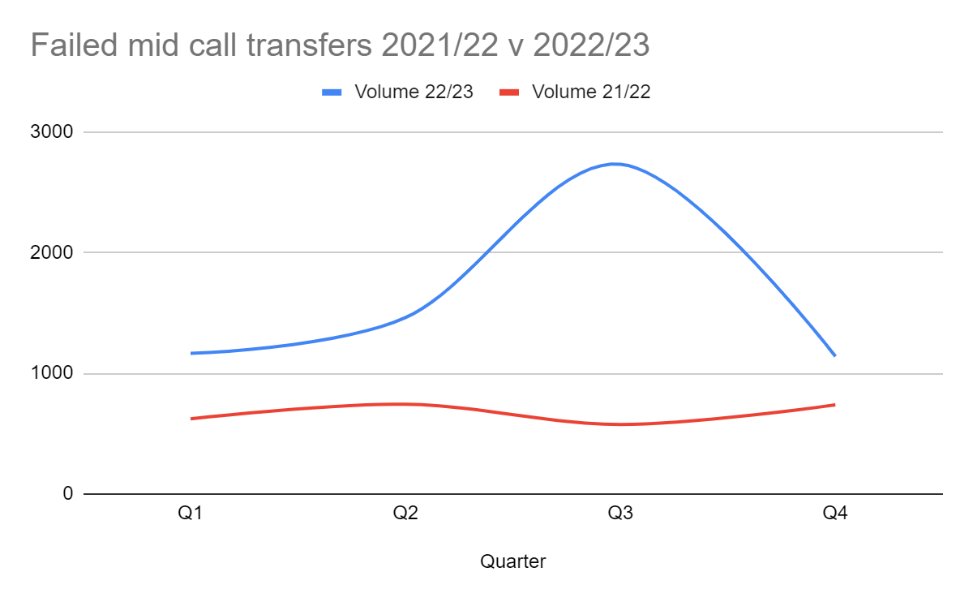
Failed MCTs
Please note: figures for Q4 22/23 only include January figures and do not yet include Feb and March.
Notes:
Failed MCTs Q3 -
October 22
783
November 22
873
December 22
1,076
Important that if we cant do an MCT, the referral place is up to date, so also really important to make sure numbers and emails are up to date
Total failed MCT’s Q3
2,732

Slide 58
Call to action
We are aware that demand for all services has increased compared to this time last year and this puts pressure on referrals
To ensure that clients get to the right place we have been undertaking our review of referral details
This involves checking:
We have the correct referral number on your RAST page
We are sending email referrals (and weekly recon reports) and case notes to the correct addresses
We have the best up to date RAST contacts
If you think you have not confirmed these either with our team or policy please get in touch

Slide 59
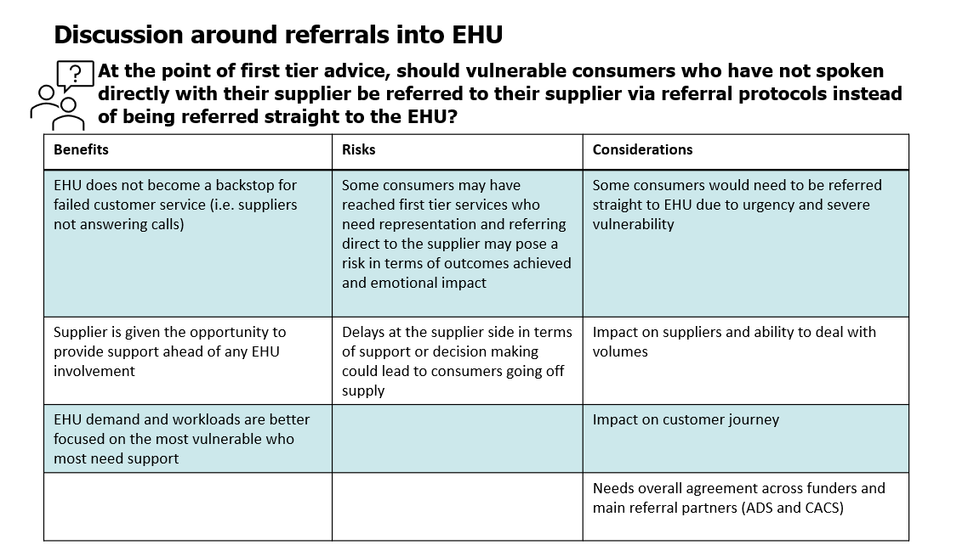

Slide 60
Citizens Advice energy
policy team update
Dr Elizabeth Blakelock

Slide 61
Energy Team Update
Supplier Liaison Meeting
22nd February 2023

Slide 62
Contents
Publications, blogs and consultation responses
Team updates
Energy Retail Markets
Net Zero Homes
Energy Network and Systems
Notes:
62

Slide 63
Recent publications
Supporting microbusiness customers with debt: A good practice guide for non-domestic suppliers
Kept in the dark - The urgent need for action on prepayment meters
Domestic energy supplier performance data
Grinding to a halt? Removing the roadblocks to increased energy efficiency and decarbonisation of private housing in Wales
Access Denied Digital disadvantage and exclusion in the energy market
Notes:
63

Slide 64
Recent Blogs
Open for business?
Too little, too soon: Energy Bills Discount Scheme puts thousands of small businesses at risk
3 Things you need to know about energy this #EnergySavingWeek
It’s time to stop forcing people onto prepayment meters - here’s why
What is a heat pump and why will you be hearing more about them in the future?
Comparing how much electrical appliances cost to use
What you need to know about the Energy Bills Support Scheme
How can we help digitally disadvantaged people get the best out of the energy market?

Slide 65
Consultation Responses
We have responded to Ofgem’s DCC review, Ofgem’s consultation on strengthening financial resilience, and Ofgem’s consultation on extending the Market Stabilisation Charge (MSC) and the Ban on Acquisition Tariffs.
We also responded to Ofgem’s consultation regarding the Last Resort Supply Payment claim minded-to position, Ofgem’s consultation on changes to how energy balancing costs are charged and to the Ofgem DSO Incentive Governance Document consultation.
We also responded to the BEIS consultation on the design of the ECO+ scheme (2023-2026), responded to UK Regulators Network (UKRN) guidance for regulators on the methodology for setting the cost of capital, and published the Citizens Advice Correspondence regarding the agreement between Bulb and Octopus.
See all our consultation responses here

Slide 66
Energy Retail Markets Team: updates
Current policy/advocacy work
Recently published Kept in the Dark, a report highlighting the urgent need for a total ban of the forced installation of prepayment meters - until additional safeguards are put in place.
Good Practice Guide for non-domestic energy companies highlighting the steps they can take to help microbusiness customers with debt.
Recently published Access Denied, looking at digital disadvantage and exclusion in the energy sector
‘Tackling Energy Debt’ - a discussion paper on potential solutions to growing levels of consumer debt in the energy market.

Slide 67
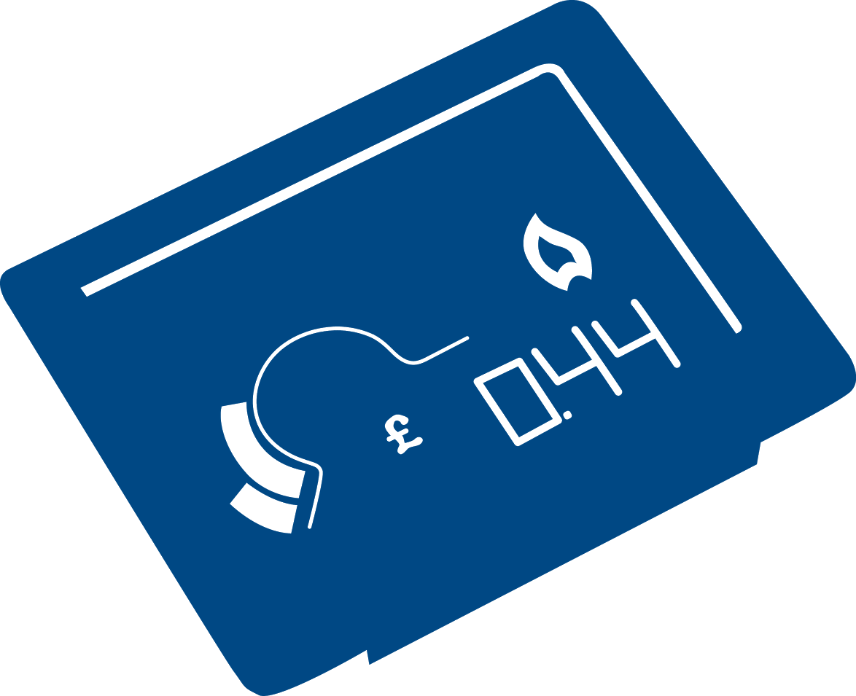
Net Zero Homes: updates
Current policy/advocacy work
Publication of report on energy efficiency in the private rented sector
Published energy efficiency report for Wales: Grinding to a halt?
Blog on heat pumps
Blog on the consumer experience of public EV charging stations
Gave evidence to Lords Environment and Climate Change Select Committee investigating the progress so far of the Boiler Upgrade Scheme
Coming soon
Research on smart technologies and vulnerable consumers
Research on Local Area Energy Planning
Research on flexibility capital

Slide 68
Energy Networks & Systems Team: updates
Current policy/advocacy work
Published the first in a series of discussion papers on the potential consumer impact of the government’s Review of Electricity Market Arrangements (REMA)
Also regarding REMA, we have worked with BEIS (as was) to develop an end-user forum to ensure consumer views are well represented. We recently co-facilitated the first forum.
Responded to Ofgem consultation regarding code governance reform
Coming soon
Research into the wider system benefits of Energy Efficiency
Output of work with the Electricity System Operator on consumer research around the Winter Demand Flexibility Scheme

Slide 69
AOB

