Slide 1
Extra Help Unit
Domestic - Supplier Liaison Meeting Q4 2020/21
May 2021
www.ehu.org.uk

Slide 2
EHU workloads
Changes from Q3 to Q4 20/21:
Complaints ↓1%
Ask the Adviser
↑5%
Enquiries
↑8%
Priority cases ↓11%

Slide 3
EHU Q4 20/21 –
High level complaint trends
Key Changes Q3 to Q4 20/21
PPM ↓36%
Billing ↑7%

Slide 4
EHU Q4 20/21 – category codes
Across the nations, prepayment self disconnection accounts for only 17% of complaints in Scotland, but slightly higher proportions in England and Wales of 24% and 21% respectively.
Disputed bills, inaccurate bills, unable to credit prepayment meter (fault) and supply point administration queries account for 4-5% of overall complaints individually.
Self-disconnection was the most common sub category of complaint, accounting for 23% of domestic complaints in Q4.

Slide 5
EHU Q4 20/21 Referral Partners
The Citizens Advice consumer helpline remain responsible for the majority of cases logged by the EHU, accounting for 94% of complaints logged.
Notes:
Increase of 3% in proportions - referrals from CS
3% bureaux in Sc, practically 0 in England and wales

Slide 6
EHU Q4 20/21 KPIs and Performance
KPIs and Measures | April to June 2020 | July to September 2020 | October to December 2020 | January to March 2021
Complaints Received | 2228 | 2,583 | 3,269 | 3,240
Complaints Closed | 2499 | 2,300 | 2,795 | 3,164
Enquiries | 372 | 435 | 593 | 611
Ask the Adviser | 272 | 308 | 386 | 416
Quality Assessments: 70% of cases categorised as green 90% of cases categorised as green or amber * | Green = 71% Green or Amber = 92% | Green = 78% Green or Amber = 95% | Green = 78% Green or Amber =94% | Green = 74% Green or Amber = 96%
Financial Redress ** | £439,651 | £614,177 | £472,075 | £510,448
DOMESTIC Casework
60% of cases closed within 35 WD | 66% | 63% | 66% | 57%
75% of cases closed within 66 WD | 84% | 82% | 86% | 81%
Tangible outcome (80%) *** | 85% | 85% | 85% | 84%
Accent customer satisfaction survey: Consumers satisfied or very satisfied with the quality of service (85%) | 90% | 90% | 91% | 92%

Slide 7
EHU Q3 20/21 - Securing positive outcomes
In 85% of domestic complaints, a positive outcome was secured.
‘I liked the fact that the Extra Help Unit don't just leave you after phone call, they follow up with emails and phone backing. Supporting you till you are fully satisfied. The support stays with you.’
‘The lady was lovely and helpful. I don't think it would have been sorted without them’
Accent January 2021

Slide 8
EHU Q4 20/21 – Customer satisfaction Survey
Cases closed September to November, report received in January 2021
91% satisfied with quality of service
95% felt the person handling case understood their problem
90% satisfied with length of time taken to resolve complaint
90% felt they were kept informed
86% said EHU made a difference to their energy complaint

Slide 9
Operational update
Workloads and initiatives undertaken to cope with backlog of new cases
Business Case 21/22
Resource changes – impact on recovery
Stage 1 unallocated
Age profile day 13
↓35%
Volume 463
↓25%
Notes:
Day 13 reduction of 35% 463 25% reduction in stage 1s 7.2.21

Slide 10
Expansion of Priority Team
Team of six now taking the vast majority of priority calls
Offline on a Wednesday when the rest of the team cover priority calls.
New dedicated priority line coming soon
New Priority Process
Circulated on 6th April solidifying how EHU expect suppliers to handle the most urgent cases.
Caseworkers to be contacted within 2 hours of logging a priority with supplier
Supplier to respond to priority forms within two working days
Transition of first tier energy advice to Advice Direct Scotland
Change on 1st April 2021
Smooth transition
EHU receiving the expected referrals with little/ no impact on consumers.

Slide 11
Servicemail replacement project
Project officially underway and Project Board formed
CAS working with Waterstons IT consultancy assisting CAS IT with new System selection process
Identified 3 suppliers who are going to bid for tender
Identifying all requirements for the system
Workshops planned with key stakeholders, suppliers and EHU team
Successful supplier session held on 5th May 2021 – thanks to all those involved at short notice
Aim is to have new system in place for April 2022.
Home Heat Fund
EHU gained £27k for 37 Scottish consumers to assist with energy debt and ongoing consumption
Scottish Government crisis funding administered by ADS
Fuel Bank Foundation
Established new partnership to gain access to fuel vouchers where suppliers unable to assist any further

Slide 12
New supplier expectations document
“A regulated provider must, after discussion with the Council, put in place appropriate arrangements to deal effectively with section 12 and 13 complaints.... in an appropriate and prompt manner.”
Provision 8 of the Gas and Electricity (Consumer Complaint Handling Standards) Regulations 2008
Variation across suppliers in how cases are managed can sometimes lead to unnecessary delays in case resolution and closure
EHU working to update some processes, and expectation of significant efficiency gains from new database
New document to set out basic expectations of standards we require suppliers to meet
If these expectations are not consistently being met and there is no improvement following engagement, then matter could ultimately be referred to Ofgem for consideration

Slide 13
Industry Updates – looking ahead
Backbilling
EUK workshop likely to be held in June (date TBC)
Still some concerns over how some suppliers are interpreting regulations
Changes to disputes process
Self disconnection and RPU exception removed
Self-disconnection
EHU report circulated to suppliers in Q4
Feedback provided to EHU
Approach to compliance concerns
Monthly analysis January – March

Slide 14
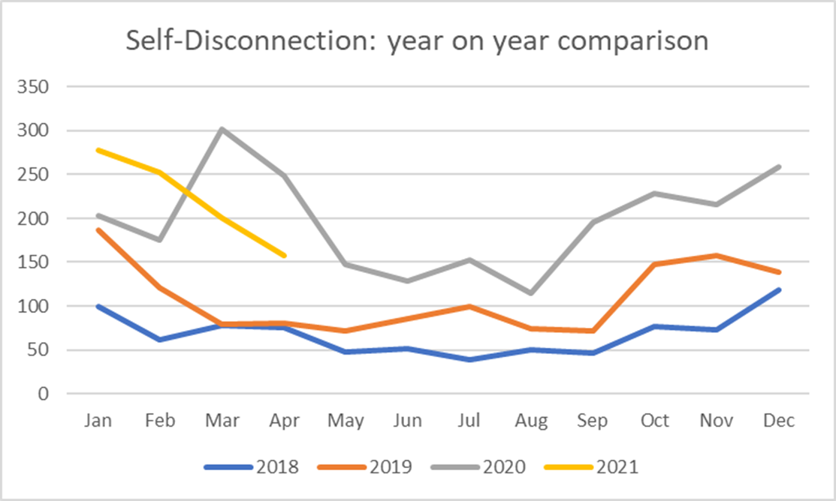
Self-Disconnection volumes April 2018 to date
Although still some decrease in volumes during warmer periods, recent overall volume of self-disconnection cases remain high

Slide 15
Questions?

