Slide 1
Energy team update
Supplier liaison meeting
January 2016

Slide 2
Research Blogs
Published The Disrupted Decade
The Disrupted Decade Change is coming for Britain’s energy consumers, but will it make life easier?
Profits in the pipeline - what National Grid’s £13.8 billion deal tells us about what consumers should pay for energy networks
Forthcoming
Support for vulnerable energy consumers
Attitudes of SMEs towards smart meters
Installation and use of heating controls
Fuel poverty and public health
Consumer experience in the off-gas sector
Information request on district heating
Time of use tariffs

Slide 3
Information requests
Upcoming events
19th January: Non-Domestic Supplier Event
Switching request to suppliers in scope for the second release of the energy comparison metric (due date of 10 February)
All energy tariffs

Slide 4
Retail team updates
Energy supplier rating was soft launched in December, with a second release of data due in March.
Plans for the PSR Tool are progressing
Signposting Audit has been published

Slide 5
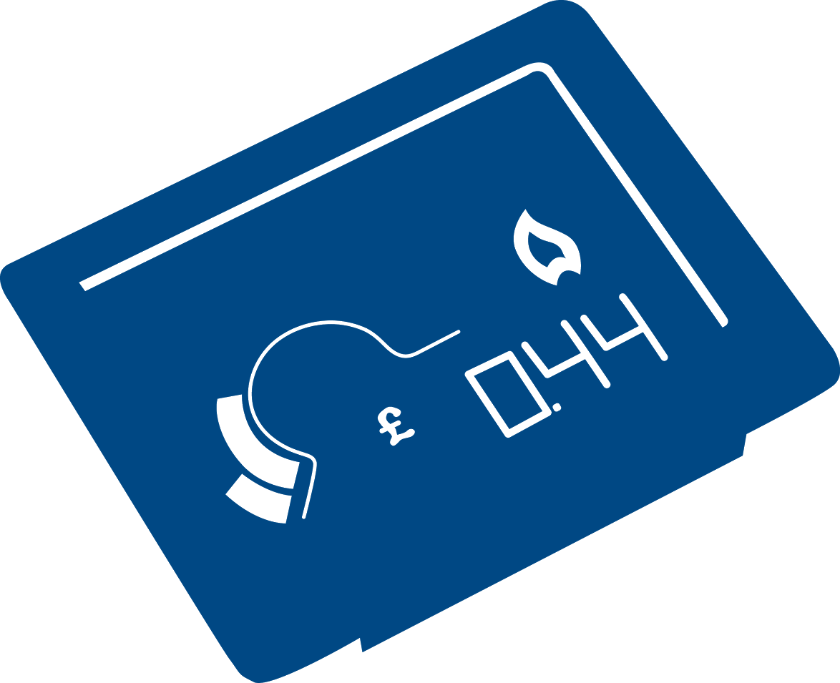
Smart & Sustainable updates
Community Energy research - supplier appointed
Steering Group for BEIS consumer research on district heating
New consumer service monitoring for energy efficiency and small-scale renewable measures launched
Following our workshop, work is being taken to update the proof-of-concept data dashboard based on input from stakeholders.
Notes:
Research looking at the consumer experience of community energy schemes and the benefits they provide has now kicked off. CSE are the appointed contractors working with us on this project. The inception meeting is taking place on the 17th January and we hope to have some preliminary results by the end of March.
We have been invited to represent consumers on the steering group of BEIS latest piece of work looking at the consumer experience of district heating schemes. The inception meeting for the research was on the 15th December and since then we have provided feedback on the draft survey questionnaire.
The first iteration of a report using our own data from customer contacts on energy efficiency and small-scale renewables has been drafted and we hope to be able to make use of this data ro help with continued policy development post-Bonfield Review.

Slide 6
Energy supplier comparison tool project
Evaluation of first release | Early January - end February 2017
Overall score published on Citizens Advice PCW | January 2017
Deadline for second switching information request (for relevant suppliers only) | 10 February 2017
Data checking and assurance period | 10 February - 28 February 2017
Final publication shared with suppliers in scope of second release | 28 February 2017
Second release on Citizens Advice website & PCT Overall score published on external PCWs (dependent on appetite) | Early March 2017
6 month evaluation (including review of metrics and market coverage) | May-June 2017

Slide 7
Presented by:
victoria.macgregor@citizensadvice.org.uk
Date: 18 January 2017

Slide 8
How to signpost and refer vulnerable customers to the right source of help
Research findings

Slide 9
Why this topic?
“We want suppliers to demonstrate better, more consistent identification of vulnerability and to respond to consumers in a way that takes into account their individual circumstances, needs and interests.”
Ofgem working paper on broad principles, August 2016

Slide 10
Case study
The client was a single mother with 3 year-old twins. She had suffered from anxiety and depression on and off for several years, which caused problems with managing her finances. She had built up debts over the last 4-5 years due to a number of personal events that had taken priority: her grandfather passed away, her brother was sent to prison and she was no longer speaking to her mother. She was also caring for her grandmother full-time. The children’s father sometimes helped out with essential costs but had not contributed for the past 3-4 months due to claiming benefits and not having enough money.

Slide 11
Case study (continued)
The advisor completed a financial statement and confirmed that the client had more money going out than coming in. She had several priority debts including for electricity, council tax and a magistrates court fine, as well as non-priority debts. She was advised on possible options to increase her income, such as applying for carer’s allowance, asking her energy supplier to put her on a cheaper tariff, applying for the Warm Home Discount and having a water meter fitted. She was also advised on possible solutions for her debts, including a debt relief order. She was signposted for further advice on child maintenance. The advisor also provided basic energy efficiency tips, sent a fact sheet and offered further in-depth advice.

Slide 12
What are the challenges for energy suppliers?
Engaging vulnerable customers with offers of help
Getting staff on board
Knowing where to signpost or refer

Slide 13
Our recommendations
Agree a company policy for signposting and referring vulnerable consumers to third parties
Set up clear signposting and referral options to a range of organisations
Be consistent in offering additional help
Allow consumers to access services on their own terms and provide support when needed
Empower customer facing staff to make good referrals
Build relationships with referral partners and learn from each other

Slide 14
Next steps - more good practice
How to assess ability to pay
Safe and reasonably practicable
Repeat self-disconnection

Slide 15
Good practice guide: how energy suppliers can signpost and refer vulnerable consumers to the right source of help

Slide 16
Thank you
Presented by: Naomi Grayburn
Date: 18th January 2017

