Slide 1
Domestic supplier liaison meeting
22 November 2023

Slide 2
Agenda
Time | Agenda item | Lead
9.30 – 9.40 | Introduction Actions from last meeting | Natasha Gilmour Suzi Cassie, EHU Citizens Advice Scotland
9.40 – 10am | Consumer Service Operations update | Leanne Dullard, Citizens Advice
10am – 10.15 | Advice Direct Scotland Operations update | Hazel Knowles, Advice Direct Scotland
10.15 – 10.55 10.55 – 11.05 | Extra Help Unit Operations update Trends & concerns from Q2 BREAK | Natasha Gilmour Angus McMillan George Holmes, EHU Citizens Advice Scotland

Slide 3
Time | Agenda item | Lead
11.05 – 11.20 | Lightening Talk ECO4 funding and how suppliers target consumers to meet obligations | Introduced by Angus McMillan, EHU Citizens Advice Scotland Mark Murphy, Scottish Power
11.20 – 11.30 | Energy Ombudsman | Adon Laizans, Energy Ombudsman
11.30 – 11.40 | Consumer Scotland | Michael O’Brien, Consumer Scotland
11.40 – 11.50 | Citizens Advice Energy Policy Team Energy policy update | Dr Elizabeth Blakelock, Citizens Advice
11.50 – 12noon | AOB & Close | Natasha Gilmour, EHU Citizens Advice Scotland

Slide 4
Actions from last meeting

Slide 5
Domestic Supplier Liaison
November 2023
Citizens Advice

Slide 6
Consumer service systems
As part of the ongoing governance process for the project, we have identified a number of risks and barriers to progress
As such, we don’t believe we are in a position to be able to deliver the necessary components of our systems infrastructure by April 2024
We are now reviewing our options to maintain service stability and continuity, which will require extending contracts with our current suppliers and a reassessment of the existing project
Assuming we agree extensions with our suppliers, then there will be little to no disruption to partners referrals or reporting for the new financial year

Slide 7
Performance and Operations
Key points from quarter two are:
Demand for the quarter decreased by 32% compared to quarter 2 2022/23
Priority call demand saw a 11% increase over the quarter when compared to the same time period last year
Client Satisfaction remained above KPI
Overall quality for the service was achieved across the year

Slide 8
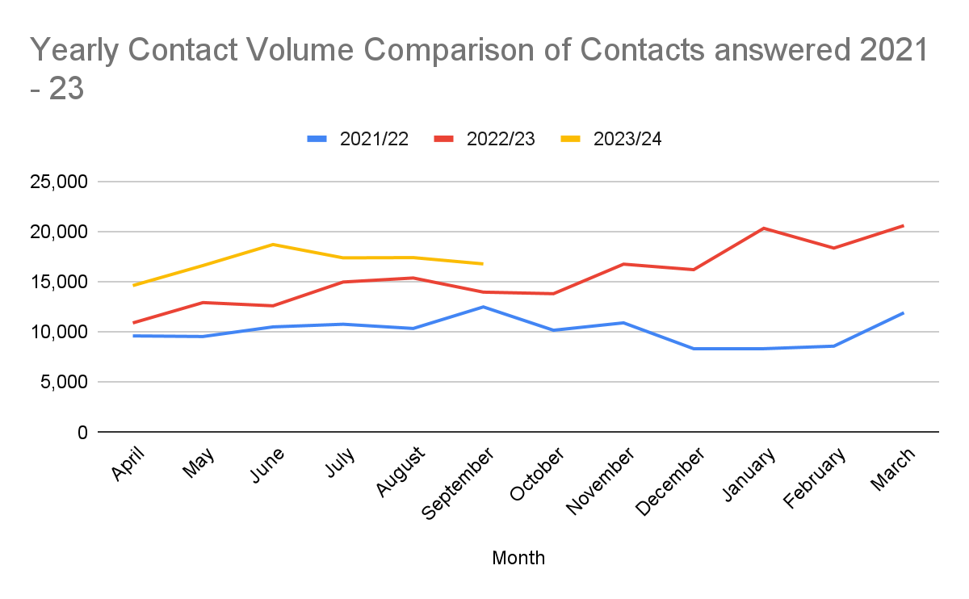
Contact volumes comparison 2021/22 to 2023/24

Slide 9
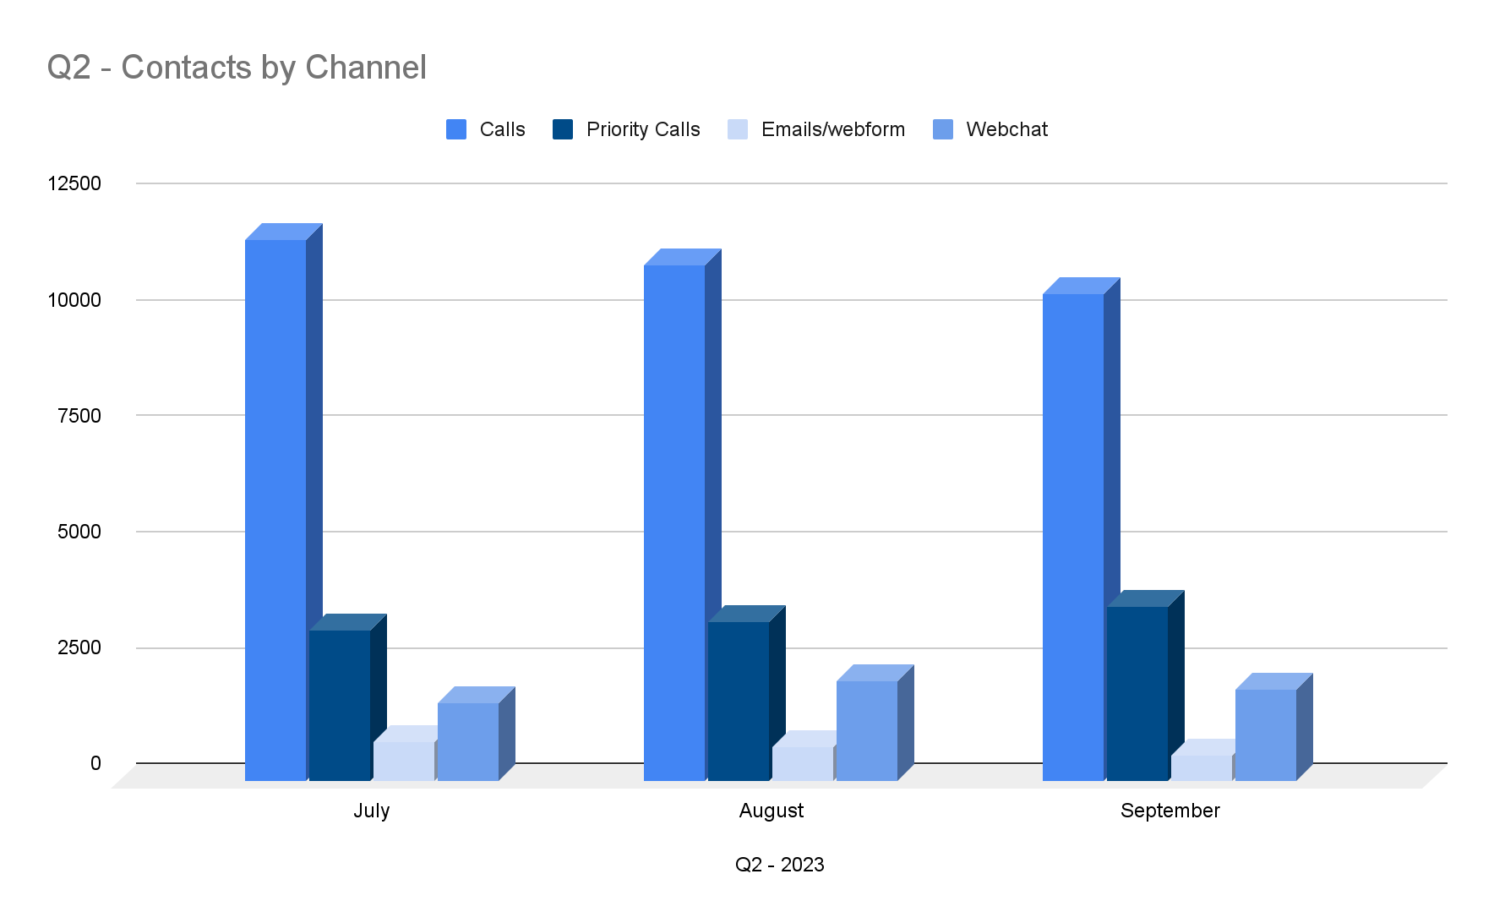
Q2 contacts answered by channel

Slide 10
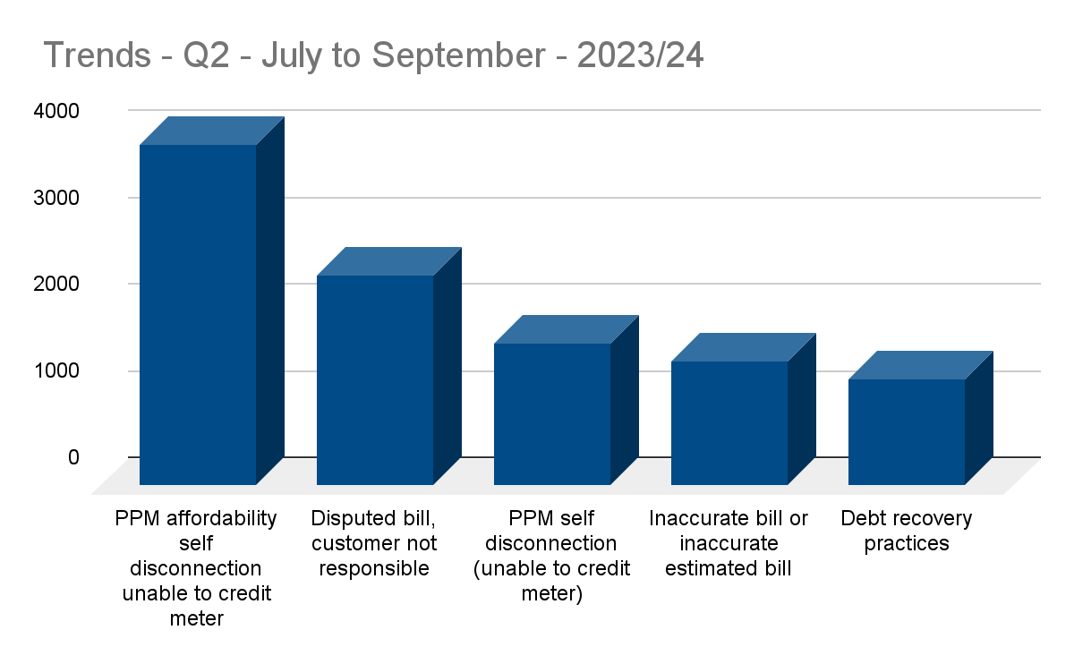
Trends Q2 2023/24

Slide 11
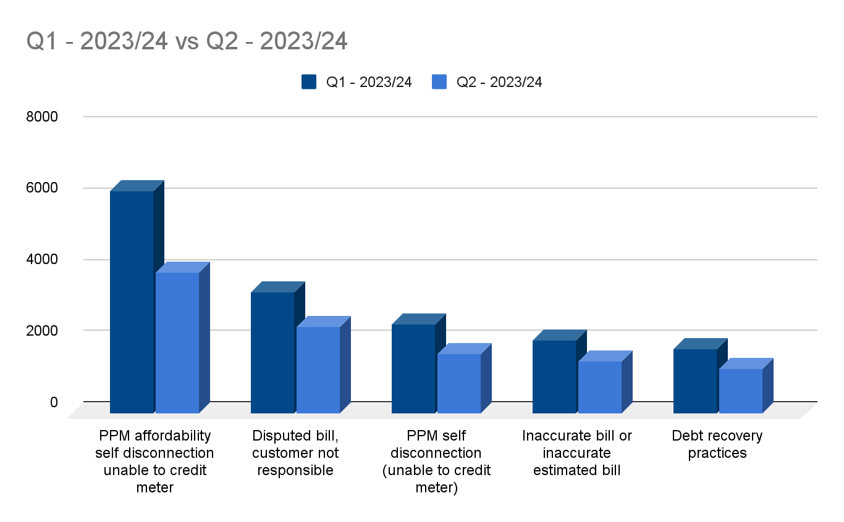
Trends Q1 vs Q2 2023/24

Slide 12
Q2 Trends split by nation
England |  | Wales
PPM affordability self disconnection unable to credit meter | 3679 | PPM affordability self disconnection unable to credit meter | 217
Disputed bill, customer not responsible | 2276 | Disputed bill, customer not responsible | 107
PPM self disconnection (unable to credit meter) | 1545 | PPM self disconnection (unable to credit meter) | 91
Inaccurate bill or inaccurate estimated bill | 1354 | Debt recovery practices | 73
Debt recovery practices | 1124 | Inaccurate bill or inaccurate estimated bill | 71
Direct debit issues | 806 | Unable to credit PPM (faulty meter/payment device) | 52
Unable to credit PPM (faulty meter/payment device) | 736 | Direct debit issues | 44
Catch up bill received | 630 | Meter accuracy | 27
Meter accuracy | 504 | Catch up bill received | 26
Final account reconciliation | 500 | Domestic supply disconnected | 25

Slide 13
Signposted cases
Signposting agency | Apr-Sep 23 |  | Signposting agency | Apr-Sep 22
 | Signposts | % of cases |  | Signposts | % of cases
Other | 11996 | 14.8% | Other | 17255 | 25.5%
Energy Broker | 9689 | 12.0% | Financial Ombudsman Service | 9667 | 14.3%
Energy Ombudsman | 3562 | 4.4% | Energy Ombudsman | 4419 | 6.5%
Gas Safety Register | 2564 | 3.2% | Information Commissioner's Office | 2310 | 3.4%
Ofgem | 1933 | 2.4% | Ofgem | 1242 | 1.8%
Total Signposts (other organisations): 36,249
Signposts to English & Welsh LCAs inc Adviceline: 5,866
Signposts to Scottish LCAs: 113

Slide 14
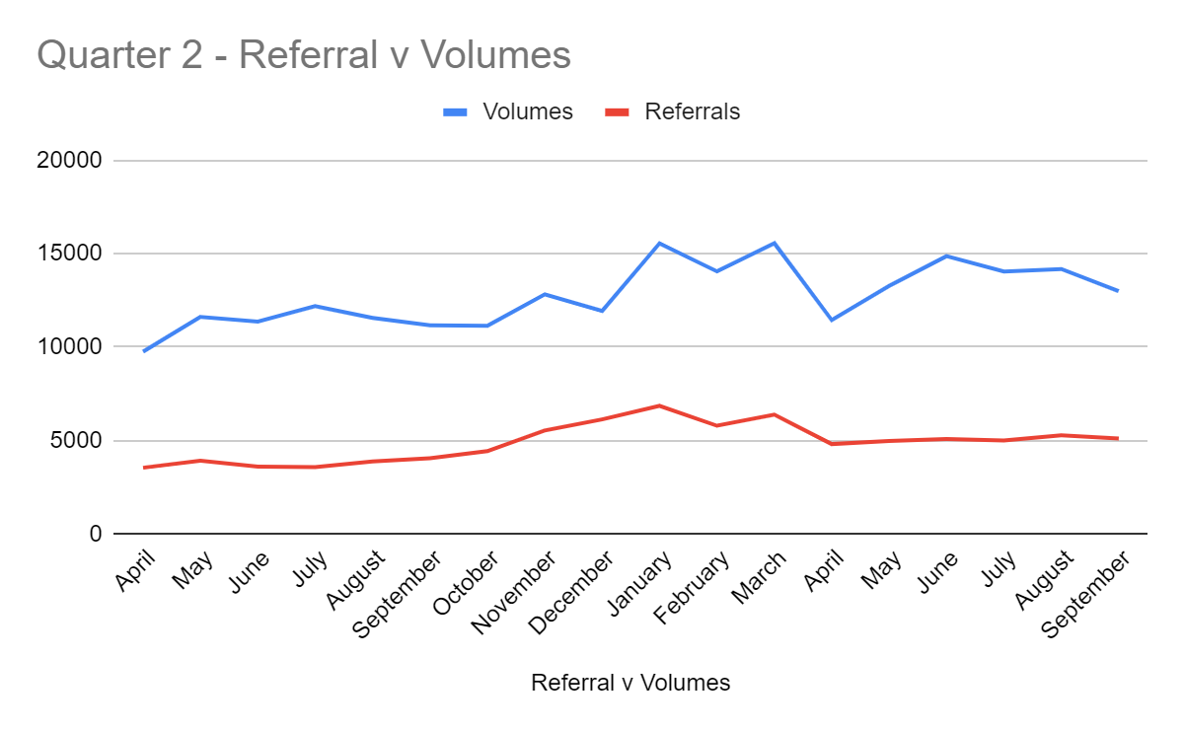
Referrals against volumes April 22 - September 23

Slide 15
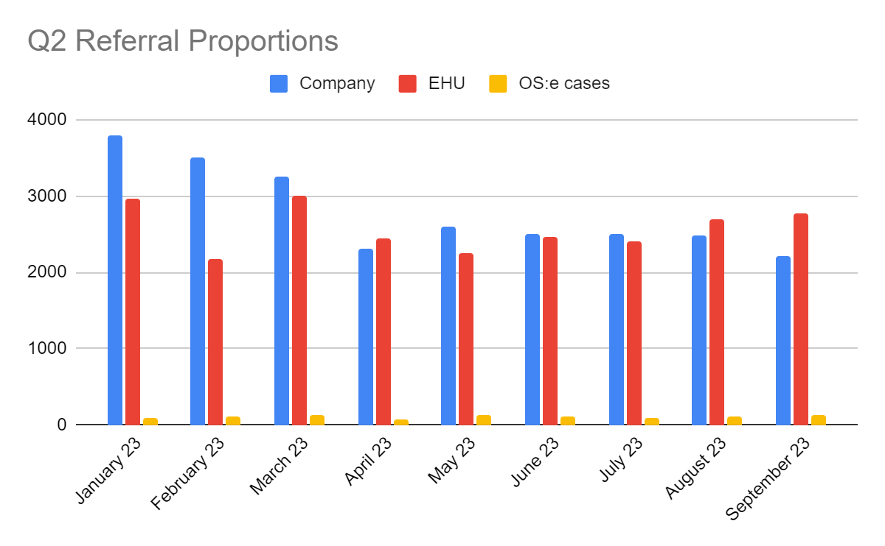
Referral proportions April 22 - September 23

Slide 16
Presented by: Leanne Dullard
Date: 22nd November 2023

Slide 17
Advice Direct Scotland
Domestic Supplier Liaison Quarter 2 2023
Hazel Knowles
Energy Project lead

Slide 18
Key Points from Quarter 2
Contact Volume
An overall drop from Q1 with numbers appearing to stabilize
23% increase from the Q2 2022
Priorities
Increase in self-disconnection cases as we move into winter.
Home Heating Support Fund
The Fund typically experiences a reduction in the number of applications over summer.
In Quarter 2 we received 4,086 applications. An increase of 47% from the previous year.
Quarter 3
We predict to see a rise in case numbers, and for self-disconnection and affordability cases to increase as we move into the colder weather

Slide 19
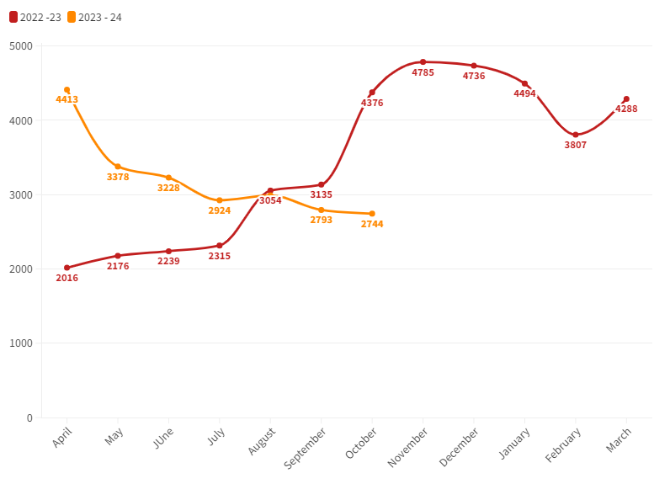
Volume by Month

Slide 20
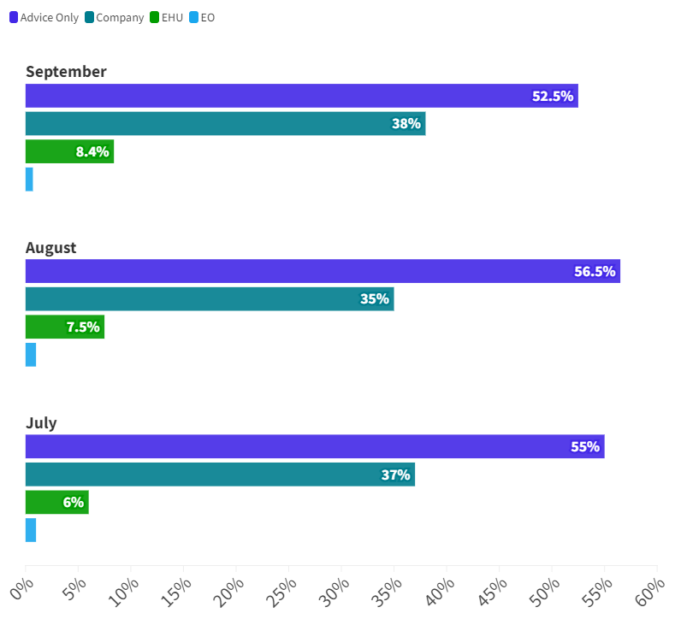
Referral Type

Slide 21
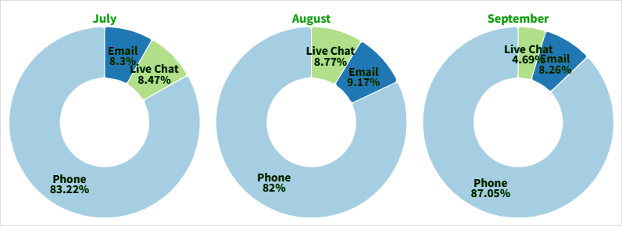
Contact Type

Slide 22
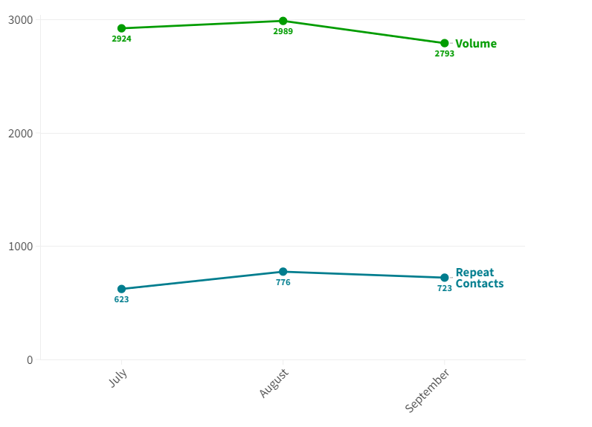
Repeat Contacts

Slide 23
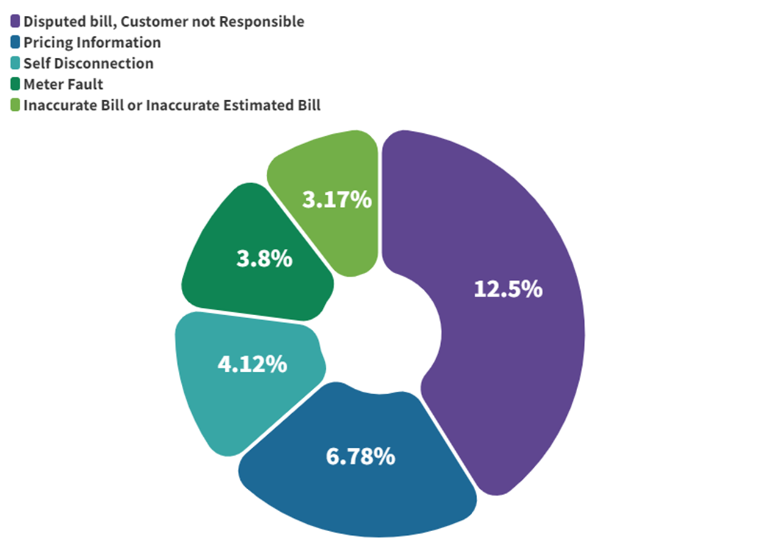
Top 5 Codes

Slide 24
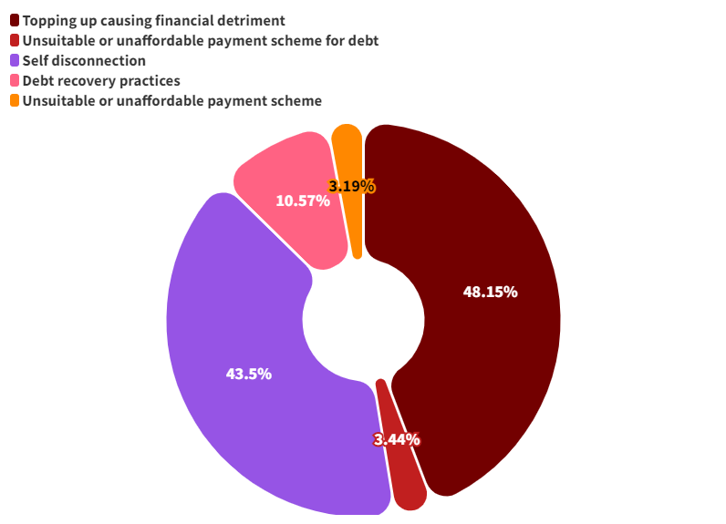
Top 5 Affordability Codes

Slide 25
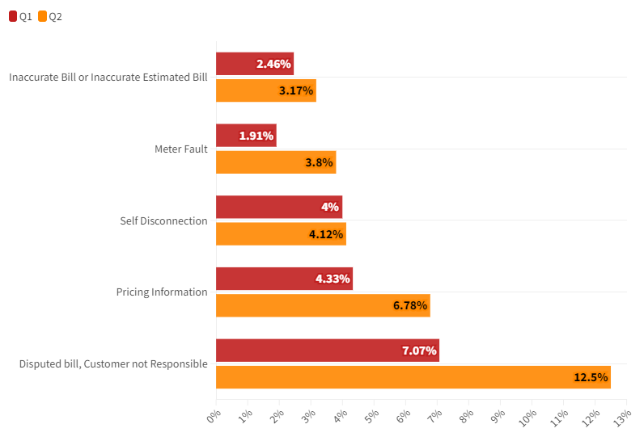
Code Breakdown Q1 vs Q2
Trends compared to previous years
Vs

Slide 26
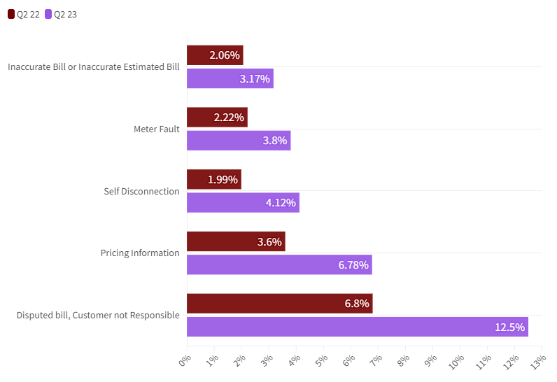
Code Breakdown Q2 22 vs Q2 23
Trends compared to previous years
Vs

Slide 27
Anita’s Story
Anita contacted us as she was concerned that she was being charged two standing charges. She had a complex two rate meter.
Our agent was able to explain regulation around standing charges for her meter and advise her options.
With this information she decided to request that her supplier switch her over to a single rate, rather than keep her two rates, she no longer had storage heaters so wasn’t benefiting from a heat rate. Our agent informed her that she doesn’t have to pay two standing charges if she is paying a standard rate.
Anita called us back to thank us for helping to explain the matter and get a quick solution, her bills have already come down and she is very relieved.

Slide 28
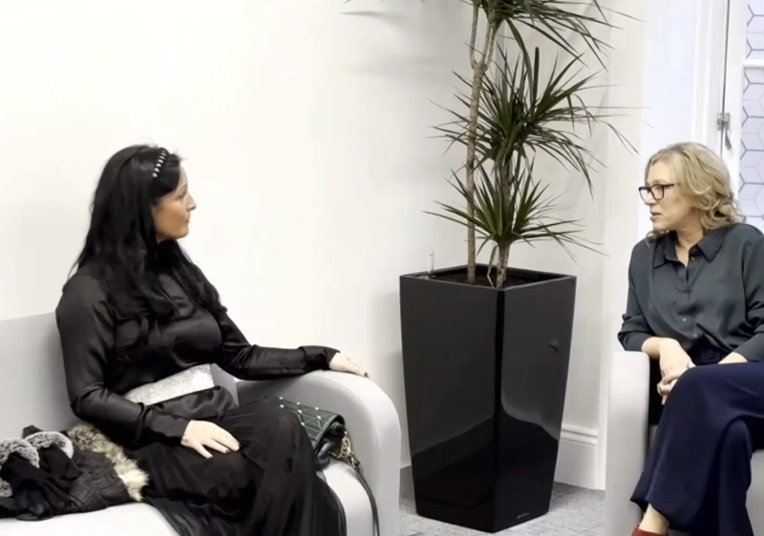
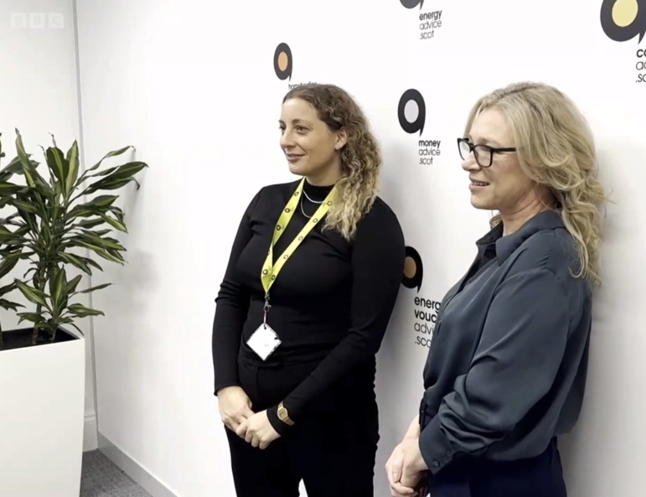
Social Tariffs
We were proud to welcome Scottish Energy Minister Gillian Martin to our offices last week to speak about her letter to the UK Government calling for a social tariff.
We also had some clients attend to meet the Minister and speak about their experiences with fuel poverty

Slide 29
Other Work
Working
with food banks
Fringe event with Energy Minister Gillian Martin
Looking at energy producers and other routes to provide support
Working with SCOPHRA and MECOPP to improve access to support for park home residents

Slide 30
Christmas Opening Hours
22nd | 23rd | 24th | 25th | 26th | 27th | 28th
9-5 | x | x | Closed | Closed | 9-5 | 9-5
29th | 30th | 31st | 1st | 2nd | 3rd
9-5 | x | x | Closed | Closed | 9-5

Slide 31
Supplier Liaison Update
22nd November 2023

Slide 32
CAS - Worried this winter campaign
Research from CAS indicates that energy bills are the biggest financial concern for 2.2 million people this winter.
The research is based on analysis of YouGov polling, and also estimates that over 1.4 million people are worried about being able to adequately heat their home this winter.
People can visit www.cas.org.uk/worried:
Online advice pages or interactive self-help tools like www.moneymap.scot
Specialist services like the Money Talk Team
Find their local CAB if they feel they need one to one advice
https://www.youtube.com/watch?v=rSjp-8zbOiI

Slide 33
Casework Volumes Q2 2022/23
96% of cases domestic
70% of complaints involve self disconnection

Slide 34
KPIs 23/24
Area | KPI 23/24 | Q2 23/24 | Q1-Q2 23/24
Responding to Complaints | 95% of priority complaints are raised with supplier within 48 hours of case being received | 93% | 92%
 | 90% of complex complaints raised with supplier within 20 days of case being received (from Q2) | 94% | 86%
Case Resolution Timescales | 75% of domestic priority complaints resolved within 28 days | 91% | 86%
 | 70% of domestic complaints resolved within 85 days | 89% | 84%
Positive Outcomes | 95% of domestic complaints resolved with a positive outcome/change | 95% | 95.5%
Quality Assurance | 90% of cases checked meet the required quality standards | 92% | 92%
Customer Satisfaction | 85% of Domestic consumers surveyed satisfied or very satisfied with overall quality of service 80% of domestic consumers surveyed satisfied with outcome achieved | 96% 89% | 95% 88%
Staff Morale | 75% of staff describing their current mental health and wellbeing as satisfactory 75% of staff reporting they have a good sense of achievement from the work they do | 80% 86%

Slide 35
Accent Customer Research
cases closed July to September 2023
Outcomes and measures Q2 23/24
96% satisfied or very satisfied with overall quality of service
91% happy with referral process
89% satisfied with outcome
85% felt EHU helped them find a way forward
62% felt their mental health and well being improved after support
82% felt less stressed after EHU support
Financial redress
£1,674,993
Answered 97% of calls 19435
Fuel Bank Foundation Partnership
127 Fuel Bank Vouchers
totalling over £3k
“It’s taken so much stress off of me. People should phone them because you are not on your own. They are willing to help and immediately made things better.
I am very grateful they exist. I am very thankful. They gave me all the help I needed."
Accent Report September 2023

Slide 36
Additional Support Project – Quarter 2 2023 Update
71 consumers supported
£17,045 in potential financial gain
Main themes:
28% benefits check, 27% difficulty making payment, 16% benefit advice claims process, 10% energy debt
Main outcomes:
32% benefit advice/income max and signposting to advice agency, 14% income max, 7% initial debt advice and supported signposting to advice agency
How can suppliers help further?
Make teams aware that the support workers may make further requests for help or information
More flexibility
Access to specialist support and winter initiatives etc
Additional Support cases:
Do not show on reporting or the portal
Excluded from the league table metrics

Slide 37
Referral Partners – across the nations

Slide 38
Operational challenges and development 23/24
7 Caseworkers in training and 3 starting in December
2 Lead Caseworkers
2 Quality Assurance Officers
Training – Data Protection/data requests, Managing Challenging phone calls and Supporting Bereaved consumer
EHU was awarded the BS 18477 in inclusive service provision for the second year running - identifying and responding to vulnerable consumers.
EHU was a finalist in the Helplines Partnership Awards Innovation and Future Proofing
Civ tech
Portal
New office premises

Slide 39
Referral trends Q2 2023/24
Category codes Q2 | Jul | Aug | Sep | Q2 Total | % of domestic cases
PPM self-disconnection (combined categories) | 1,808 | 2,041 | 2,388 | 6,237 | 73%
Unable to credit PPM (technical issues - combined) | 185 | 196 | 167 | 548 | 6%
Disputes bill, customer not responsible | 71 | 66 | 80 | 217 | 3%
Debt recovery practices | 80 | 62 | 67 | 209 | 2%
Inaccurate bill or inaccurate estimated bill | 72 | 56 | 62 | 190 | 2%
Meter provision or exchange | 26 | 33 | 38 | 97 | 1%
Supply point administration query (MPRN/MPR/MPAS) | 21 | 33 | 34 | 88 | 1%
Erroneous transfer | 30 | 26 | 32 | 88 | 1%
Catch up Bill Received | 29 | 34 | 21 | 84 | 1%
Unsuitable or unaffordable payment scheme to cover debt | 23 | 25 | 30 | 78 | 1%
0.3% of domestic cases related to reported concerns with involuntary changes to prepayment

Slide 40
Self-Disconnection – Guidance and impact on Casework
Clear direction provided in Ofgem's consultation on ASC bad debt:
"In practice, we consider that the risk and extent of serious detriment from self-disconnection should, in almost all circumstances, override the risk of increasing consumer debt when considering ASC provision for customers in vulnerable circumstances.”
Please note:
Given the high bar set suppliers should consider whether to persist with a prepayment meter if ongoing support needed;
Energy suppliers should provide clear and detailed explanation if ASC or other support is not to continue;
Suppliers should proactively consider whether winter initiatives can be used to support EHU consumers.

Slide 41
Complex self-disconnection case study
An 18 year old consumer was very recently bereaved following the sudden loss of her mother. Her electricity supplier had added a charge of nearly £5,000 onto the PPM for 3 years’ worth of unmetered usage saying the meter had been tampered with. She had no knowledge of these issues as her mother had always topped up the meter before.
Every time she topped up, 35% of the money was taken towards the debt and she was struggling with a very low Universal Credit income. She had dyslexia and was being supported by an advocacy worker. The supplier had proposed a reduced collection rate of 25% but this was still unaffordable. She was surviving on fuel vouchers, food bank parcels and a crisis grant that her support team put in place.
After EHU intervention the supplier agreed they should not have held her liable for the charges or any meter tampering that took place on her late mother’s account. The balance was withdrawn in full and £30 refunded for payments already taken towards the debt. An apology and goodwill gesture of £150 was also provided. Her advocacy worker said: "She wanted me to pass on a big thank you for all your help in assisting us both with this matter, and I echo this thanks – all your work is so appreciated and will hopefully make a real difference to her circumstances."

Slide 42
Focus on back billing
The Extra Help Unit has regularly been raising concerns about billing errors and the application of back billing reductions for many years.
Our concerns led to Ofgem sending an open letter to the industry in December 2020, as well as joint sessions with EUK, EO and Ofgem.
Growing concerns coming to light regarding back billing at several suppliers again:
Collection of data/use of data to avoid estimated readings
Concerns about calculation of back billing reductions not reflecting the spirit of the rules

Slide 43
The disputes process
No significant changes for an extended period – approximately 80% of cases outside of scope of current disputes process.
Aim to seek views on what changes could be considered, and then consult on a potential evolution of the disputes process.
Some key points:
Progression of disputes must never impact casework or communication with our clients
Must not drive negative supplier behaviours
Must not lead to grey areas which impact consistency
Must not be unduly onerous on the EHU or Suppliers in terms of resource or cost

Slide 44
Complaint handling and phone access
Increasingly since Covid led to many of us home working, email has become the primary means of communicating, even on priority cases, and this has benefitted us overall.
Growing concern though on some more complex cases that this is slowing case resolution in certain situations.
We therefore need to make sure arrangements are still in place for:
Speaking with a complaint's handler the same day (when working)
To speak to escalated contacts about especially urgent issues or about complex cases which aren’t progressing

Slide 45
Working Together
Resourcing and timescales over festive season
Last year volumes of priority complaints over festive season were very high at a time when all organisations had additional annual leave.
Please ensure that case loads for your company are up to date heading into this period.
Closed: 25th, 26th December; 1st and 2nd January.
Please consider resourcing for priority cases following periods of extended friendly credit.

Slide 46
Working Together
2nd January
Please remember that the EHU is closed on the 2nd January.
Any priority cases normally referred to Extra Help Unit will be directly referred to suppliers by the Consumer Service who are open.
Where a consumer is particularly vulnerable or has other less urgent issues requiring investigation they may still be referred to the EHU.
If the consumer calls back to say they did not get the assistance required a referral will also be made to the Extra Help Unit.
The EHU will call consumers referred to the EHU on the 2nd of January on the 3rd of January to confirm whether a case needs to be opened or not. Where the matter is resolved the case will be closed as an enquiry no action, and therefore not included in league table data.

Slide 47
Questions?

Slide 48
Break 10.55am – 11.05am

Slide 49
ECO4 funding and how suppliers target consumers to meet obligations
Supplier lightening talk

Slide 50
ECO4 / GBIS
Government Obligations
Customer Business
22/11/2023

Slide 51
Energy Company Obligation (ECO) ECO4 1st Apr 2022 – 31st Mar 2026
Government Obligations
Support the most vulnerable households in the least efficient homes
Households in or at risk of fuel poverty
In receipt of an eligible means tested benefit
At risk of living in a cold home (Flex)
EPC Band of D-G
£4Bn budget across energy sector
Support circa 450k homes
Solid Wall Minimum Requirement 90k homes
Cap on replacement of gas heating systems (5k pa)
Inefficient boiler replacement / FTCH / Renewable heating uncapped
Alignment with PAS2035: 2019
Work carried out to PAS2030 / MCS
Trustmark accredited supply chain
Primary measures: Wall, roof, floor insulation
Funding for fabric first,
whole house retrofit
Improve energy performance on households by 2 x EPC bands
F&G - D
D&E - C

Slide 52
Great British Insulation Scheme (GBIS) ECO4 Apr 2023 – Mar 2026
Government Obligations
Designed as a single measure scheme
Focus on installing cost-effective measures in as many homes as possible
£1Bn budget across energy sector
ECO4 qualification criteria
In receipt of an eligible means tested benefit / identified as vulnerable to fuel poverty
20% of obligation (minimum)
EPC Band D-G
Council Tax Band A-E (Scotland)
Contributions
GBIS / ECO+
Low-Income Group
General Group

Slide 53
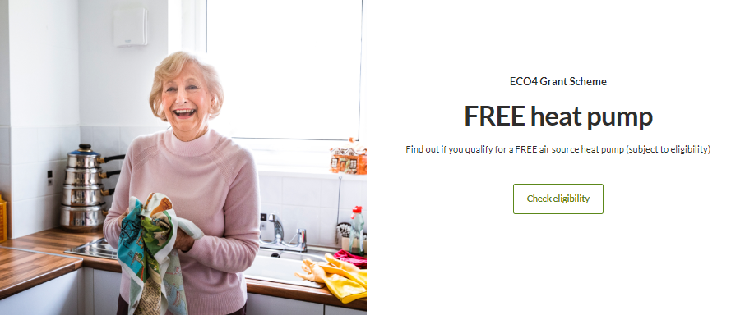
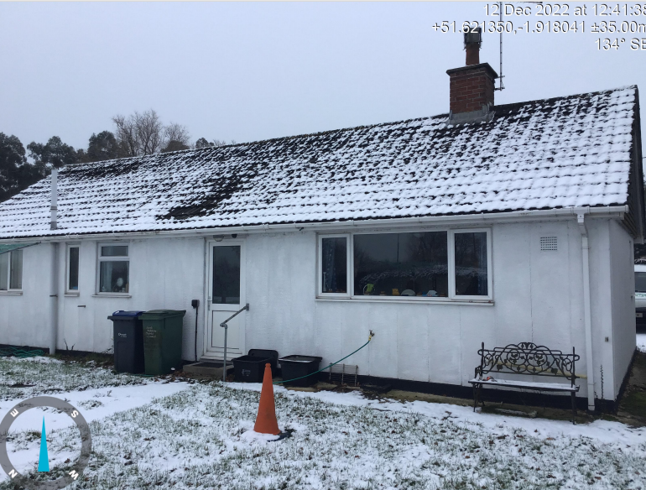
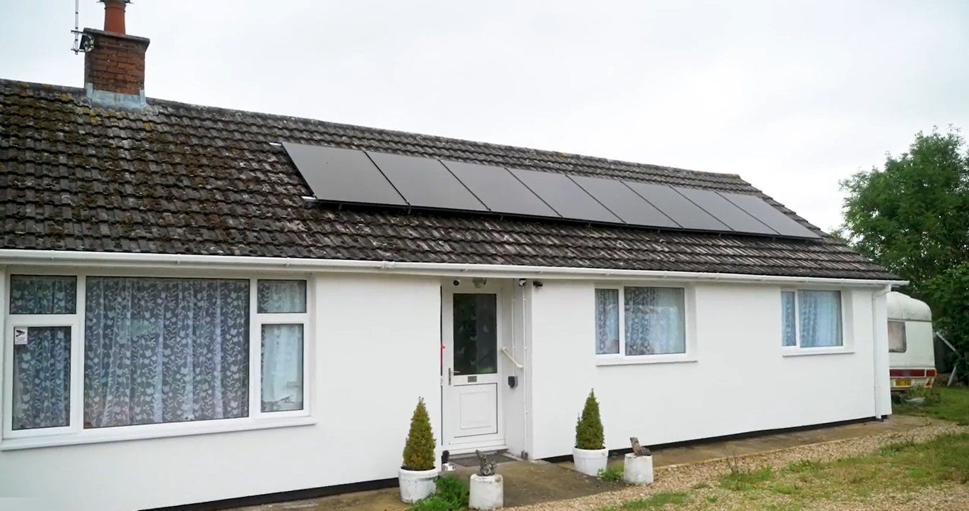
Government Obligations
Helping Customers with ECO4
Customer case study
Customer can check their eligibility on our website
Before
Energy Efficiency Rating - F
After
Energy Efficiency Rating - C
Background
ScottishPower has a requirement under the Energy Company Obligation (ECO) and the Great British insulation scheme to deliver energy efficiency measures to the most vulnerable domestic households in the least efficient properties.
We also have an ambition to grow the number of heat pumps being installed in the UK (where recommended), making the transition to low carbon heating more accessible, affordable and fair
Action Taken
We have developed a unique proposition combining our ECO4 and our Great British Insulation Scheme (GBIS) offering energy efficiency measures.
The measures installed under our programmes are making truly life-changing impacts to these households.
Building relationships with Health Care professionals in various NHS areas
Fabric Improvements
Result
In 2023 we have supported the installation of in excess of 12,000 measures in 4,000 homes
Installed over 1,500 heat pumps under the ECO4 scheme.
Generating leads for ECO & GBIS:
Live eligibility checker on the front page of the scottishpower.co.uk website.
Sales channels activated and Newsletter campaigns created to drive volume through existing and new ScottishPower energy supply customers
Targeted email campaigns and outbound calling to specific groups such as Warm Home Discount recipients, geographical area-based projects and customers who meet the Supplier flex qualification criteria.
Building a sustainable and scale able programme to support customers with health issues impacted by a cold home
350mm External Wall Insulation
Heating Improvements
8kW Air Source Heat Pump
1.7kWp Solar PV system
Smart Thermostat
Thermostatic Radiator Valves
Case Study:
Charles' Story

Slide 54
ECO4 – process
What do we need to know to make a referral?
Customer details
Contact information
Household qualification criteria
Property tenure
Owner occupier – PRS –SHP
House type
No. bedrooms
Main heating source
Heating type
Make a referral
What will happen once a referral is submitted?
The referral will be allocated to a delivery partner
The partner will make contact with the customer within 10 working days
The partner will arrange to carry out an assessment on the customer’s home
Qualified assessor will visit to determine all the measures that are suitable for the home and if it is possible to improve it in line with scheme requirements
Any plan developed will be discussed and agreed with the homeowner ahead of any installation
The more measures that can be carried out the longer the installation will take and measures may cause some disruption while being fitted
Any installation of measures will be subject to this assessment
What will happen after measures are installed?
All measures have to be installed to industry standards, whether insulation or heating, so customers should be confident in the work being undertaken
If the customer wants more information on standards, their assessor or installer will be able to provide this
The measures fitted will contribute to keeping the home more comfortable, warmer in winter and more efficient to heat

Slide 56
Energy Ombudsman
Domestic Supplier Liaison Meeting
November 2023

Slide 57
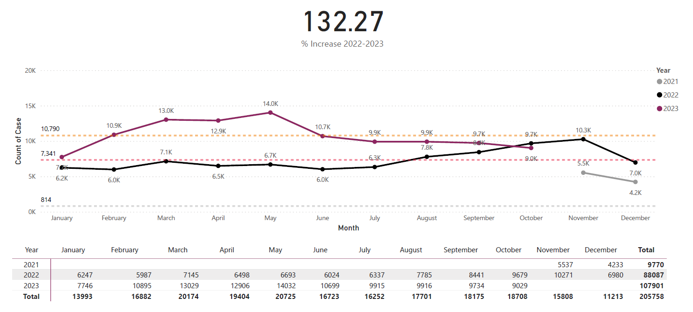
Industry Case Volumes

Slide 58
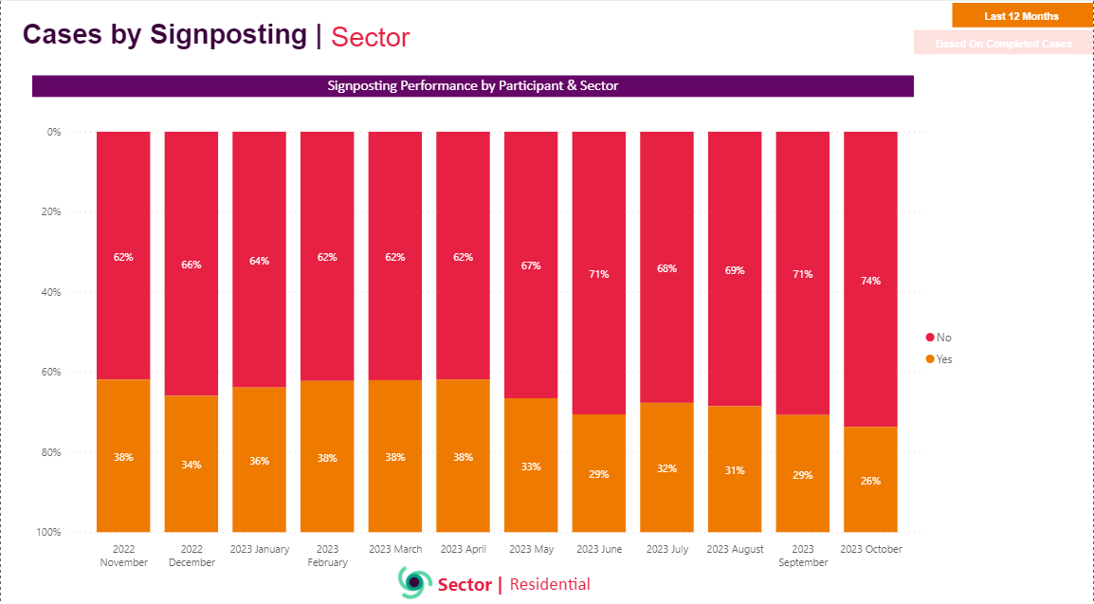
Sector Signposting YTD

Slide 59
Overdue Decisions

Slide 60
Energy Ombudsman – Summary
Reduced Case Volume
Overdue Remedies / Check Resolution
Increased headcount – Preparation for Christmas
Christmas Opening
Supplier Liaison Panel – New Year plans

Slide 62
Consumer Scotland - Policy Update Supplier Liaison Meeting 22 November 2023

Slide 63
Who we are
Consumer Scotland is a Non-Ministerial Office, created by the Consumer Scotland Act 2020, and accountable to the Scottish Parliament. Our role is to advocate for consumers in Scotland and we have statutory functions in relation to energy
Our purpose is to improve outcomes for current and future consumers, including individual consumers and small businesses. We work across the public, private and third sectors and have a particular focus on three consumer challenges:
Affordability
Climate change mitigation and adaptation
Consumers in vulnerable circumstances

Slide 64
Workstreams: 2023-2024
Affordability
Energy Affordability Tracker, recurring inc. Consumer Spotlight on Energy 3
Better targeted support, inc. facilitated sessions; Health, Disability and the Energy Crisis report
Retail
Responding to key developments, inc. Involuntary PPM; Consumer Standards; winter support
Ongoing engagement, inc. DESNZ quadrilateral; Ofgem consumer groups and charities
Infrastructure and non-retail markets
Review of Electricity Market Arrangements; RTS phaseout and local flexibility markets; RIIO-GD3
Internal working groups
Energy Consumers Network; publication of Scottish Energy Insights and Coordination Group report

Slide 65
Tracker: Headlines from the Autumn wave
For the Autumn wave of our Energy Affordability Tracker, YouGov surveyed 1,500 households in Scotland during October 2023. The headline findings include that:
30% of households are finding it difficult to keep up with energy bills
43% of respondents are finding it more difficult to keep up with their energy bills now compared to this time last year, with only 13% reporting finding it easier
Almost a quarter (23%) have borrowed money or missed rent payments to pay energy bills, over the six months from April to October
Eight percent report being in energy debt or arrears
The tracker continues to show that disabled households, those on the lowest incomes, those without access to mains gas, and PPM users, are amongst the groups which are most likely to report struggling with energy costs

Slide 66
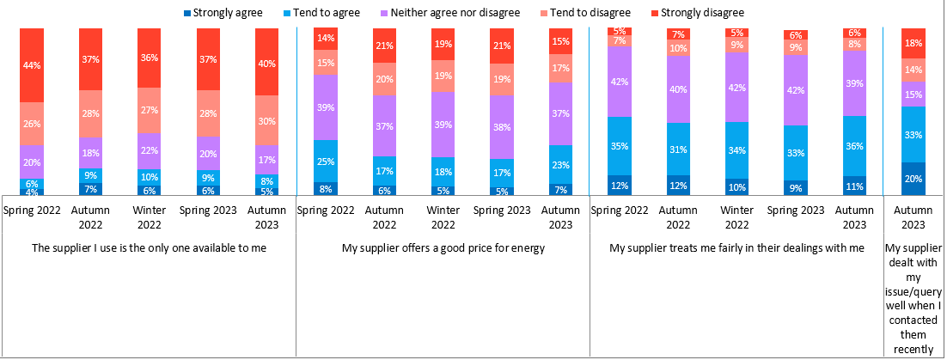
Three in ten agree their supplier offers a good price for energy and nearly half say their supplier treats them fairly, marking an increase in both compared to Spring 2023.
Agreement statements about energy suppliers
SER1. When thinking of your energy supplier, how much do you agree or disagree with the following statements? Base: All (Spring 2022 n=2,012; Autumn 2022 n=1,586; Winter 2022 n=1,621; Spring 2023 n=1,579, Autumn n=1589 and those who contacted their supplier n=492)

Slide 67
Over half report the language in their energy bills is easy to understand and their supplier makes it easy for them to get in contact if they need to, the latter increasing since Spring 2023.
Agreement statements about energy suppliers
SER1. When thinking of your energy supplier, how much do you agree or disagree with the following statements? Base: All (Spring 2022 n=2,012; Autumn 2022 n=1,586; Winter 2022 n=1,621; Spring 2023 n=1,579, Autumn 2023 n=1,589)

Slide 68
Workplanning: 2024-25
Our workplanning process for 2024-2025 is now underway. Consumer Scotland will consult on its draft workplan in early 2024. Your input would help inform this process and would be greatly welcomed. In energy, our work will consist of both continuing workstreams and new areas of focus, including:
Retail – inc. developing our understanding on the future of retail
Affordability – ongoing internal analysis and building on work undertaken in 2023-2024 with disabled people’s organisations
Heat networks – preparing for regulation in the sector
Infrastructure and non-retail markets – considering how market reform, innovation, and improved whole system co-ordination and planning could maximise the benefits of the transition for consumers in Scotland
Low-carbon technologies – research into consumer attitudes

Slide 69
Thank you Contact: michael.obrien@consumer.scot

Slide 70
Energy Team Update
Supplier Liaison Meeting
22nd November 2023

Slide 71
Contents
Publications, blogs and consultation responses
Team updates
Energy Retail Markets
Net Zero Homes
Energy Network and Systems
Notes:
71

Slide 72
Recent publications
Heat GB: Calculating the network costs for low carbon heating
Balancing Act: The implications of transferring policy levies from electricity to gas bills
Citizens Advice joint letter to Secretary of State for Energy Security and Net Zero on heat pump adoption
Notes:
72

Slide 73
Recent Blogs
Small businesses fearful for the future as debt crisis mount
The rising tide of energy debt
Are you in energy debt? Speak, seek, save
Who wants energy efficiency measures?
Why decisions on heat could cut the cost of net zero
Why delaying action on net zero will cost consumers
The crisis isn’t getting better — and for housing it’s getting worse
New house, new energy bills
Don’t let bill sharing heat up

Slide 74
Consultation Responses
We have responded to the DESNZ and Ofgem consultation on heat networks regulation (consumer protection), Ofgem’s consultation on its approach to reviewing the wholesale costs allowed for in the price cap and Citizens Advice response to the DESNZ consultation on proposed amendments to the Boiler Upgrade Scheme.
We have also responded to the DESNZ consultation on introducing fixed price certificates into Renewables Obligation, Ofgem's call for input on engaging domestic consumers in energy flexibility and to the Ofgem call for input on the impact of high inflation on the network price control operation.
We have responded to the Ofgem consultation on levelling the cost of standing charges on prepayment meters, and published Towards a more innovative energy retail market: call for evidence.

Slide 75
Consultation Responses
We have responded to Ofgem’s Non-Domestic Market Review: findings and policy consultation, the Environment and Climate Change Committee’s inquiry into electric vehicles, and Ofgem’s Call For Input on the development of a competition framework for the domestic retail market.

Slide 76
Energy Retail Markets Team: updates
Current policy/advocacy work
We will be undertaking enhanced monitoring on forced PPM installations until Spring 2024, reviewing all cases on a weekly basis.
We responded to the Autumn Statement and to Ofgem’s debt announcement, calling for additional support with energy bills.
Responded to consultations on innovation in the retail market (DESNZ) and the development of a competition framework (Ofgem)
The final installment in our Unequal Crisis blog series has been published, looking at the challenges faced by Gypsy, Roma, and Traveller communities and their exposure to fuel poverty.

Slide 77
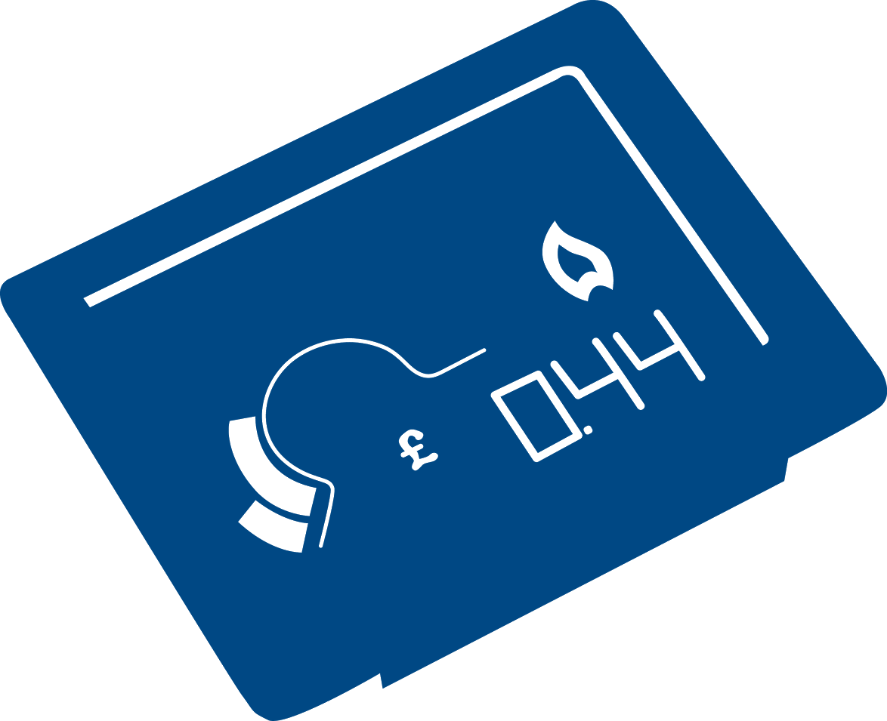
Net Zero Homes: updates
Current policy/advocacy work
Published a joint letter to the SoS as an outcome of our roundtables discussing the necessary actions required to increase demand for heat pumps and energy efficiency measures.
Responded to consultations on the Boiler Upgrade Scheme (DESNZ) and the regulation of heat networks (DESNZ and Ofgem).
Responded to Ofgem’s call for input on engaging domestic consumers in energy flexibility.
Provided written evidence to the Environment and Climate Change Select Committee’s inquiry into electric vehicles.
Coming soon
Blogs on the consumer experience of electric heating, spray foam insulation and inclusive innovation for energy flexibility.
Research on consumer protections for net zero changes (December)

Slide 78
Energy Networks & Systems Team: updates
Current policy/advocacy work
We published research into the network costs arising from various heat decarbonisation options, that concluded maintaining full consumer choice was prohibitively expensive.
Responded to Ofgem consultations regarding the retail price cap and the impact of inflation on network price controls.
Co-facilitated the DESNZ end-user forum regarding the Review of Electricity Market Arrangements
Coming soon
Research into ensuring Community Benefits for hosting energy infrastructure represent good value for money for consumers generally

Slide 79
AOB

Slide 80
Thank you

