Slide 1
Domestic supplier liaison meeting
24 May 2023

Slide 2
Agenda
Time | Agenda item | Lead
9.30 – 9.40 | Introduction Actions from last meeting | Natasha Gilmour Suzi Cassie, EHU Citizens Advice Scotland
9.40 – 10am | Consumer Service Operations update | Leanne Dullard, Citizens Advice
10am – 10.15 | Advice Direct Scotland Operations update | Hazel Knowles, Advice Direct Scotland
10.15 – 10.55 | Extra Help Unit Operations update CivTech Challenge update Portal development update Update on impact of alternative self-disconnection process Trends & considerations relating to the new Ofgem code of practice | Natasha Gilmour Angus McMillan George Holmes, EHU Citizens Advice Scotland

Slide 3
Time | Agenda item | Lead
10.55 – 11.05 | BREAK
11.05 – 11.25 | Supplier Spotlight Discussion on the impact of the introduction of the Involuntary PPM - Supplier Code of Practice | Led By Angus McMillan, EHU Citizens Advice Scotland
11.25 – 11.35 | Citizens Advice Scotland Update from Impact - Social Justice team | David Hilferty, Citizens Advice Scotland
11.35 – 11.50 | Citizens Advice Energy Policy Team Energy policy update | Zoe Guijarro, Citizens Advice
11.50 – 12noon | AOB & Close | Natasha Gilmour, EHU Citizens Advice Scotland

Slide 4
Actions from last meeting

Slide 5

Domestic Supplier Liaison
May 2023
Citizens Advice and The Extra Help Unit

Slide 6
Consumer service systems project - 2024 - 1 / 2
We’ve undertaken a review of systems for the consumer service and taken into account an number of factors in what the future could look like
  Procurement
  Value for money
  Internal technology policy
  Data security
  Future proofing our service and systems
Having balanced all these factors up we’ve decided to replace the current CMS and data warehouse/reporting functions of our systems with our own internal Casebook product
This decision is not a reflection of the current provider or their services

Slide 7
Consumer service systems project - 2024 - 2 / 2
The project is underway and is being co-run by the Operational team and our internal Product team
DBT are aware and supporting
We are still working to understand how this will directly impact the current ways of working but our intention is to maintain the current workings of the service in relation to how data and referrals are shared with partners
We will update on this project in these meetings and additionally when necessary moving forward

Slide 8
Referral Partner audit 2023
In the last meeting we discussed a joint project with the Citizens Advice Policy Team began to review all referral contact details with suppliers
The project to update key referral information for suppliers has now been completed
The result of which meant we updated over 50 supplier referral pathways, either updating details for the RAST, referral emails or removing them completely
Thank you for your participation and please contact us if you wish to check or update any of your information

Slide 9
Challenging client behaviour
Over the last few years we have seen a rise in challenging behaviour exhibited by clients. This can vary from challenging conversations to abusive comments or threatening language
This has an impact on adviser well being and also adds impact to management time in investigating incidents
We have rolled out some measures including a ladder of escalation as tp how to treat these incidents in the same way each time and a “be kind” message on our IVR
We suspect all our partners across the landscape experience similar things and we’d like to open up a conversation about best practice
Would there be appetite for a break out session on this next time or any lightning talks about how your organisation handles this?

Slide 10
Performance and Operations
Key points from 2022/23 are:
Demand for the year increased by 50% compared to 2021/22 and far outstrips any other year that the service has been operating
Priority call demand saw a 197% increase over the course of the year, with Q3 and Q4 seeing the highest volumes received
Client Satisfaction remained above KPI at 82%
Overall quality for the service was achieved across the year

Slide 11
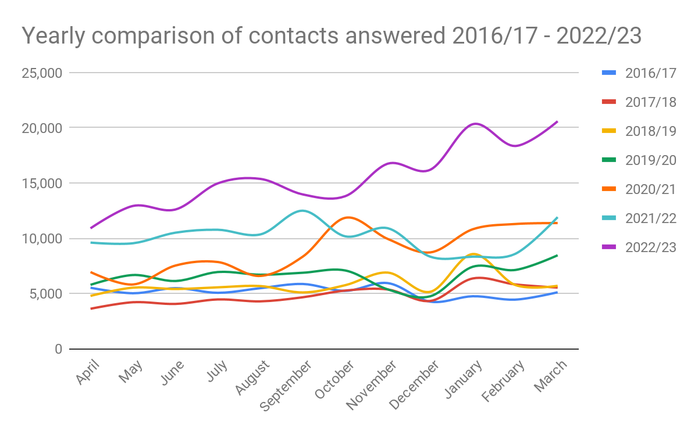
Contact volumes comparison 2016/17 to 2022/23

Slide 12
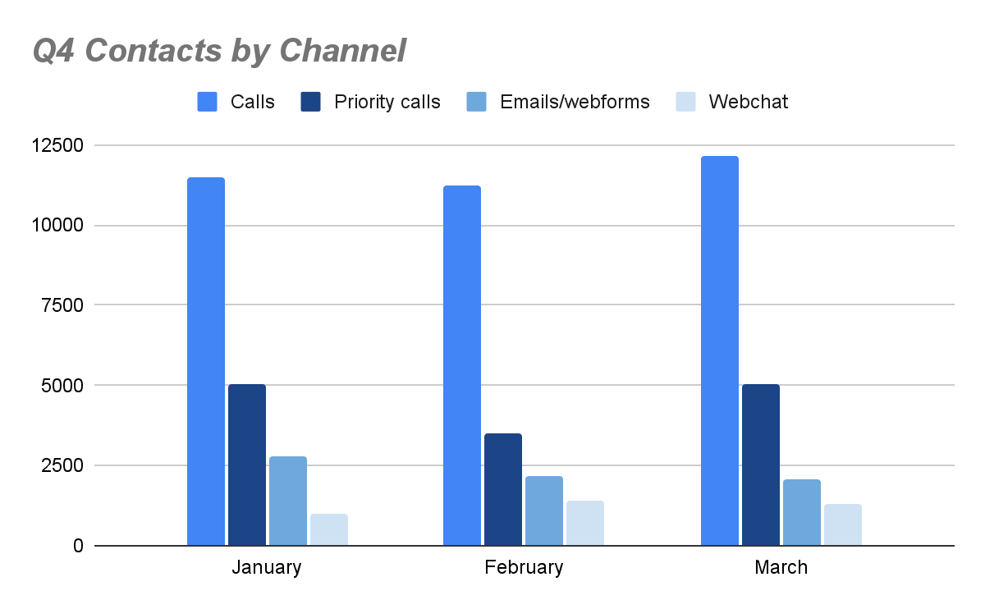
Q4 contacts by channel

Slide 13
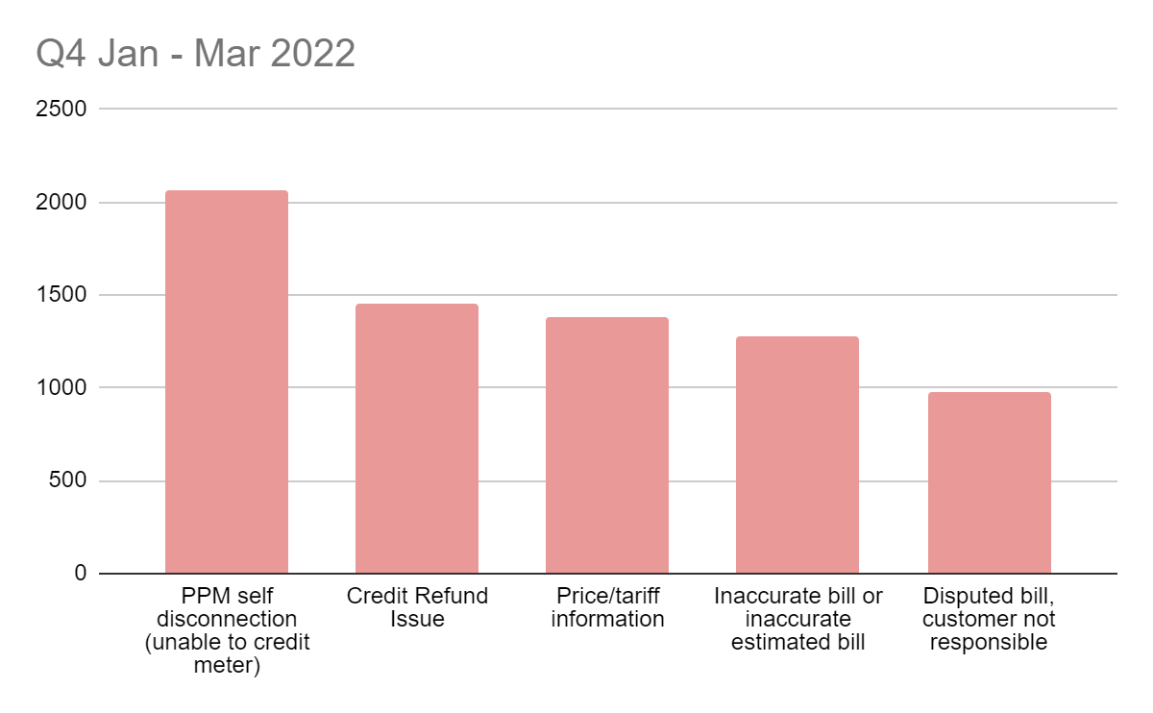
Trends - Q4 2022

Slide 14
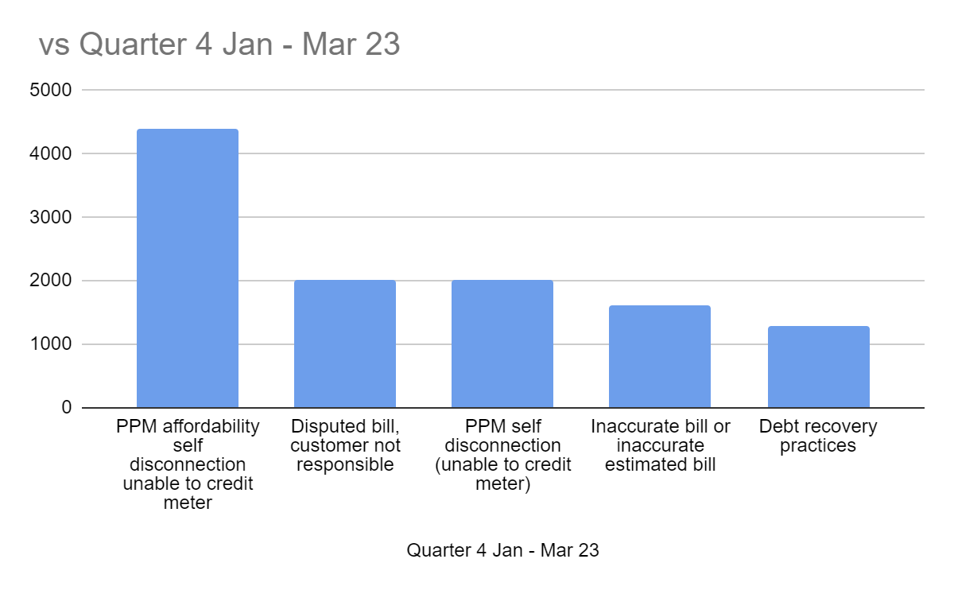
Trends Q4 2023

Slide 15
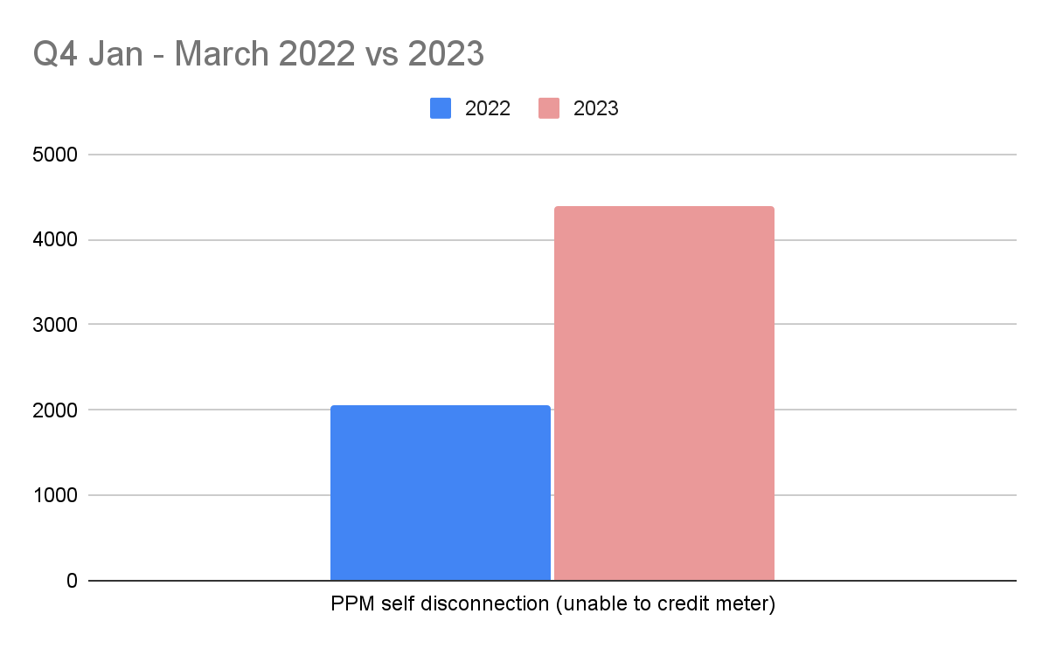
Trends

Slide 16
Q4 Trends split by nation
England |  | Wales
PPM affordability self disconnection unable to credit meter | 4085 | PPM affordability self disconnection unable to credit meter | 309
Disputed bill, customer not responsible | 1921 | PPM self disconnection (unable to credit meter) | 115
PPM self disconnection (unable to credit meter) | 1901 | Disputed bill, customer not responsible | 96
Inaccurate bill or inaccurate estimated bill | 1546 | Inaccurate bill or inaccurate estimated bill | 69
Debt recovery practices | 1217 | Debt recovery practices | 64
Voucher not received | 1041 | Unable to credit PPM (faulty meter/payment device) | 63
Pricing information | 855 | Voucher not received | 56
PPM affordability: topping up causing financial detriment | 838 | PPM affordability: topping up causing financial detriment | 54
Unable to credit PPM (faulty meter/payment device) | 805 | Warm Home Discount | 46
Meter accuracy | 779 | Meter provision or exchange | 45

Slide 17
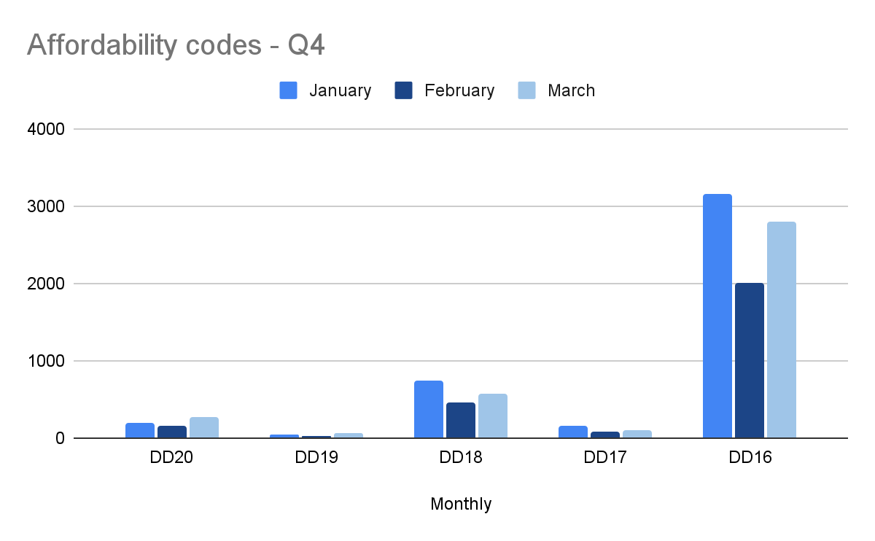
Q4 affordability trends
DD20
Credit meter affordability: direct debit or next bank transfer payment to cause financial detriment
DD19
Credit meter affordability: missed direct debit or bank transfer payment
DD18
PPM affordability: topping up causing financial detriment
DD17
PPM affordability: self-disconnection (unable to credit meter) - failed supplier
DD16
PPM affordability self disconnection unable to credit meter

Slide 18
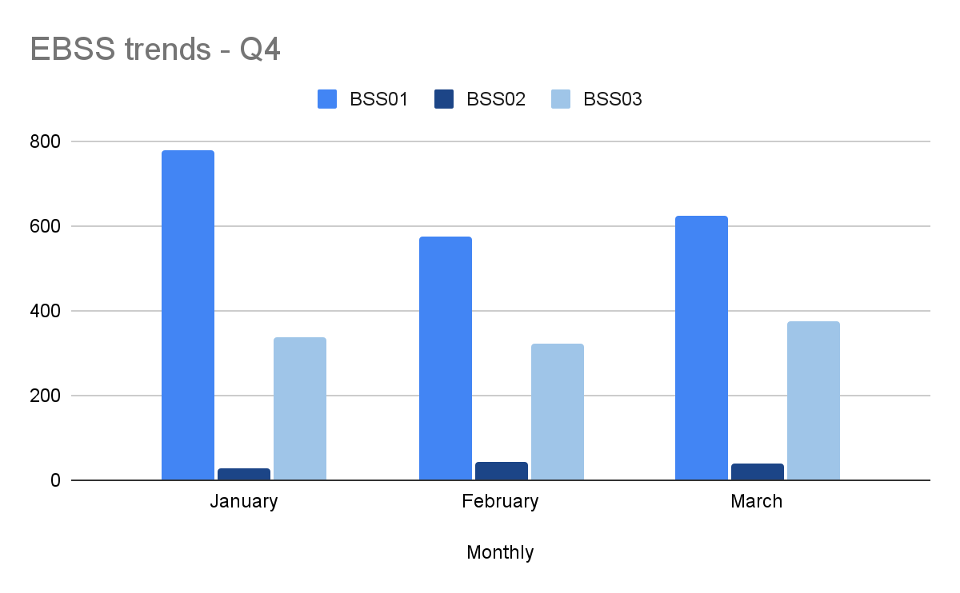
Q4 new EBSS codes
BSS01 - Voucher not received
BSS02 - Problem topping up at paypoint/Post Office
BSS03 - Other

Slide 19
Google analytics - energy pages
Top 10 energy website pages | Q4 2022/23 | Q4 2021/22 | % difference
Grants and benefits to help you pay your energy bills | 280,081 | 230,957 | +21.26%
How to read your smart electricity meter | 75,497 | 133,538 | -43.46%
How to read your energy meter | 66,410 | 103,445 | -35.80%
How to read your smart gas meter | 56,668 | 103,145 | -45.05%
You can’t afford to top up your prepayment meter | 50,349 | 58,971 | -17.12%
Find out if your energy meter is faulty | 44,577 | 37,583 | +18.60%
Energy bill too high | 38,477 | 41,161 | -6.52%
Find out who your gas or electricity supplier is | 34,726 | 32,839 | +5.74%
Getting a smart meter installed | 33,578 | 21,105 | +59.09%
Struggling to pay your energy bills | 32,486 | 44,274 | -26.62%
Total energy page views Q4 22/23 | 3,490,096

Slide 20
Signposted cases for Q4
Signposted to | Total signposts
Citizens Advice local office | 7,329
Energy ombudsman | 701
National Debtline | 277
Ofgem | 275
Shelter | 217
ConsumerLine | 136
Signposted to | Total signposts
Information Commissioner's Office | 93
Law Society | 63
Citizens Advice Scotland | 60
Consumer council for water | 15
Age Concern | 8
Other / blank | 54,831
Total signposts for Q4 - 64,005

Slide 21
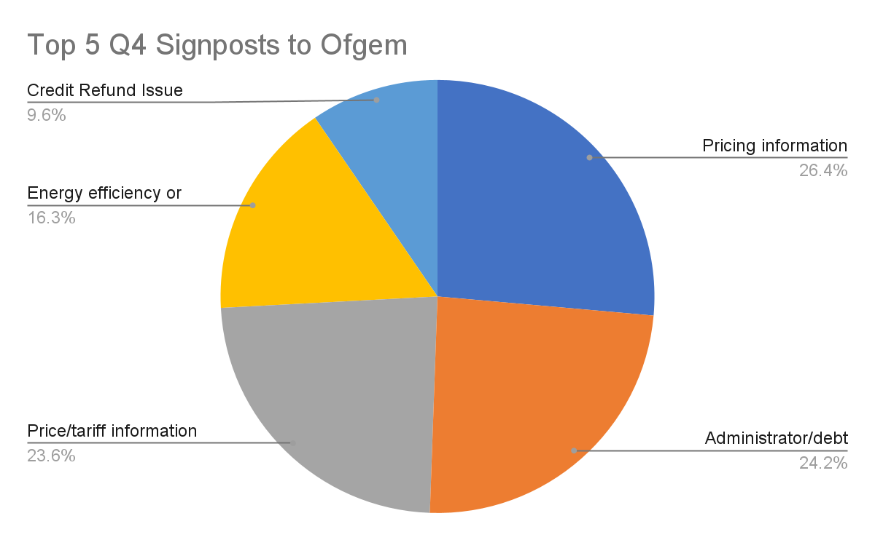
Signposted to Ofgem
Top 5 Issues | Count
Pricing information | 47
Administrator/debt issue | 43
Price/tariff information | 42
Energy efficiency or renewables advice | 29
Credit Refund Issue | 17

Slide 22
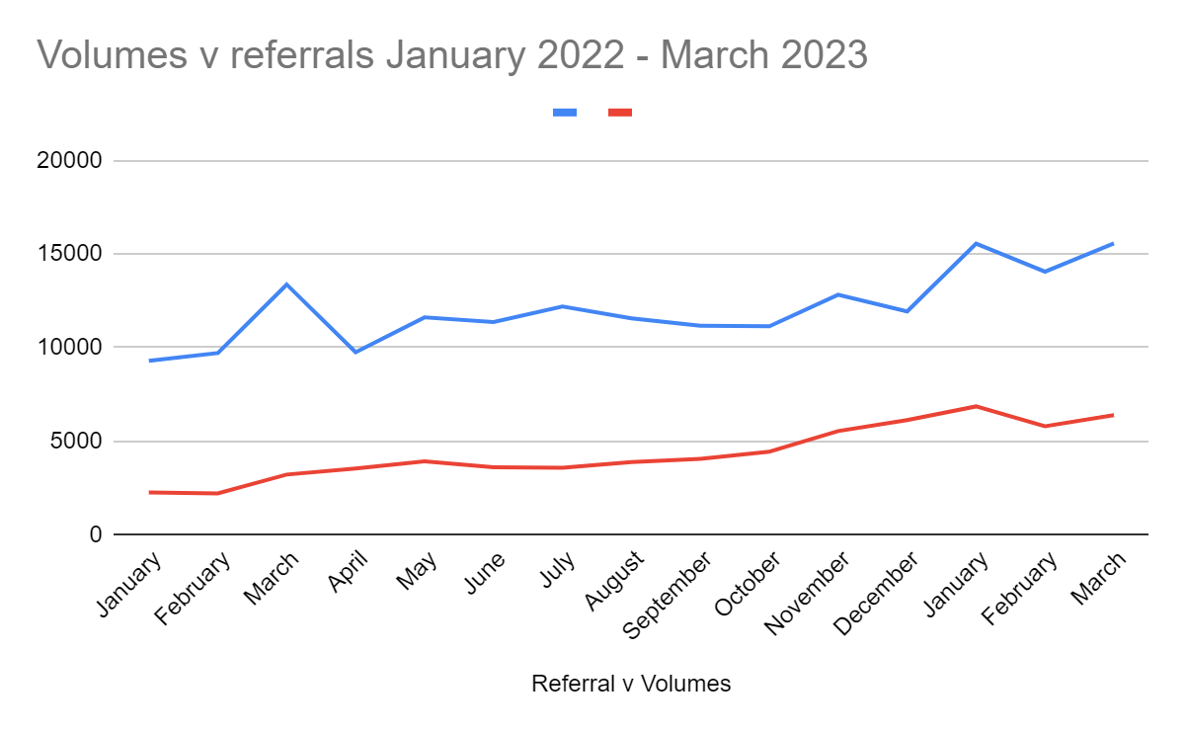
Referrals against volumes January 22 - March 23

Slide 23
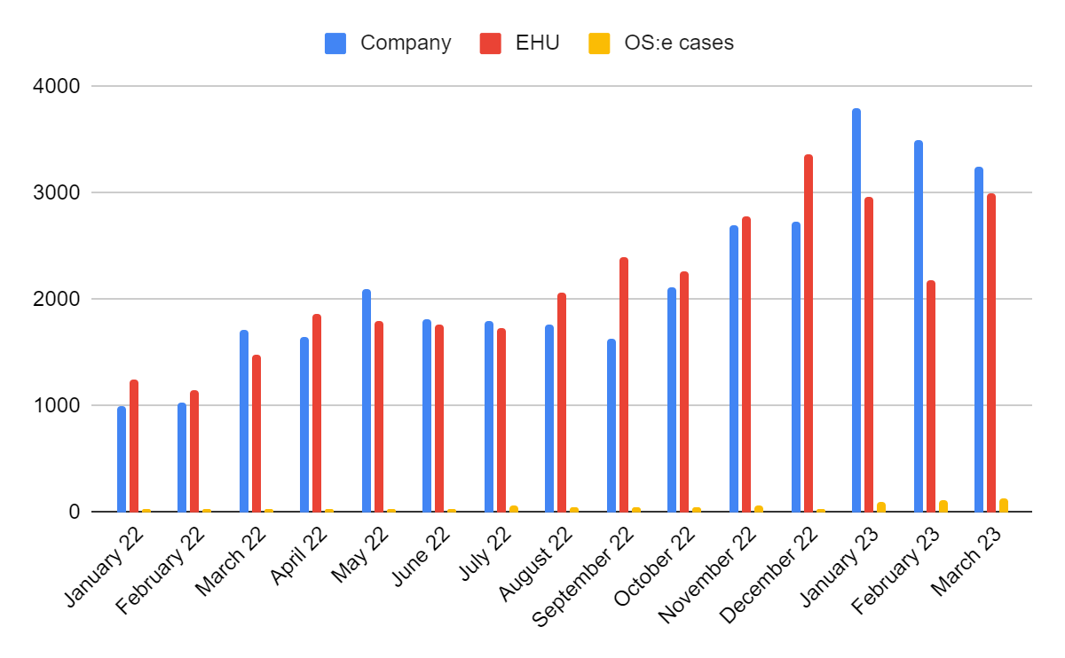
Referral proportions January 22 - March 23

Slide 24

Presented by: Leanne Dullard
Date: 24 May 2023

Slide 25
Advice Direct Scotland update

Slide 27

Volume by month

Slide 28
Enquiries By Contact Type

Slide 29
Referrals

Slide 30
Top 5 codes used

Slide 31
Repeat Contacts

Slide 32
Live Supplier Referrals

Slide 33
Top 5 Affordability Codes

Slide 34



Holistic Support
Internal Referral System
Money/Debt Advice
Consumer Advice
General Advice
Home Heating Support Fund

Slide 35

Contacted energyadvice.scot with an EBSS issue
Was referred to moneyadvice.scot for income maximisation advice
Helped to make an application for energy funding
Case Study

Slide 36
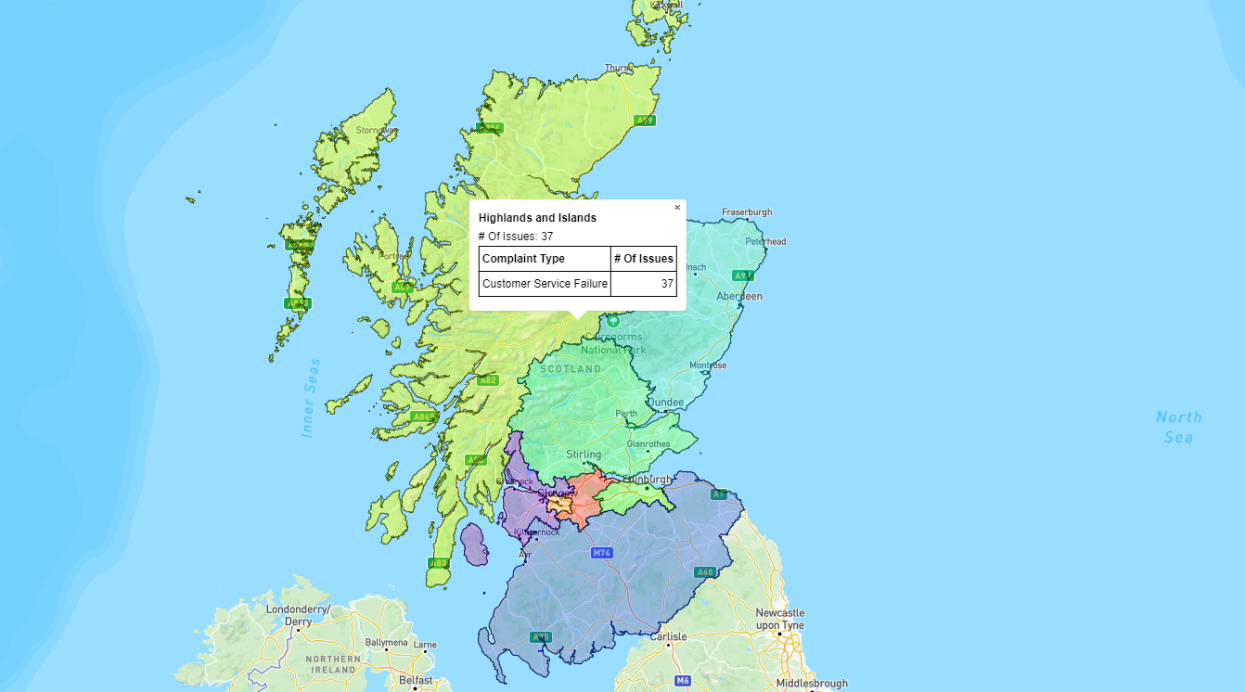
Energy Advice Heat Map
https://yourconstituency.advicedirect.scot/

Slide 38



Supplier Liaison Update
24th May 2023
Natasha Gilmour, George Holmes & Angus McMillan

Slide 39

Business Case 23/24
  Investigating complaints and negotiating with suppliers to achieve the best possible outcome, in line with KPIs. (this includes understanding and articulating concerns where consumers struggle to do this)
  Advocating strongly on behalf of consumers, seeking a resolution that takes account of any personal circumstances and detriment caused. This also includes validating correct actions have been taken by supplier.
  Ensuring appropriate payment methods and sustainable payment plans are agreed.
  Delivering a case ownership approach so the client deals with the same caseworker from start to finish.
  Highlighting support available such as Warm Home Discount, Priority Services Register, trust funds and signposting.
  Delivering continual improvement on case handling, processes and policies. Ensuring ongoing support and training is provided to staff to ensure they are able to deal sensitively with highly emotional and distressing situations.
  Delivering ‘Ask the Adviser’ Service to support advice agencies and referral partners with more complex queries.
  Maintaining close working relationships with key referral partners to ensure vulnerable consumers reach the EHU in an effective and timely manner.
  Working collaboratively with suppliers, policy colleagues across Citizens Advice Scotland and Citizens Advice England and Wales, Ofgem and key stakeholders to provide insights into trends, highlighting compliance and supplier performance concerns using a strong evidence base.
  Co-chairing and Co-ordinating the Citizens Advice Scotland and Citizens Advice quarterly domestic supplier liaison meetings and 6 monthly micro-business meetings to update industry on performance, operational issues and trends.

Slide 40

The KPIs for 23/24 are designed to prioritise and deliver:
A person centered and high quality service to consumers in vulnerable situations
Positive outcomes for vulnerable consumers
Improved work flow and workload management
Increased protections to health and well-being of staff

Slide 41
KPIs 23/24
Area | KPI 23/24
Responding to Complaints | 95% of priority complaints are raised with supplier within 48 hours of case being received
 | 90% of complex complaints raised with supplier within 20 days of case being received (from Q2)
Case Resolution Timescales | 75% of domestic priority complaints resolved within 28 days 75% of micro-business priority complaints resolved within 40 days
 | 70% of domestic complaints resolved within 85 days 70% of micro-business complaints resolved within 85 days
Positive Outcomes | 95% of domestic complaints resolved with a positive outcome/change 85% of microbusiness complaints resolved with a positive outcome/change
Quality Assurance | 90% of cases checked meet the required quality standards
Customer Satisfaction | 85% of Domestic consumers surveyed satisfied or very satisfied with overall quality of service 75% of Micro business consumers surveyed satisfied or very satisfied with overall quality of service 80% of domestic consumers surveyed satisfied with outcome achieved 55% of micro-business consumers surveyed satisfied with outcome achieved
Staff Morale | 75% of staff describing their current mental health and wellbeing as satisfactory 75% of staff reporting they have a good sense of achievement from the work they do

Slide 42
Resource Requests 23/24
4 Caseworkers
Quality Assurance Manager
Quality Assurance Officer
Service Delivery Manager
1 Lead Caseworker

Slide 43
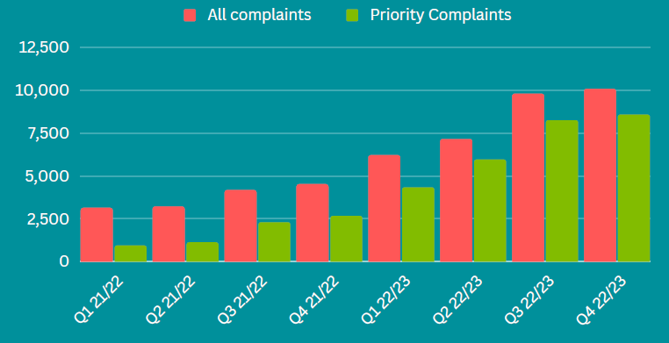
Casework Volumes Q4 2022/23
Total complaints = 10,043
↑3% from Q3
Priority Complaints = 8,551
↑4% from Q3
Self Disconnection = 6,688
↑10% from Q3
Self Disconnection cases 273% higher in Q4 2022/23 compared to Q4 2021/22
86% of complaints were priorities
March highest month ever for self-disconnection complaints (2607)
97% of EHU work was domestic related

Slide 44
KPI Domestic performance 22/23
 | 60% of complaints closed within 35WD | 75% of complaints closed within 66wd | 70% of Priority complaints closed within 20WD | 70% of cases categorized as green, 90% categorized as green or amber | 80% of complaints closed with a positive outcome | 85% of consumers satisfied with service
Q4 22/23 | 77% | 89% | 76% | 75% & 92% | 86% | 93%
Q1-Q3 22/23 | 77% | 89% | 82% | 73% & 92% | 84% | 92%

Slide 45
Accent Customer Research
cases closed in December 2022 to February 2022
Outcomes and measures
93% satisfied or very satisfied with overall quality of service
92% happy with length of time to deal with problem
89% satisfied with outcome
79% felt EHU helped them find a way forward
51% felt their mental health and well being improved after support
Financial redress
£1,209,635
Answered 87% of calls (19,680)
Fuel Bank Foundation Partnership
297 Fuel Bank Vouchers
Supporting 717 people in households
totalling over £14,553k
They were genuine, very polite and very understanding. It's what people need at the moment. It's very stressful. They were amazing.
There was a level of empathy and compassionate. They were supportive, clear and helpful.”
Accent Report March 2023

Slide 46
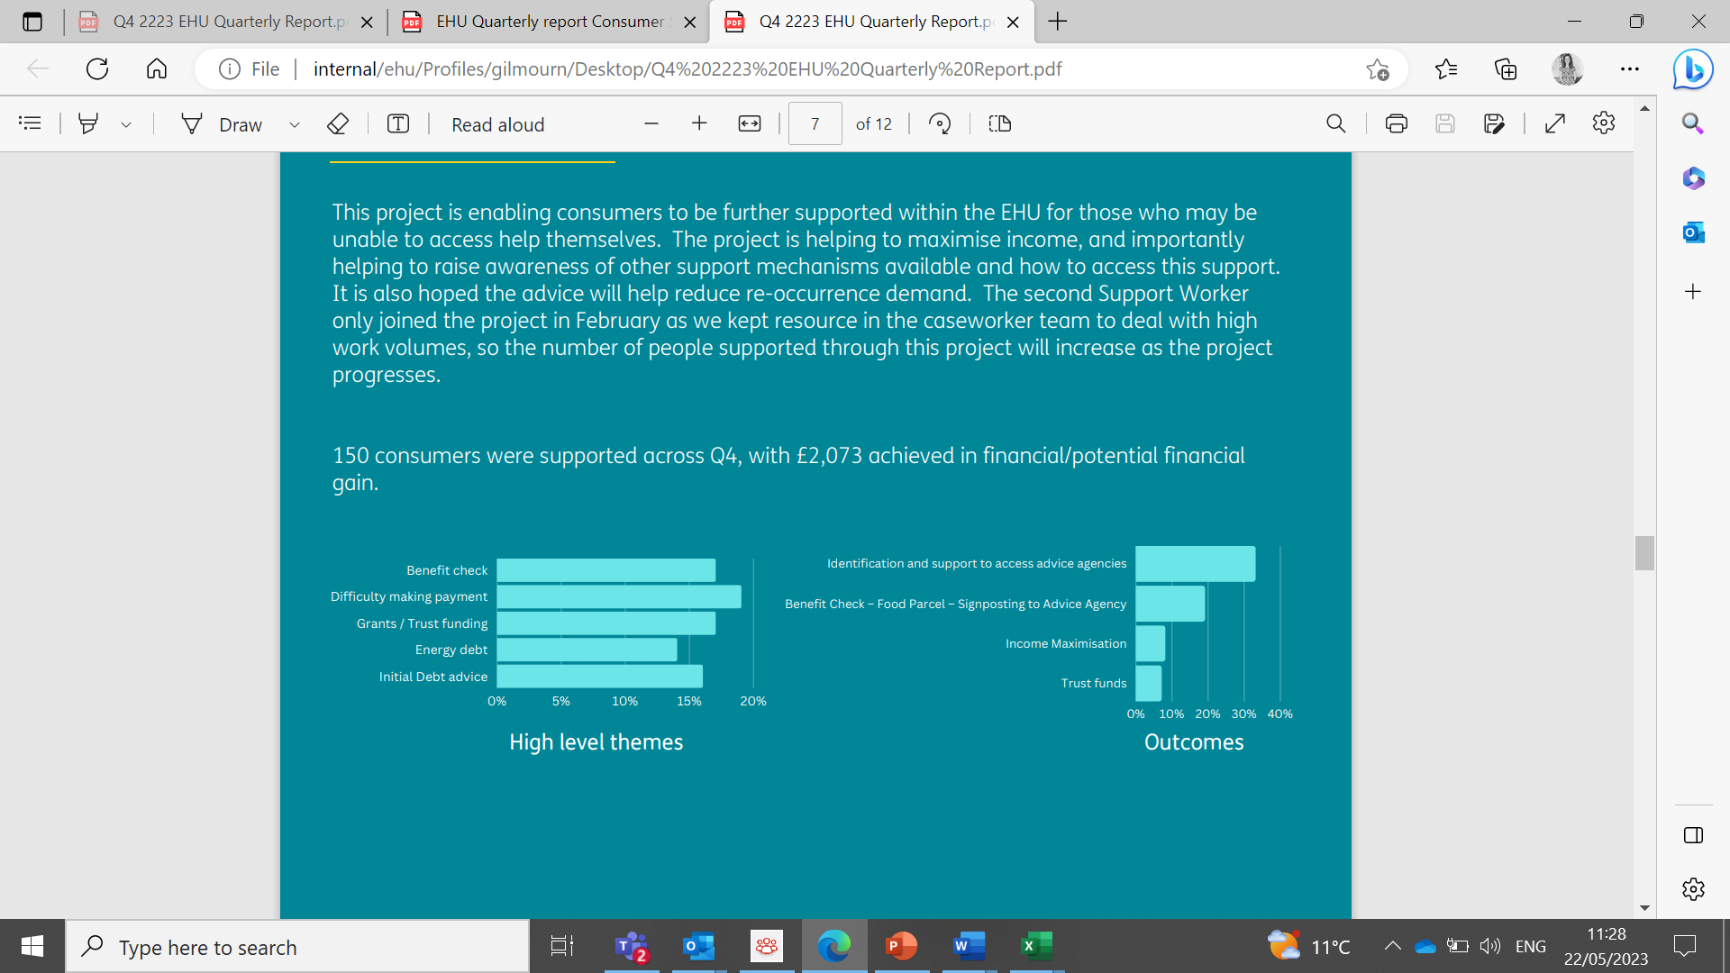
Additional Support Project – Quarter 4 2023 Update
Developments
Home Heat Fund
Home Energy Scotland
Clarifying potential financial gain and increased number of outcomes log
Trussell Trust partnership – food vouchers
Supplier Support packages

Slide 47
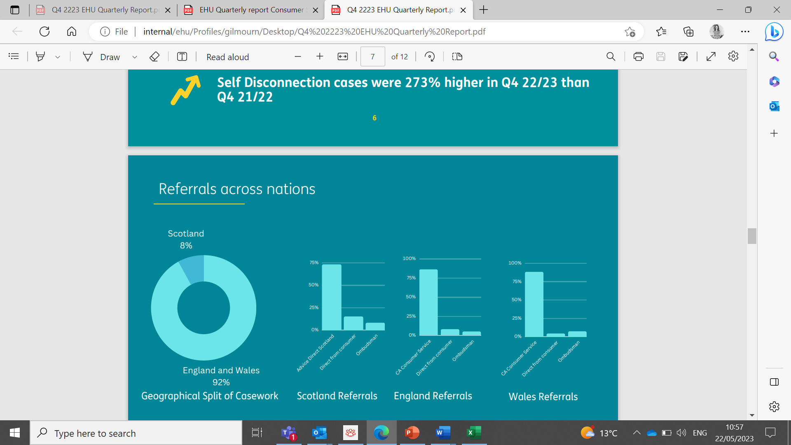


Referral Partners and dealing with demand
Cases to be assigned:
Volume: 172 - 54% reduction since last meeting
Age Profile: 13 days – reduction of 30%
Plan in progress
7 Caseworkers recruited, including 2 additional authorised in January

Slide 48

Operational Development
Civ Tech Challenge 8
We are in the accelerator phase of the CivTech Challenge, having selected a company following an intense exploration phase.
Tool to help us prioritize our most vulnerable clients, minimising risk and maximizing efficiency. SIDE have written a blog on the challenge.
Building HelpFirst — March. SIDE recently won a Scottish Government… | by Andy Bell | SIDE Labs | Apr, 2023 | Medium

Slide 49

EHU Supplier Portal Update
The Extra Help Unit implemented a Microsoft Dynamics (D365) in May 2022 and the new CRM system.
We spent around 6 months getting used the system internally and have been working on where we could use this technology to connect better with our key stakeholders.
The EHU Supplier Portal is the second phase of our journey on the new system which will allow all suppliers access to our system via a portal. This will transform Casework as we know it, improve communication with Energy Suppliers and improve access to data/information.
The portal will allow suppliers to see live what active/ resolved cases they have, the status reason of cases, when the next action is due, the Caseworker dealing with the case, the consumer details and much more.

Slide 50

EHU Supplier Portal progress:
In March we held sessions with a group of suppliers and the EHU team to get feedback on the scope of the project
In April we had a design phase and locked in the scope via user stories with our third party developer
Development work started on the 9th May which will take 4 weeks with two sprints of two weeks
We will be testing the solution in early June and hoping roll out to small group of suppliers by the end of the month
All other suppliers will follow very quickly after this with
the goal of having all suppliers using the portal in by end
of Q2 – please let Angus know if you are interested in being
an early adopter of the EHU Supplier Portal

Slide 51
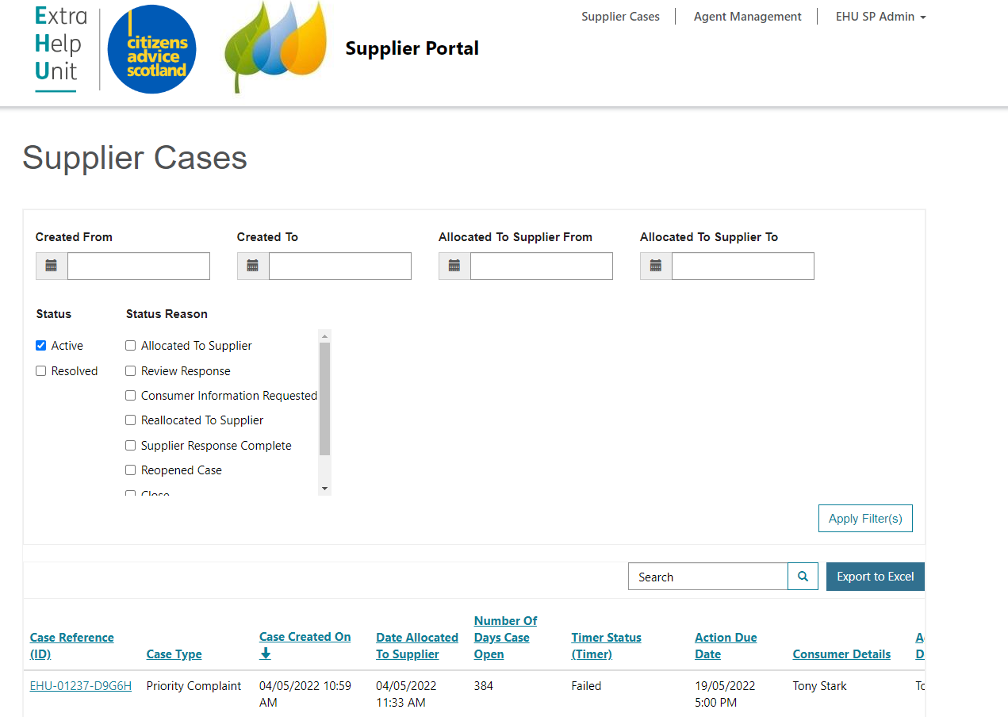
EHU Supplier Portal – Supplier Admin home page

Slide 52
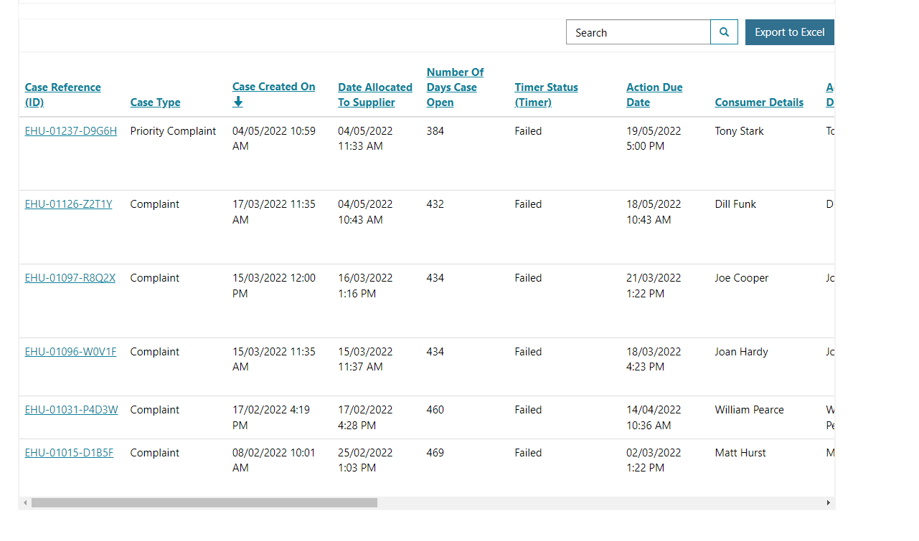
Supplier Agent/Admin - case table view

Slide 53
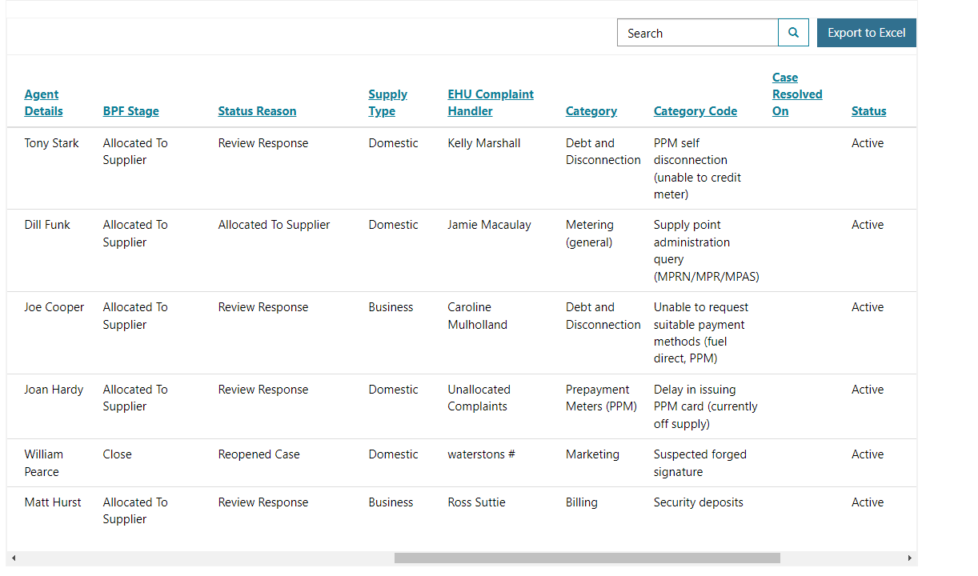
Supplier Agent/Admin - case table view continued

Slide 54
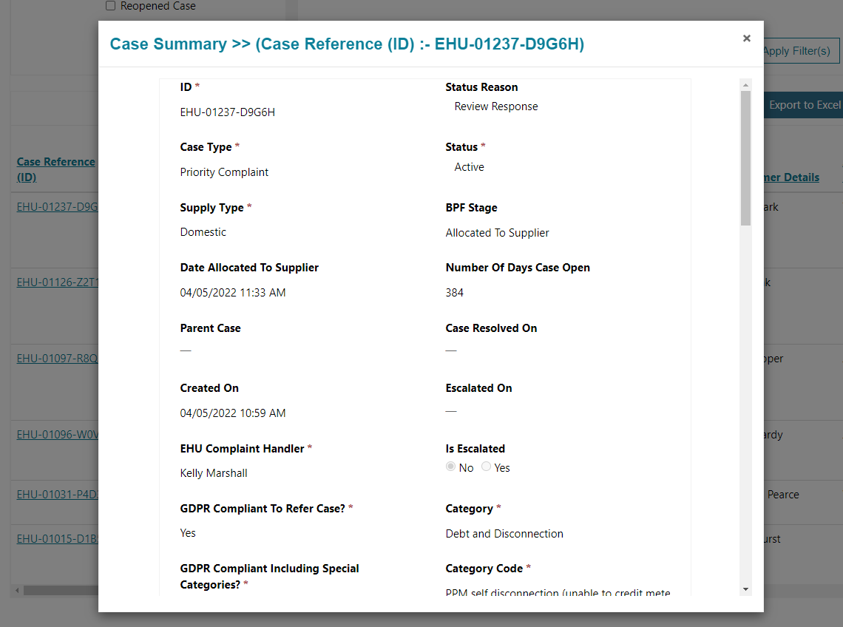
Supplier Agent/Admin - case drill down

Slide 55
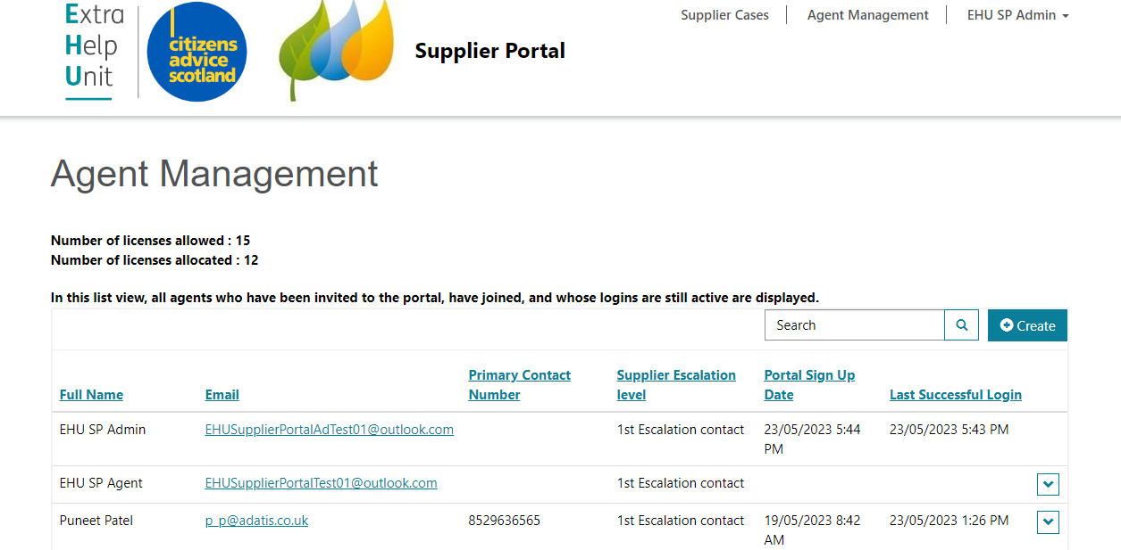
Supplier Admin – Agent Management page

Slide 56


Slide 57

Working Together
Aged cases, Timeliness of responses & Escalations
Open case numbers reduced from 4,725 open cases on 10th January to consistently under 3,000 cases during May 23
Still work to be done on responses and updates being provided on complaints within every 14 calendar days (unless delay explained)
New reporting on case failure time to identify cases when the SLA failure has been significant.
Escalations to highlight problems with outcomes offered or lack of responses, are vital to address issues with a case not progressing. Essential these are responded to quickly.

Slide 58

Quality of responses
Background to complaints often not explained
Short and direct answers to questions, leads to more questions
Obligations missed e.g. GS payments
Suggestion of licence condition breaches
Too many requests needed across cases for additional information/explanation
Unnecessary 3 way conversations
Extra training planned with Caseworkers to improve questioning and knowledge.

Slide 59
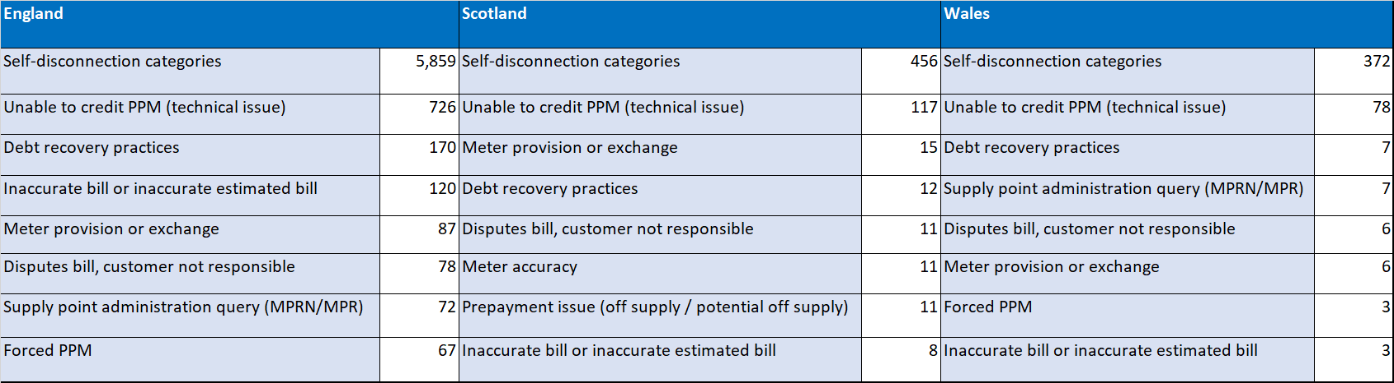
Top 8 trends by region
Prepayment priority cases still dominant
Unable to credit PPM (technical issue) down 50% on Q3
Metering and billing cases codes similar across all regions
Forced PPM cases reduced significantly in March
Debt Recovery Practice cases being given more scrutiny

Slide 60
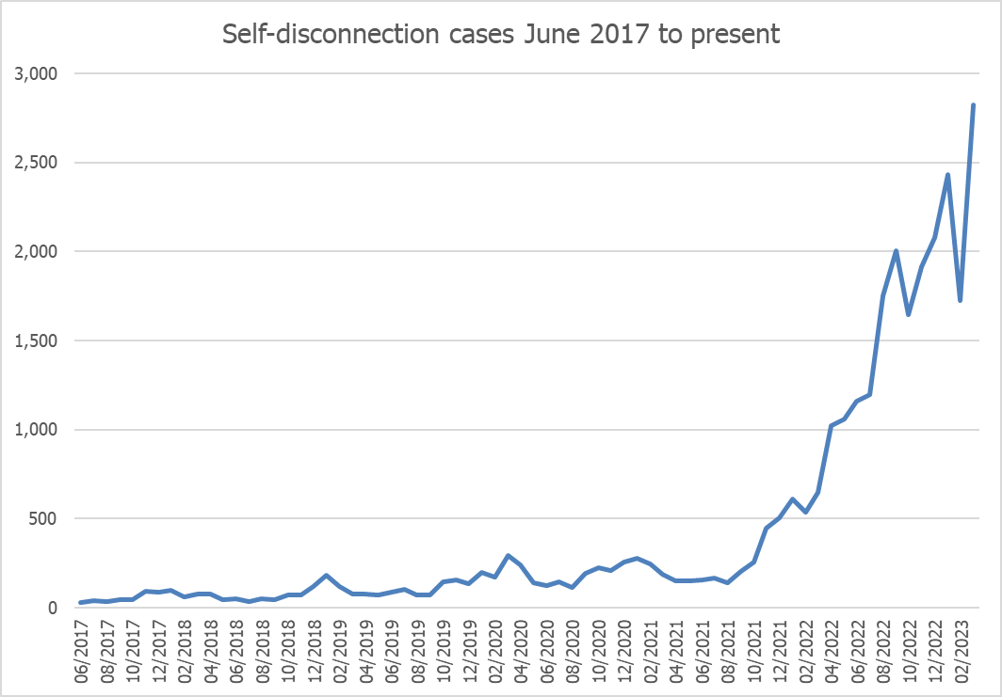
Self-disconnection
June 2017:
26 self-disconnection cases
March 2023:
2,824 self-disconnection cases

Slide 61
4 Suppliers live
2 Suppliers moving to process
Reduced time in call queues
Alterative self-disconnection process
Participating suppliers have stated improvements in managing resources – allocation not tied to call distribution
Quicker responses, of better quality, allowing EHU Caseworkers to resolve cases more quickly
Notably less escalation activity for participating suppliers, and better tracking of ongoing cases

Slide 62

Repeat self-disconnection cases
When prepayment market share is taken into account, there are big differences across the industry regarding:
Volume of self-disconnection cases being logged by the Extra Help Unit per supplier (in March the variation was between 1.47 cases and 11.60 cases per 10,000 prepayment customers)
Number of repeat self-disconnection cases being logged across suppliers
With new COP and the ongoing cost of living crisis, we are carrying out additional analysis focussed on cases where one consumer has returned frequently seeking more help.

Slide 63

Initial findings
Most of the consumers sampled to date do not clearly meet the medium risk criteria for prepayment meters being unsuitable
Many of the consumers have taken part in our Additional Support Project but aren't entitled to additional income
Often inconsistency within suppliers in how the same consumer is dealt with by several people
Clear issue is that consumers genuinely cannot afford ongoing consumption
Some suppliers appear to have more integrated solutions with third parties offering financial advice and assessments
Where consumer are gaining repeated ASC they are staying on supply, but debt balance is continuing to build

Slide 64

Next steps
Complete the analysis so we have a representative sample
Create generic scenarios for discussion with the regulator, stakeholders and industry
Aim to understand why some suppliers generating significantly fewer cases and repeat cases
Share best practice
Provide analysis to Ofgem for their consideration
As it stands our position is always to ask for assistance if a consumer has self-disconnected or is at risk of self-disconnection

Slide 65
Questions?

Slide 66
Break 10.55am – 11.05am

Slide 67
Supplier spotlight discussion

Slide 68

Supplier spotlight
Discussion on the impact of the introduction of the Involuntary PPM - Supplier Code of Practice
What are the main challenges for industry?
What are the potential solutions to ongoing energy costs and debt when a consumer can't have a prepayment meter under the COP?
What is considered good practice for supporting consumers with obtaining financial advice?
How do you think the industry should define when a consumer is "frequently" self-disconnecting (in relation to section 2.16 of the code)?

Slide 69

Supplier Liaison Meeting
24 May 2023
David Hilferty
Strategic Lead (Social Justice)

Slide 70
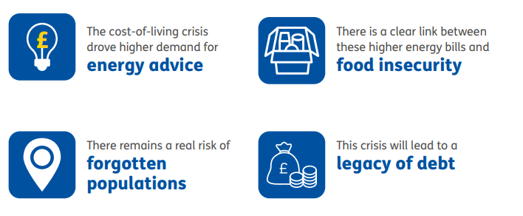
What we are seeing

Slide 71
Debt legacy

Slide 72
Thank you
Contact: david.hilferty@cas.org.uk

Slide 73

Energy Team Update
Supplier Liaison Meeting
24th May 2023

Slide 74
Contents
Publications, blogs and consultation responses
Team updates
Energy Retail Markets
Net Zero Homes
Energy Network and Systems
Notes:
74

Slide 75

Recent publications
Demand: Net Zero
Domestic energy supplier performance data
Fairer, warmer, cheaper: new energy bill support policies to support British households in an age of high prices
Damp, cold and full of mould
Tackling energy debt - Assessing options to address the growing energy debt crisis
Splitting opinion - is splitting the wholesale market the best way to deliver an affordable energy system?
Notes:
75

Slide 76
Recent Blogs
Our views on Ofgem’s RIIO-ED2 Final Determinations (decisions) for the electricity distribution sector
Energy bills could stay high for a long time — people will need help
Thousands of small businesses have been left behind by energy suppliers’ failures to administer support
Why the Energy Price Guarantee should not increase from April
A public charging penalty is emerging for electric drivers

Slide 77
Consultation Responses
We have responded to Ofgem’s consultation on the Future of local energy institutions and governance consultation, to the Ofgem Call for Input: Future of Distributed Flexibility 2023, and to Ofgem’s proposed amendments to the Electricity (Connection Guaranteed Standards of Performance) Regulations 2015.
We responded to Ofgem’s Statutory consultation on amendments to the Electricity (Standards of performance) Regulations 2015 for Severe Weather Compensation, to the Ofgem Informal consultation on the removal of EV POLR provision from SLC 31F, and to Ofgem’s Consultation on Guidance for Third Party Intermediary Alternative Dispute Resolution Scheme Criteria.
We also applied to intervene in the CMA Energy Licence Modification Appeal 2023 (ED2), responded to the to the DESNZ consultation on Improving Boiler Standards and Efficiency, and shared our views on the Ofgem RIIO-ED2 Final Determinations for the electricity distribution sector.

Slide 78
Consultation Responses
We have responded to the Ofgem call for evidence on prepayment rules and protections, to the Department for Energy Security and Net Zero’s Capacity Market 2023 consultation, and to the Ofgem Forward Work Programme 2023-2024.
We have also responded to Ofgem’s Energy Code Governance Reform Call for input, to the Consumer Scotland Draft Work Programme 2023-2024 and to the Ofgem further consultation on amending the methodology for setting the Earnings Before Interest and Tax (EBIT) allowance.
See all our consultation responses here.

Slide 79

Energy Retail Markets Team: updates
Current policy/advocacy work
Recently published Fairer, warmer, cheaper report covering support for households navigating higher energy prices.
Published Living with a disability: the continuing crisis blogpost highlighting vulnerability of disabled people to cost of living price increases, including on energy
Recently published our latest domestic energy supplier performance data
Our Unequal Crisis and Numbers behind the stories blog series continue, with domestic energy featuring heavily in the cost of living crisis

Slide 80

Net Zero Homes: updates
Current policy/advocacy work
Publication of Demand Net zero looking at barriers of energy efficiency and low carbon household measures
Workshop on intersectionality in policy development driven by our work on smart technology in this area
Coming soon
Report on the wider benefits of energy efficiency (w/c 5th June)
Data deck on costs of net zero to homes by constituency (w/c 12th June)
Roundtables based on the Demand net zero work (June/July)
Research on smart technologies and vulnerable consumers (19th June)
Research and webinar on Local Area Energy Planning (15th June)
Research on flexibility capital

Slide 81

Energy Networks & Systems Team: updates
Current policy/advocacy work
We are intervening on behalf of Ofgem in Northern Powergrid’s (NPg) appeal to the Competition and Markets Authority. NPg are looking for £171m extra revenue, for no additional output for consumers.
Responded to Ofgem consultations regarding how the energy system needs to develop: future energy institutions; distributed flexibility; future systems and network regulation.
Coming soon
Publishing research into the wider system benefits of Energy Efficiency
The second in a series of discussion papers on the potential consumer impact of the government’s Review of Electricity Market Arrangements (REMA) - focussing on Locational Pricing.

Slide 82
AOB

Slide 83
Thank you

