Slide 1
Employment and Support Allowance and Reasonable Adjustments
A short presentation with pictures

Slide 2
Introduction
When we challenge discrimination through advice, we can:
Help more clients
Solve more problems
Make a wider impact
Get better outcomes
Lets get started!

Slide 4
Solving the 4D puzzle
disabled
+
disadvantage
=
a duty to make a change
or
it could be unlawful discrimination
Notes:
If your client, who is disabled, is applying for ESA, and
they are substantially disadvantaged by something about the application process because of their health condition, then
the DWP has a duty to make reasonable adjustments to the process that will remove that disadvantage
if they don’t that is unlawful discrimination

Slide 5
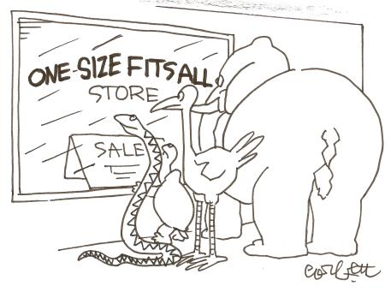
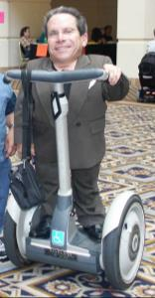
The duty to make reasonable adjustments
A blanket policy?
Notes:
Public authorities and service providers have a duty to disabled people to make reasonable adjustments to the way they do things, if that puts disabled people at a disadvantage. This duty is in the Equality Act 2010. The duty to make reasonable adjustments only applies if the person who is disadvantaged and asking for a change, meets the Equality Act definition of disability.
The pictures:
We often see disadvantage for disabled people when a public authority or service provider adopt a blanket policy or a one size fits all attitude.
Some forms of reasonable adjustment…
(its just a very cute assistance puppy!)

Slide 6
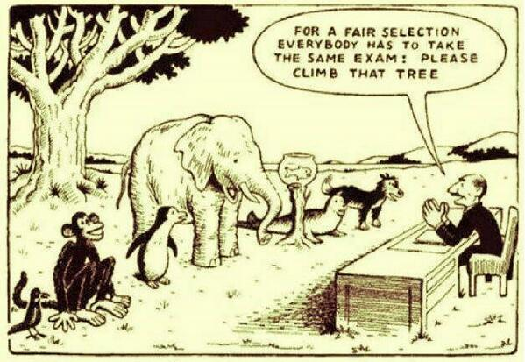
The social model of disability
Notes:
The ‘social model of disability’ was developed by disabled people and suggests that our health limitations or impairments (physical, sensory, intellectual, or psychological) are not always disabilities in themselves.
The practical barriers, negative attitudes and social exclusion that individuals experience as a result of their individual differences can and do play a significant part in disabling people. To put it simply, it’s not people who are themselves ‘disabled’, but they are disadvantaged or disabled by the ways we expect people to participate in society.
The ‘problem’ of disability is that society is set up to meet the needs of non-disabled people. It’s not designed to suit people who have impairments.
It can help us to understand how disabled people are disadvantaged.

Slide 7
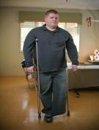
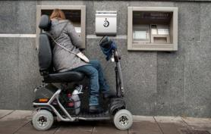
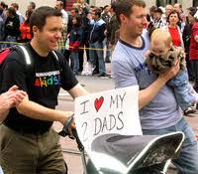
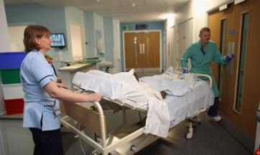
Our clients
Notes:
How many of your clients have a long term health issue or describe themselves as disabled?
How many queries do your receive about public authorities and/or discrimination?

Slide 8
Helping Tina
Tina, who is Deaf, needs to attend a Work Capability Assessment
What reasonable adjustments might Tina need?
How would you
help her?

Slide 9
A better outcome for Tina
Tina has an Equality Act disability
She is disadvantaged by the way DWP are doing things
DWP have a duty to make a Reasonable
Adjustment. If they don’t it could be unlawful discrimination
You can help Tina ask for a change that will mean she is no longer disadvantaged and explain the DWP has a duty to do that.
Notes:
Bonus points on offer!
You might also think about raising a Public Sector Equality Duty issue.

Slide 10
Helping Tina
Tina tells you the DWP won’t provide a BSL signer for her, at her next Job Centre interview.
What discrimination issues would you identify for Tina?
How would you
help her?

Slide 11
When could you use this?
Do you help clients with ESA applications and processes?
Do some of them have problems with it?
Do some of them have long term health conditions or describe themselves as disabled?

Slide 12
Our new pack will help you to
help clients with ESA applications
become more confident about disability
create your own plan of action
talk to clients about reasonable adjustments
find out what kinds of adjustments can help your clients
ask for changes to be made and follow that up
use campaigning actions to make a bigger change
engage with disabled people’s organisations

Slide 14
Find out more about our campaign to make ESA Fit for Work at www.citizensadvice.org.uk/fitforwork

