Slide 2
National Consumer Week 2015
National Consumer Week 2015 seeks to raise awareness and promote the use of new consumer rights that were brought into force through Consumer Rights Act legislation on 1 October 2015.
This year’s campaign Know your New Rights will launch in England and Wales on 2 November 2015.

Slide 3
National Consumer Week Partners
For the Know your New Rights campaign Citizens Advice is working with
National Trading Standards (NTS)
Chartered Trading Standards Institute (CTSI)
Department for Business Innovation and Skills
(BIS)
The following infographics have been provided by BIS.

Slide 5
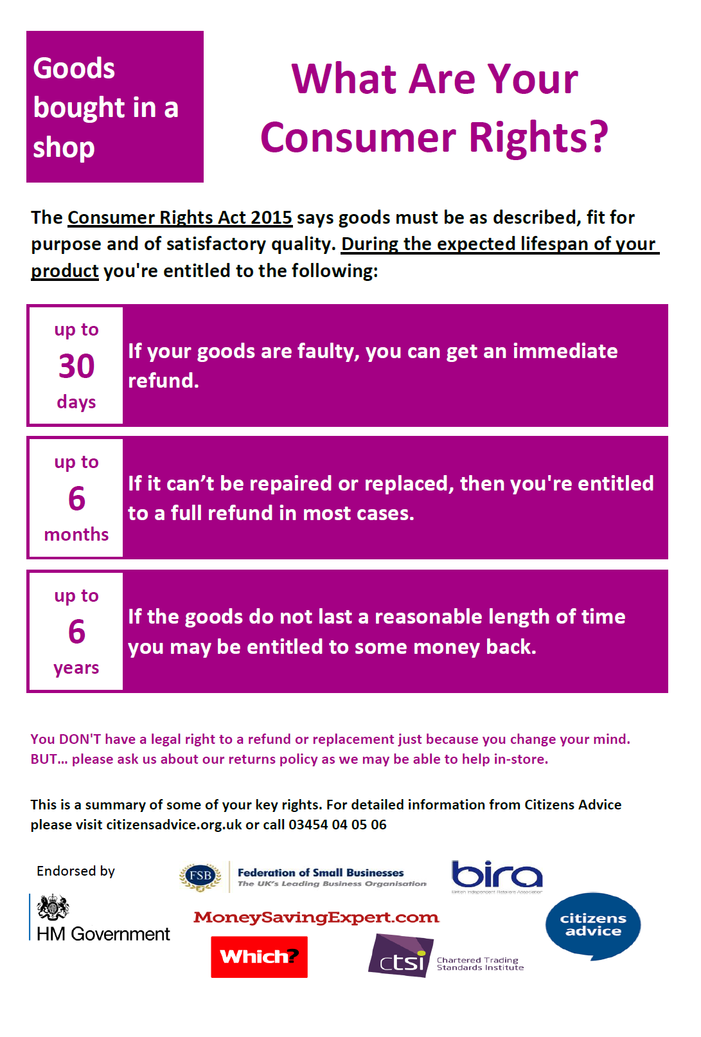

Slide 10
Further information
Find out more about the National Consumer Week campaign and free resources via webpage
www.citizensadvice.org.uk/the-consumer-rights-act-2015
Twitter: @citizensadvice
Facebook: facebook.com/citizensadvice
#consumerrights
National Consumer Week education resources
www.citizensadvice.org.uk/about-us/how-we-provide-advice/our-prevention-work/education/education-resources/

